Slide 1

Sunday, 25th January
RIVER ROOTS
Theology Proper
The Existence of God

Slide 2


The Bible & God’s Existence

Slide 3
The Bible & God’s Existence
The Bible simply proclaims God’s existence.

Slide 4
The Bible & God’s Existence
The Bible simply proclaims God’s existence.
- Monotheism

Slide 5
The Bible & God’s Existence
The Bible simply proclaims God’s existence.
- Monotheism
- God v gods

Slide 6
The Bible & God’s Existence
The Bible simply proclaims God’s existence.
- Monotheism
- God v gods
Creator — Saviour — Ruler
(Deut 4:34–35; Ps 95:3; 96:4–5; 97:7–9)

Slide 7
The Bible & God’s Existence
The Bible simply proclaims God’s existence.
- Monotheism
- God v gods
Creator — Saviour — Ruler
(Deut 4:34–35; Ps 95:3; 96:4–5; 97:7–9)
The Bible states it is foolish to deny God.

Slide 8
Arguments for God’s Existence
1. Ethnological (History)

Slide 9

“If you go through the earth,
you will perhaps observe cities without walls, without letters, sunk in the greatest ignorance; but we shall see not one which does not worship the Deity”
— Plutarch

Slide 10
Arguments for God’s Existence
1. Ethnological (History)
2. Cosmological (Beginnings)

Slide 11


Slide 12

Cosmological
Kalam
Thomist
Leibnizian
First Cause
First Mover
First Existence

Slide 13
Kalam
1. If the universe began to exist, then the universe has a cause.
Moreland & Craig
(2017, p. 480)
2. The universe began to exist.
3. Therefore, the universe has a cause.

Slide 14
Arguments for God’s Existence
1. Ethnological (History)
2. Cosmological (Beginnings)
3. Teleological (Design)

Slide 15


Slide 16
Teleological
The fine-tuning of the universe is due to either physical necessity, chance, or design.
Moreland & Craig
(2017, p. 495)
2. It is not due to physical necessity or chance.
3. Therefore, it is due to design.

Slide 17
Arguments for God’s Existence
1. Ethnological (History)
2. Cosmological (Beginnings)
3. Teleological (Design)
4. Ontological (Being)

Slide 18
Ontological Argument
It is possible that a maximally great being exists.
If it is possible that a maximally great being exists, then a maximally great being exists in at least one ‘possible world’.
If a maximally great being exists in one ‘possible’ world, then it exists in every ‘possible world’.
If a maximally great being exists in every ‘possible world’, then it exists in the actual world (since the actual world is by definition a ‘possible world’).
Therefore, a maximally great being exists.
Peter Williams

Slide 19
Arguments for God’s Existence
1. Ethnological (History)
2. Cosmological (Beginnings)
3. Teleological (Design)
4. Ontological (Being)
5. Axiological (Morals)

Slide 20
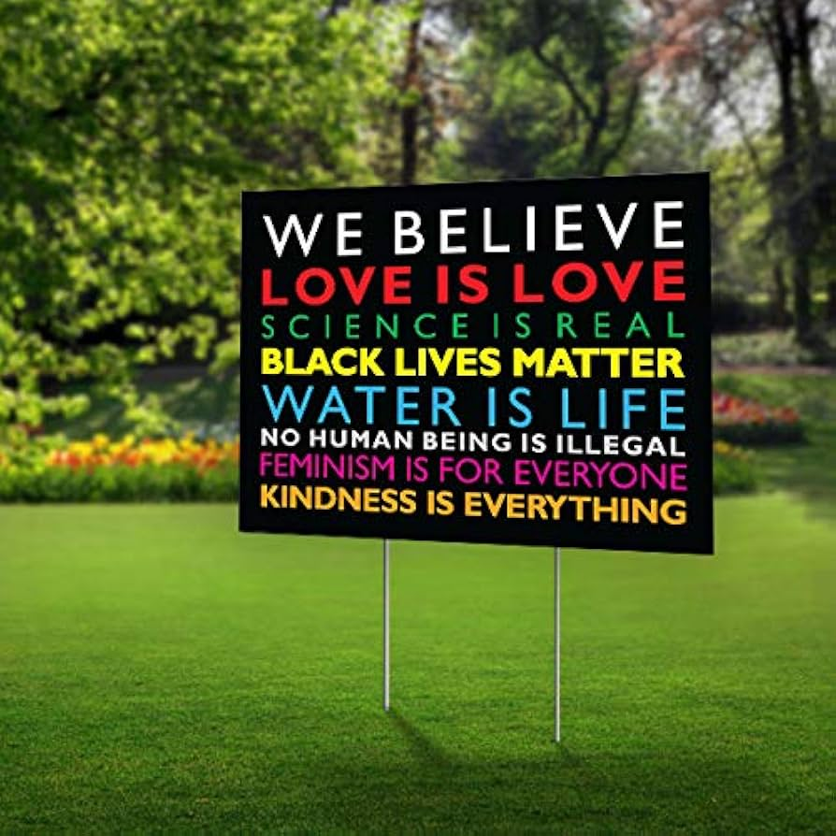

Slide 21
Axiological
1. If God did not exist, objective moral values and duties would not exist.
Moreland & Craig
(2017, p. 505)
2. Objective moral values and duties do exist.
3. Therefore, God exists.

Slide 22
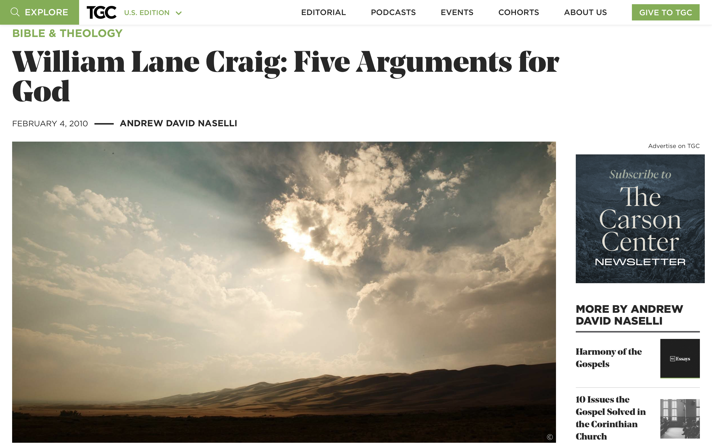

Slide 23
The Need for Divine Revelation
Hebrews 11:6
‘And without faith it is impossible to please him, for whoever would draw near to God must believe that he exists and that he rewards those who seek him’.

Slide 24
