Slide 1

Sunday, 8th February
RIVER ROOTS
Theology Proper
The Revelation of God: Special

Slide 2


Three Types of Revelation
1. General Revelation
2. Special Revelation
3. Holy Spirit Applied Revelation

Slide 3
Discussion Question
From your knowledge of the Bible, what do you think falls under this type of revelation?

Slide 4

Long ago, at many times and in many ways, God spoke to our fathers by the prophets,
but in these last days he has spoken to us by his Son, whom he appointed the heir of all things, through whom also he created the world.
— Hebrews 1:1–2

Slide 5
In History
Verbal Revelation
Providential Revelation
Visual Revelation

Slide 6
In History
Verbal Revelation
Prophets (2 Kgs 24:2; Lk 1:70).
‘Thus says the Lord…’

Slide 7
In History
Verbal Revelation
Prophets (2 Kgs 24:2; Lk 1:70).
‘Thus says the Lord…’
Apostles (2 Pet 1:16–21)

Slide 8
In History
2. Providential Revelation
Lots / Urim & Thummim

Slide 9
In History
2. Providential Revelation
Lots / Urim & Thummim
Miracles (Deut 4:32–35; Jn 2:11)

Slide 10
In History
3. Visual Revelation
Dreams & Visions — Daniel 1–6 & 7–12

Slide 11
In History
3. Visual Revelation
Dreams & Visions — Daniel 1–6 & 7–12
Theophany (Ex 3; 19)

Slide 12
In History
3. Visual Revelation
Dreams & Visions — Daniel 1–6 & 7–12
Theophany (Ex 3; 19)
Christophany (Gen 18;Judg 13)

Slide 13
Progressive Revelation
“God has not revealed himself comprehensively at any one stage in history or in any one event. Revelation is a series of divine disclosures, each of which builds upon and unpacks or unfolds that which preceded it… This contrast between the incomplete and complete, between the partial and the full, is not a contrast between false and true, inaccurate and accurate, but a contrast between shadow and substance, between type and antitype, between promise and fulfilment”.
— Sam Storms

Slide 14
In Jesus

Slide 15
Long ago, at many times and in many ways, God spoke to our fathers by the prophets,
but in these last days he has spoken to us by his Son, whom he appointed the heir of all things, through whom also he created the world.
— Hebrews 1:1–2

Slide 16
The incarnation is that event
in history which gathers up
all other revelation into itself.
— Paul Jewett

Slide 17
In Jesus
John 1:14
And the Word became flesh and dwelt among us, and we have seen his glory,
glory as of the only Son from the Father,
full of grace and truth

Slide 18
In Jesus
John 1:18
No one has ever seen God;
God the only Son, who is at the Father's side,
he has made him know

Slide 19
Discussion Question
What does Jesus reveal about God?

Slide 20
In Writing

Slide 21
London Baptist Confession (Para 1)
“Although the light of nature, and the works of creation and providence do so far manifest the goodness, wisdom, and power of God, as to leave men inexcusable; yet they are not sufficient to give that knowledge of God and His will which is necessary unto salvation.
Therefore it pleased the Lord at sundry times and in diversified manners to reveal Himself… and afterward for the better preserving and propagating of the truth… to commit the same wholly unto writing; which makes the Holy Scriptures to be most necessary, those former ways of God's revealing His will unto His people being now completed”.

Slide 22
The special revelation of God was given permanent form in Scripture…
Therefore God provided for its inscripturation, so that His revelation now comes to us,
not in the form of deeds and events,
but as a description of these
— Louis Berkhof

Slide 23
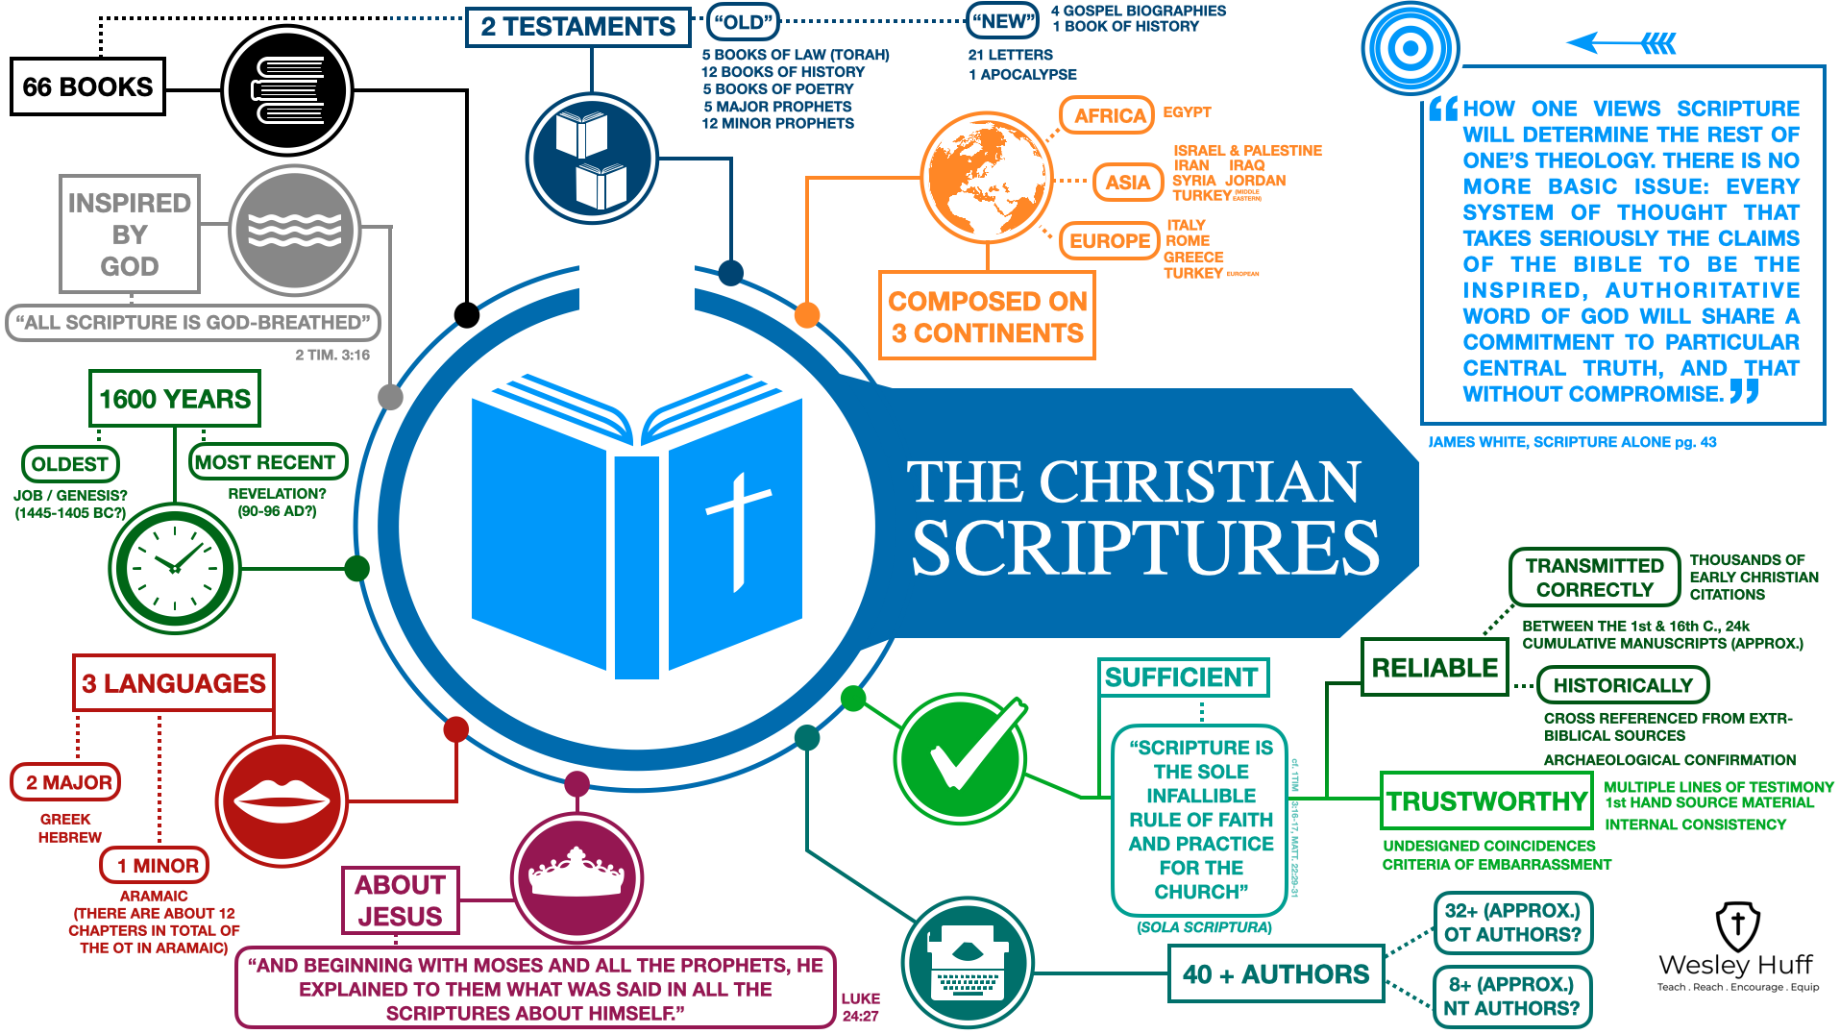

Slide 24
In Writing
Three Important ‘I’s
Inspired — 2 Tim 3:16–17

Slide 25
In Writing
Three Important ‘I’s
Inspired — 2 Tim 3:16–17
Inerrant — Jn 17:17; Prov 30:5

Slide 26
In Writing
Three Important ‘I’s
Inspired — 2 Tim 3:16–17
Inerrant — Jn 17:17; Prov 30:5
Infallible — Psalm 19:7–9

Slide 27
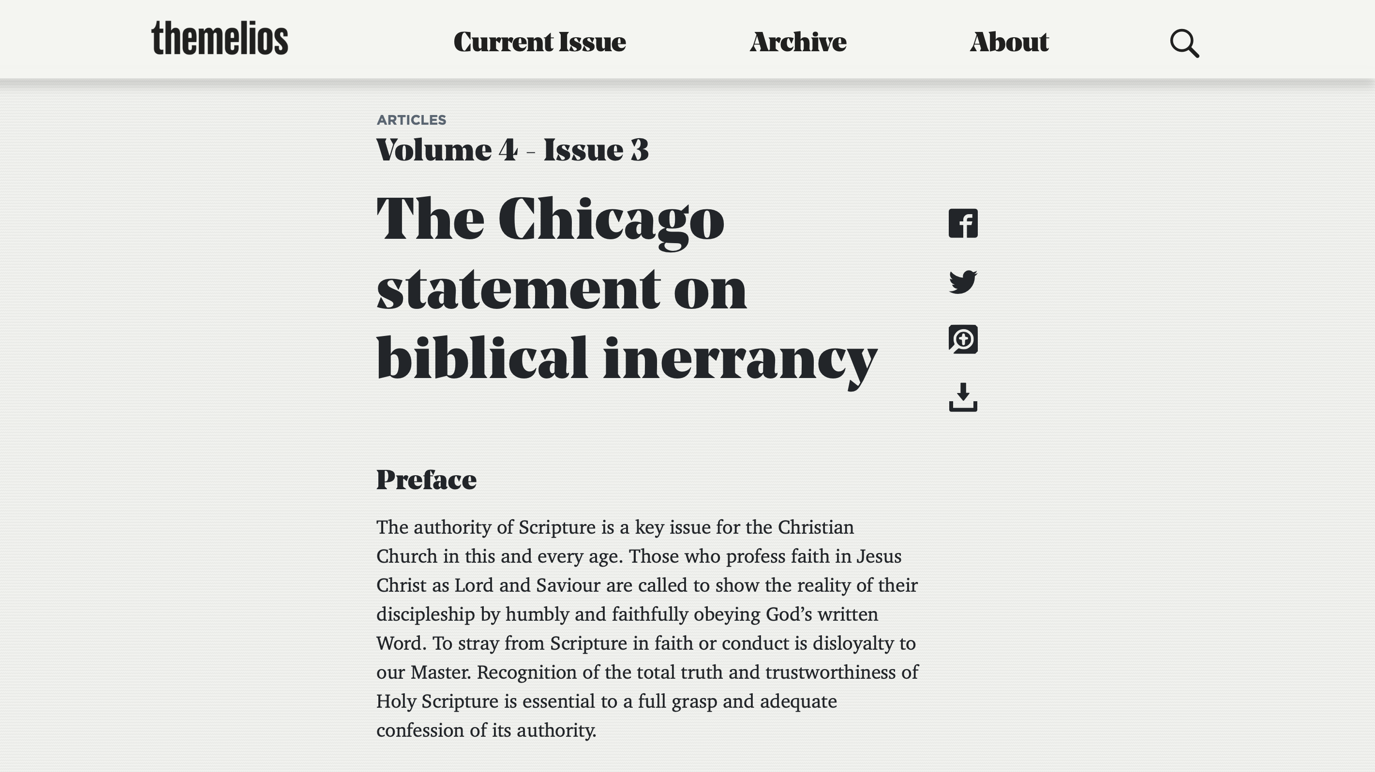

Slide 28
In Writing
The Bible is…
Sufficient for life and godliness.

Slide 29
In Writing
The Bible is…
Sufficient for life and godliness.
Clear in all its big ideas.

Slide 30
In Writing
The Bible is…
Sufficient for life and godliness.
Clear in all its big ideas.
Authoritative in all that it claims.

Slide 31
In Writing
The Bible is…
Sufficient for life and godliness.
Clear in all its big ideas.
Authoritative in all that it claims.
Necessary in order to know
God's will and God's ways.

Slide 32
General & Special Revelation
Complement one another but special revelation is clearer and has more authority.
Kevin DeYoung says, “Jesus can
illustrate with the lilies of the field,
but “it is written” can conquer the devil”

Slide 33
“Scripture and nature are
mutually interpreting for each other:
mutually meaningless without each other
and mutually fruitful with each other”
— Joe Rigney

Slide 34
