Slide 1

Sunday, 15th February
RIVER ROOTS
Theology Proper
The Triunity of God

Slide 2


5 Reasons Clarity is Important
Biblical

Slide 3
5 Reasons Clarity is Important
Biblical
Historical

Slide 4
Nicene Creed (AD325)
I believe in one God, the Father Almighty, Maker of heaven and earth, and of all things visible and invisible. And in one Lord Jesus Christ, the only-begotten Son of God, begotten of the Father before all worlds; God of God, Light of Light, very God of very God; begotten, not made, being of one substance with the Father, by whom all things were made… // And I believe in the Holy Ghost, the Lord and Giver of Life; who proceeds from the Father and the Son; who with the Father and the Son together is worshipped and glorified…”.

Slide 5
5 Reasons Clarity is Important
Biblical
Historical
Missional

Slide 6

Father, I desire that they also, whom you have given me, may be with me where I am,
to see my glory that you have given me because you loved me
before the foundation of the world.
— John 17:24

Slide 7
5 Reasons Clarity is Important
Biblical
Historical
Missional
Gospel

Slide 8
Beeke & Smalley
The gospel is essentially Trinitarian. Every member of the Trinity performs an indispensable function in our salvation. Without God the Father, there would be no one to send the Son and Spirit into the world, to accept the Son’s sacrifice, or to hear the Spirit-wrought prayers of the redeemed. Without the obedience and sufferings of God the Son, no one could escape God’s curse or enjoy God’s blessing in the Spirit.

Slide 9
Beeke & Smalley
Without the renewing work and indwelling presence of God the Spirit, no one would benefit from Christ’s redemptive work or have any assurance of being reconciled to God as his child. Apart from the divine Spirit, God could not dwell within the hearts of the redeemed to relate them to the Father and the Son. Without the Trinity, the gospel disappears

Slide 10
5 Reasons Clarity is Important
Biblical
Historical
Missional
Gospel
Practical

Slide 11
Discussion Question
What illustrations have you heard or have you used to explain the Trinity?...

Slide 12
Revelation Not Reason

Slide 13
The secret things belong to
the Lord our God, but the things
that are revealed belong to us
and to our children forever,
that we may do all
the words of this law.
— Deuteronomy 29:29

Slide 14
Revelation Not Reason
Heidelberg Catechism (Question 25)
Q. Since there is but one only divine essence, why speakest thou of Father, Son, and Holy Ghost?
A. Because God has so revealed himself in his word, that these three distinct persons are the one only true and eternal God.

Slide 15
Revelation Not Reason
Creation
  Father (Gen 1:1)
  Son (Col 1:16)
  Holy Spirit (Ps 104:30)

Slide 16
Revelation Not Reason
Resurrection
  Father (Acts 2:32)
  Son (Jn 10:17–18)
  Holy Spirit (Rom 8:11)

Slide 17
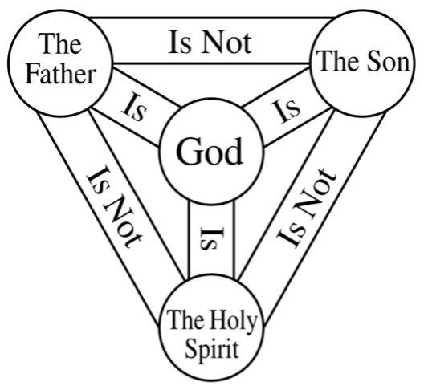
The Trinity
There is only one God
The Father is God
The Son is God
The Holy Spirit is God
The Father is not the Son
The Son is the not the Holy Spirit
The Holy Spirit is not the Father

Slide 18
Language — Person & Being
Athanasian Creed
Three Persons:
‘For the person of the Father is a distinct person, the person of the Son is another, and that of the Holy Spirit still another’.
- One Being:
‘And yet there are not three eternal
beings; there is but one eternal being’.

Slide 19
The Trinity

Slide 20
The Oneness of God
James 2:19
‘You believe that God is one; you do well. Even the demons believe—and shudder!’

Slide 21
Plurality of Persons
OT — Isaiah 61:1

Slide 22
Plurality of Persons
OT — Isaiah 61:1
NT — Mt 28:19; 2 Cor 14:13; Eph 4:4–6

Slide 23
Plurality of Persons
Gen 1:26; 3:22; Ps 110:1 (Mt 22:41-46);
Isa 6:8; 48:16; 63:7–14; Haggai 2:4–5;
Acts 2:33; 10:38; Rom 8:11; 1 Cor 12:4-6;
2 Cor 1:21–22; Gal 3:11–14; 4:4-6;
Titus 3:4–6; 2 Thess 2:13-14; Heb 6:4–6;
1 Pet 1:2; Jude 20-21; Rev 1:4-5.

Slide 24
Each Person = Fully & Wholly God
Group Exercise:
What passages show that each person of the Godhead is fully and wholly divine?

Slide 25
Each Person = Fully & Wholly God
- Father — John 20:17
- Son — John 1:1–18; 8:58; 20:28-30
- Spirit — John 14:26; 15:26; 16:7–11

Slide 26

Modalism

Slide 27
The Trinity
There is only one God
The Father is God
The Son is God
The Holy Spirit is God
The Father is not the Son
The Son is the not the Holy Spirit
The Holy Spirit is not the Father

Slide 28
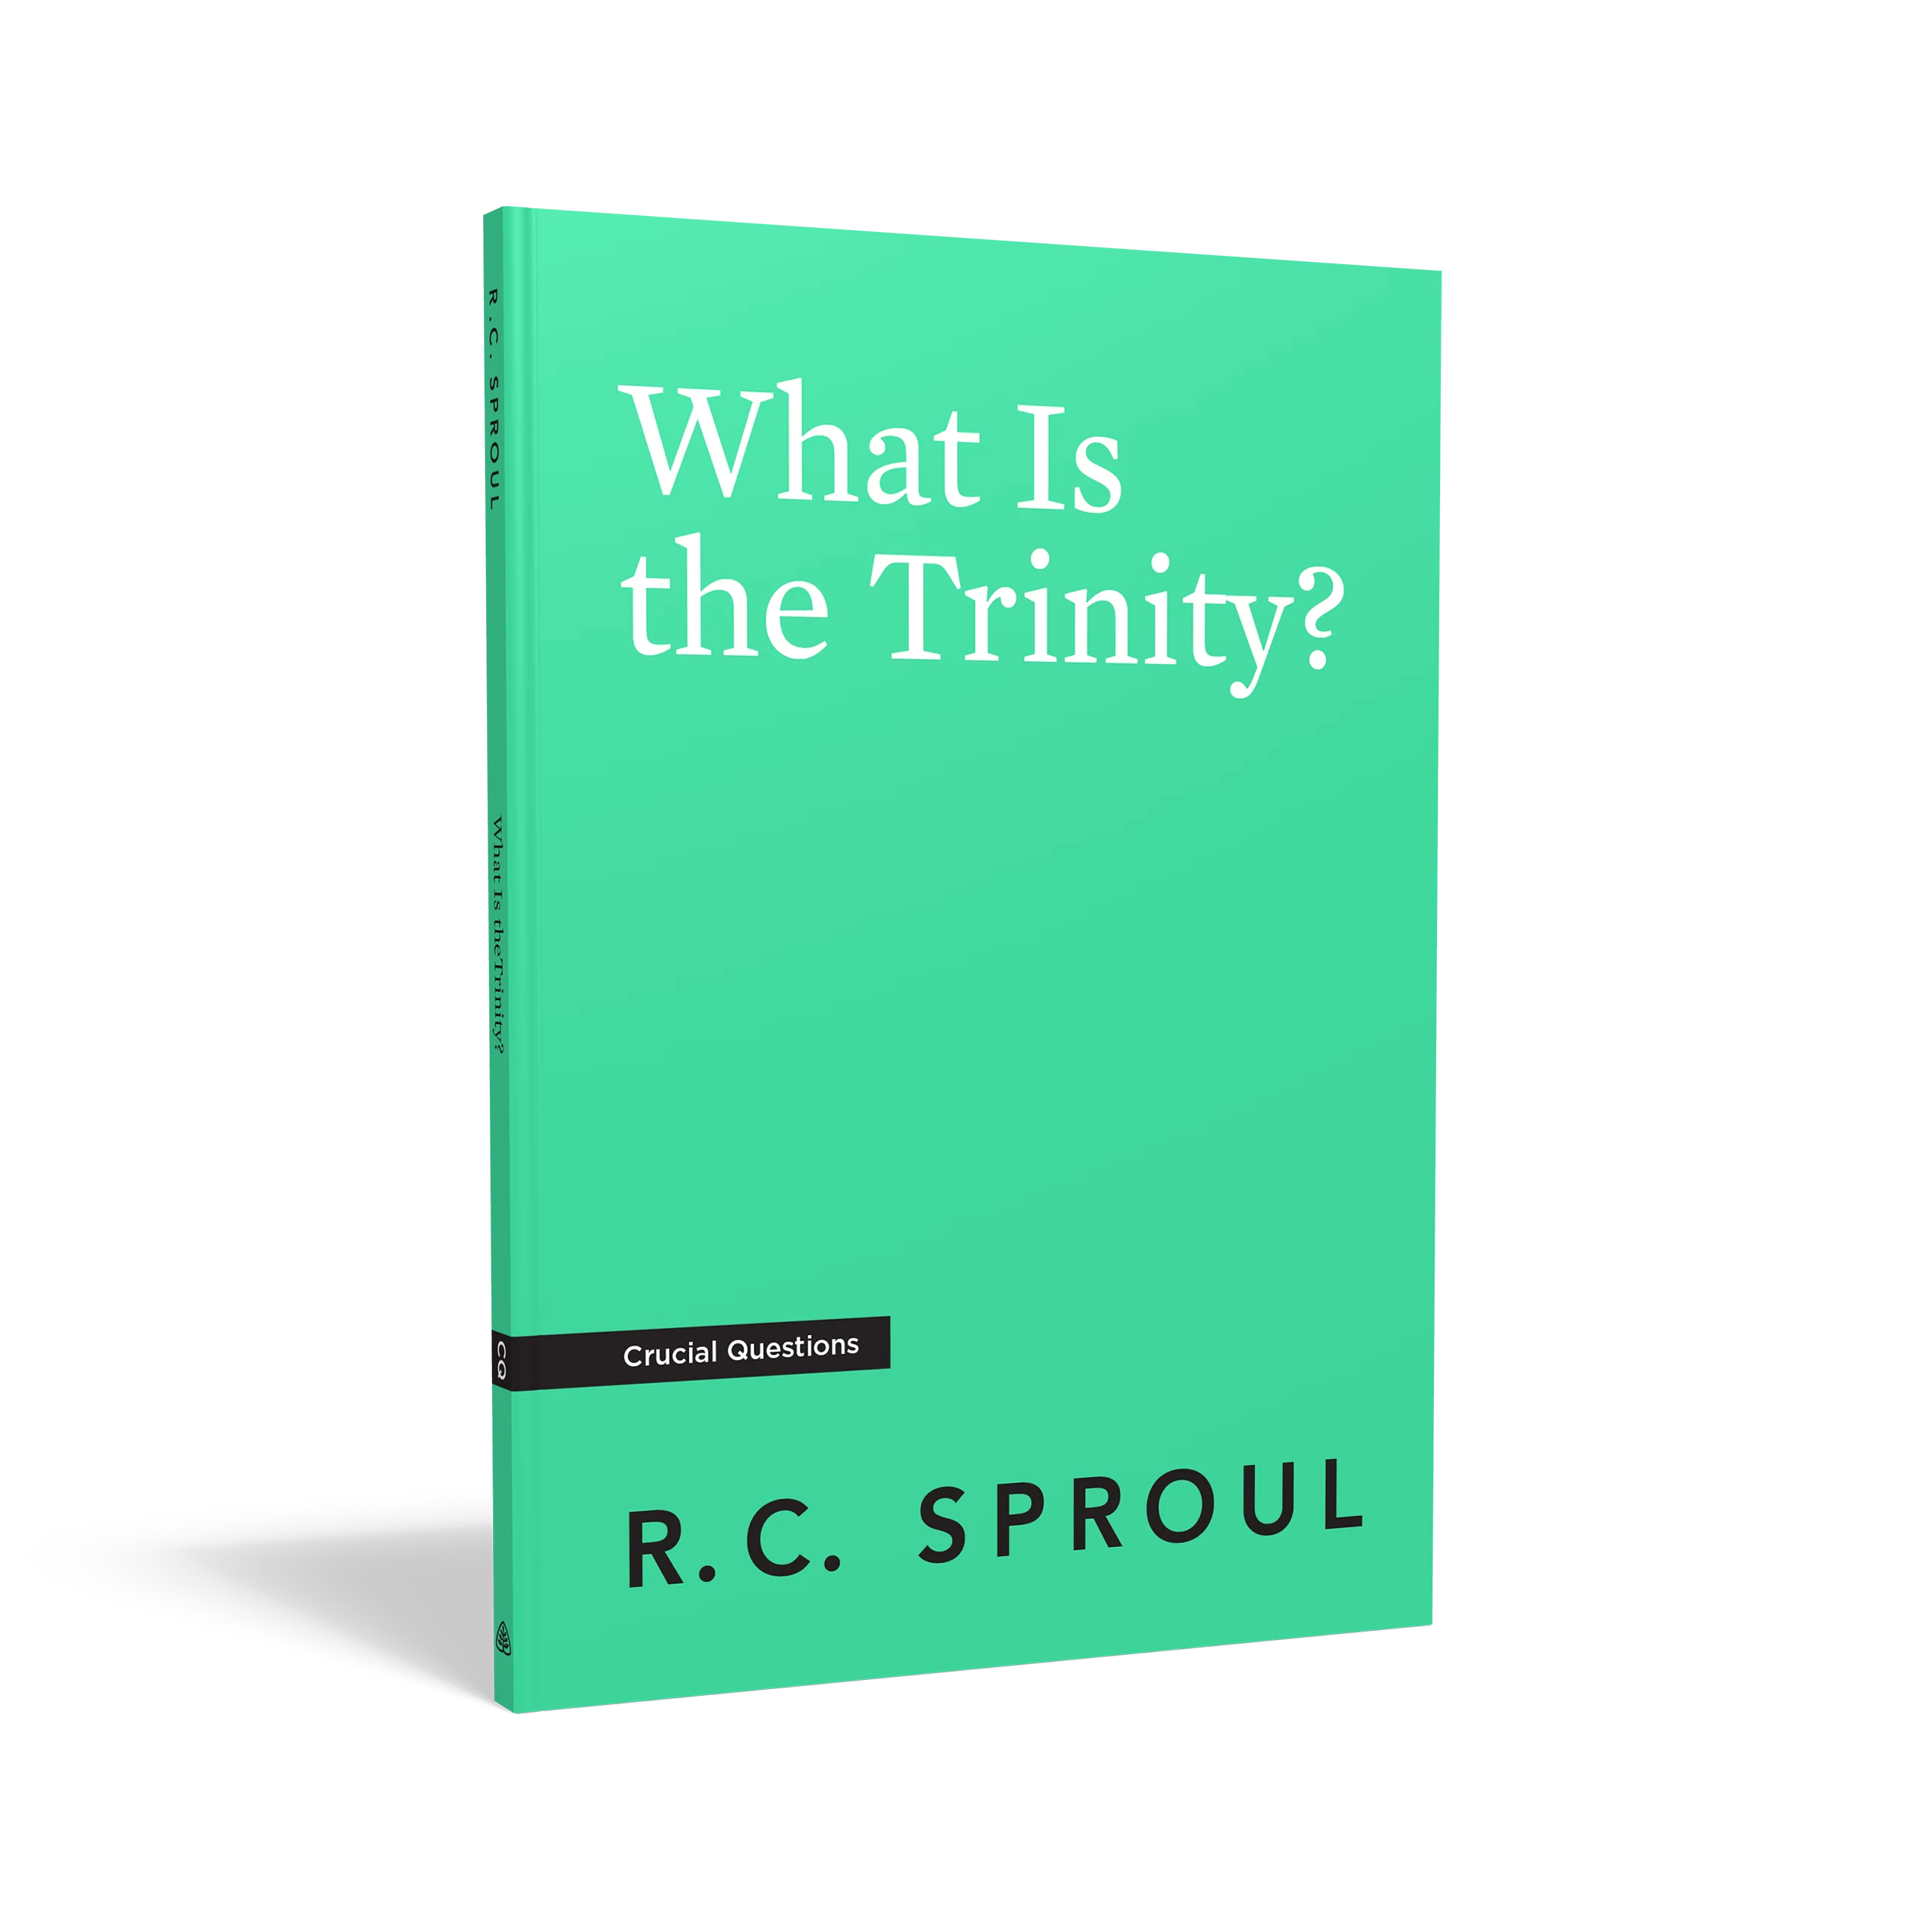



*** Creeds — Apostles’ / Nicene / Athanasian

Slide 29
