Slide 1

Sunday, 8th March
RIVER ROOTS
Theology Proper
The Communicable Attributes of God

Slide 2


Classification
1. Incommunicable — Unique
2. Communicable — Shared

Slide 3
Two Indications
Genesis 1:26–27

Slide 4
Two Indications
Genesis 1:26–27
As his creatures,
we are made in the image of God.

Slide 5
Two Indications
Genesis 1:26–27
As his creatures,
we are made in the image of God.
Ephesians 5:1

Slide 6
Two Indications
Genesis 1:26–27
As his creatures,
we are made in the image of God.
Ephesians 5:1
As his children,
we are called to imitate God.

Slide 7

and to put on
the new self,
created after the
likeness of God in
true righteousness
and holiness
— Ephesians 4:24

Slide 8
Holiness

Slide 9
Holiness
Majestic Holiness

Slide 10
Holiness
Majestic Holiness
Moral Holiness

Slide 11
Holiness
Majestic Holiness
Moral Holiness
‘be holy, for I am holy’ (1 Pet 1:14–16).

Slide 12
Righteousness

Slide 13
God always acts
in accordance with
what is right
and is himself
the final standard
of what is right.
— Grudem

Slide 14
Righteousness
God is righteous (2 Chron 12:6; Ps 89:14).

Slide 15
Righteousness
God is righteous (2 Chron 12:6; Ps 89:14).
His ways are right (Deut 32:4; Job 8:3).

Slide 16
Righteousness
God is righteous (2 Chron 12:6; Ps 89:14).
His ways are right (Deut 32:4; Job 8:3).
He loves justice & will never do injustice
(Gen 18:25; Job 37:23; Isa 61:8; Rom 9:14).

Slide 17
The Lord, the Lord,
a God merciful and gracious, slow to anger, and abounding in steadfast love and faithfulness, keeping steadfast love for thousands, forgiving iniquity and transgression and sin, but who will by no means clear the guilty, visiting the iniquity of the fathers on the children and the children's children, to the third and
the fourth generation.
— Exodus 34:6–7

Slide 18
Mercy

Slide 19
Mercy
God’s mercy is his compassion in action. God sees our misery as sinners, feels compassion for us, and so acts by not giving us what we rightfully deserve.
Psalm 103:10

Slide 20
Grace

Slide 21
Grace
Undeserved Gift
Ephesians 2:5, 8

Slide 22
Patience

Slide 23
Patience
Slow to anger / Longsuffering / Forbearance
Romans 2:4

Slide 24
Love

Slide 25
Love
AW Pink — uninfluenced; eternal; sovereign; infinite; immutable; holy; gracious

Slide 26
Love
AW Pink — uninfluenced; eternal; sovereign; infinite; immutable; holy; gracious
General = Benevolence (Mt 5:45)
Special = Complacency (Deut 7:6-8)

Slide 27
Faithfulness

Slide 28
Faithfulness
True God (Jn 17:3)

Slide 29
Faithfulness
True God (Jn 17:3)
Cannot Lie (Num 23:19)

Slide 30
Faithfulness
True God (Jn 17:3)
Cannot Lie (Num 23:19)
Faithful to his Promises & People
(Josh 21:43–45)

Slide 31
This faithfulness of God is of the utmost
practical significance to the people of God.
It is the ground of their confidence,
the foundation of their hope,
and the cause of their rejoicing.
— Berkhof

Slide 32
Forgiveness

Slide 33
Goodness

Slide 34
Goodness
Psalm 100:5; Mk 10:17–18

Slide 35
Moses said, “Please show me your glory.”
And he said, “I will make all my goodness
pass before you and will proclaim
before you my name ‘The Lord.’
And I will be gracious to whom
I will be gracious, and will show mercy on whom I will show mercy.
— Exodus 33:18–19

Slide 36
What do these mean for us?

Slide 37
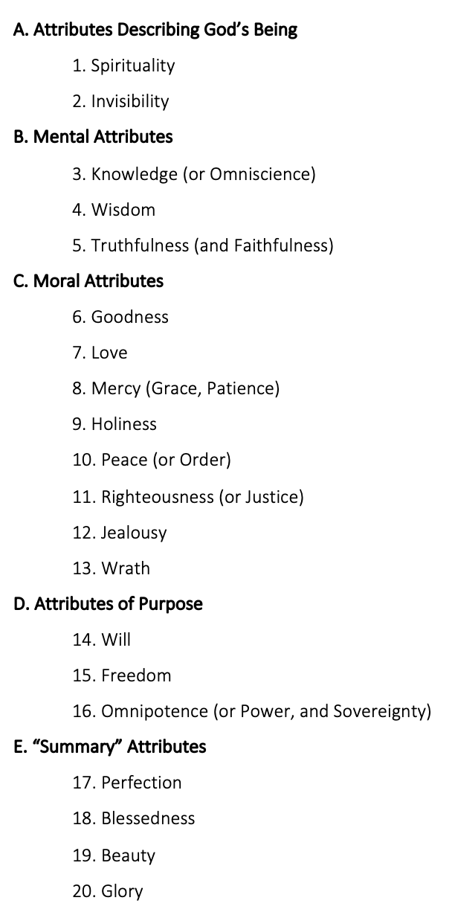

Slide 38
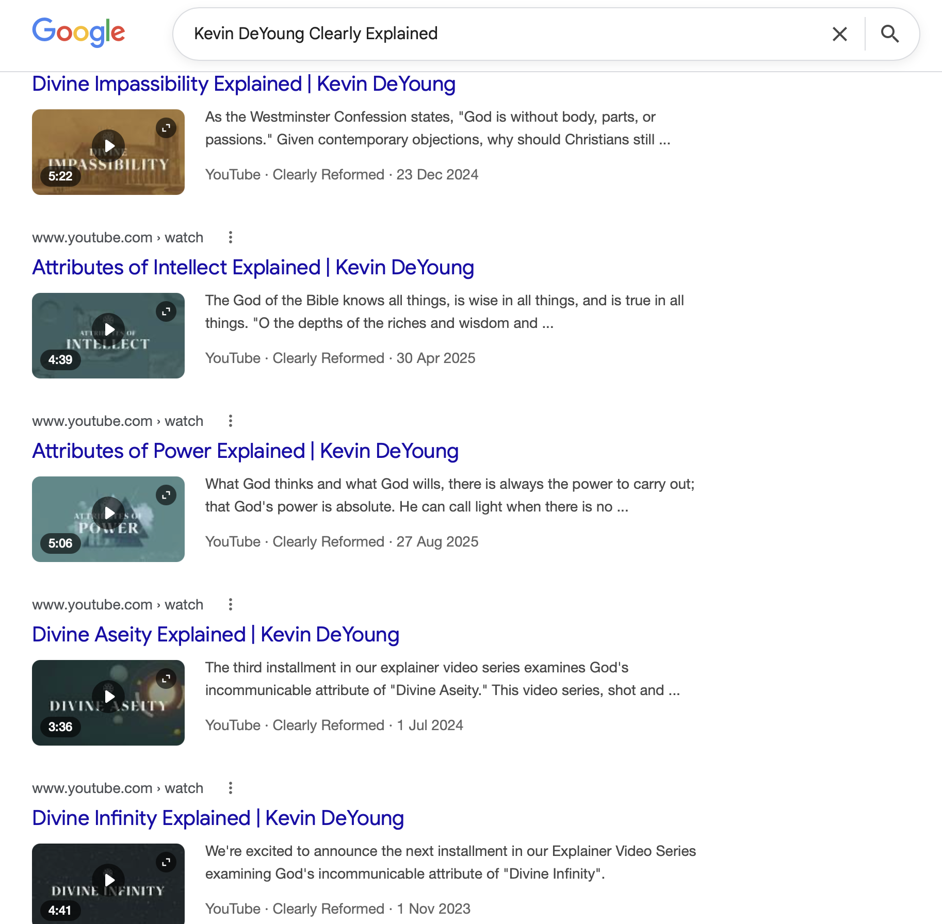

Slide 39
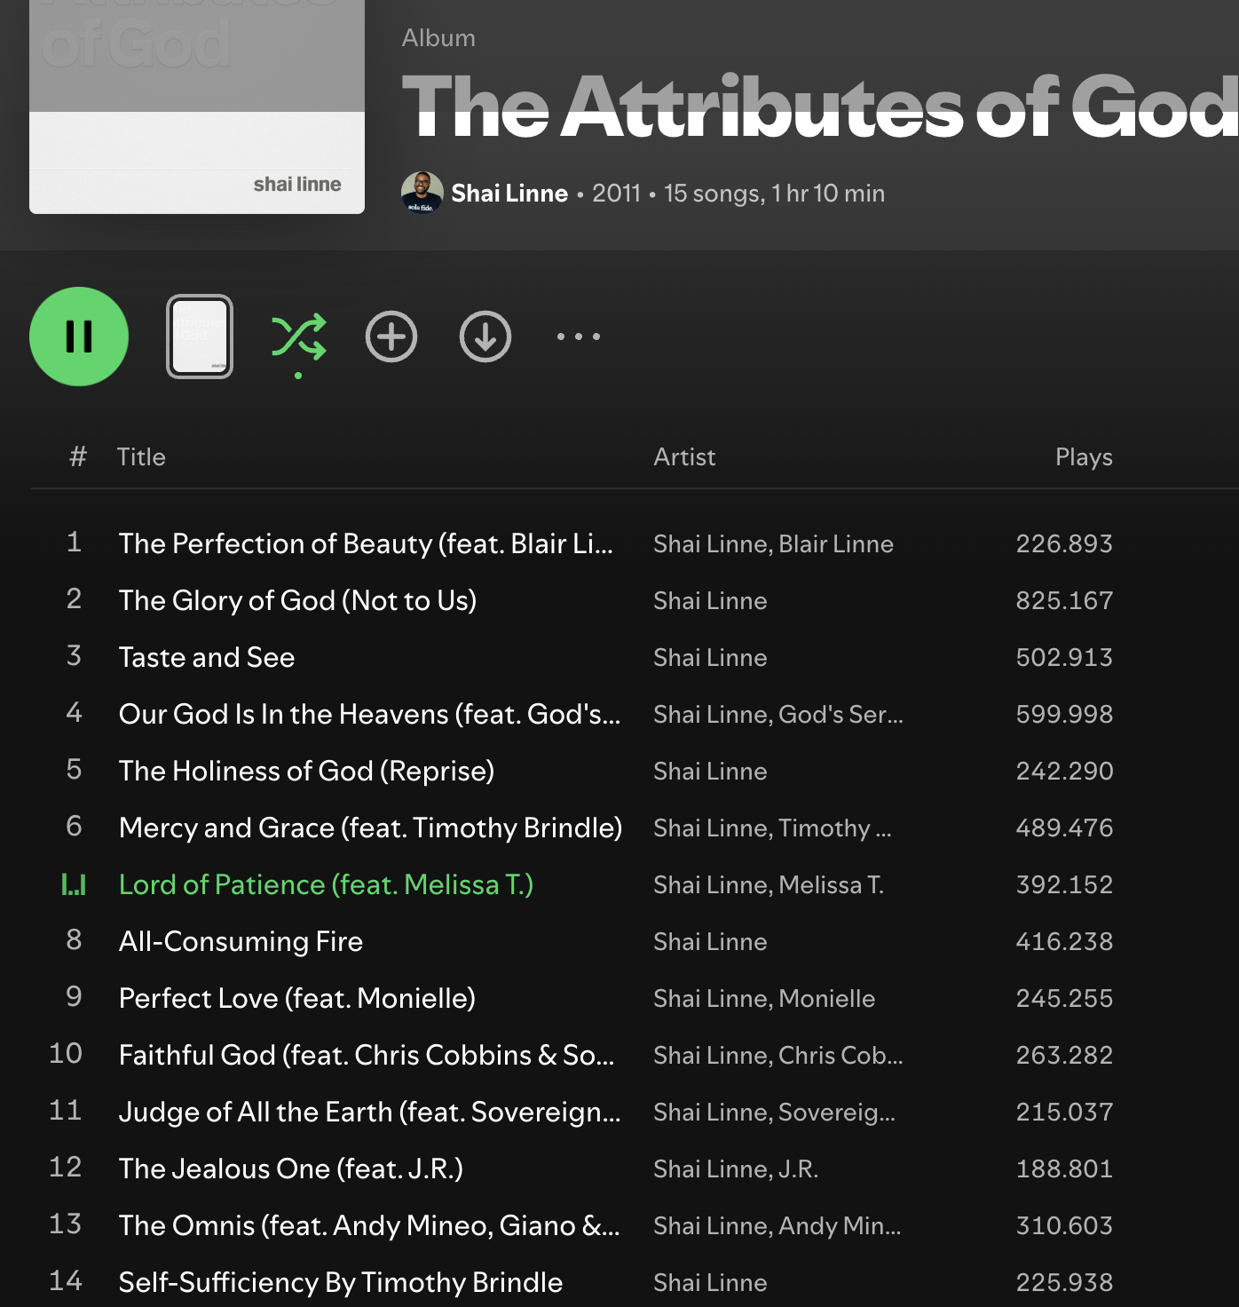

Slide 40
