Slide 1

Sunday, 1st March
RIVER ROOTS
Theology Proper
The Incommunicable Attributes of God

Slide 2


Who is God?

Slide 3
Who is God?
Q. 7 — God is a Spirit, in and of himself infinite in being, glory, blessedness, and perfection; all-sufficient, eternal, unchangeable, incomprehensible, everywhere present,
almighty, knowing all things, most wise,
most holy, most just, most merciful and
gracious, long-suffering, and
abundant in goodness and truth.

Slide 4
Classification
1. Incommunicable — Unique
2. Communicable — Shared

Slide 5
Related to Being
Infinity

Slide 6
Related to Being
Infinity
Great — Psalm 145:3

Slide 7
Related to Being
Infinity
Great — Psalm 145:3
Free from all limitations — Psalm 115:3

Slide 8
Related to Being
Infinity
Great — Psalm 145:3
Free from all limitations — Psalm 115:3
Aseity

Slide 9
Related to Being
Infinity
Great — Psalm 145:3
Free from all limitations — Psalm 115:3
Aseity
Self-Existent — John 5:26

Slide 10
Related to Being
Infinity
Great — Psalm 145:3
Free from all limitations — Psalm 115:3
Aseity
Self-Existent — John 5:26
Self-Sufficient — Acts 17:24–25, 28

Slide 11
Related to Time
Eternality

Slide 12
Related to Time
Eternality
Genesis 21:33; Psalm 90:2; John 8:58

Slide 13
Related to Time
Eternality
Genesis 21:33; Psalm 90:2; John 8:58
Immutability

Slide 14
Related to Time
Eternality
Genesis 21:33; Psalm 90:2; John 8:58
Immutability
Malachi 3:6; James 1:17; Hebrews 13:8

Slide 15
Related to Time
Eternality
Genesis 21:33; Psalm 90:2; John 8:58
Immutability
Malachi 3:6; James 1:17; Hebrews 13:8
Being / Attributes / Purposes /Word

Slide 16
Related to Creation
Omnipresence

Slide 17
Related to Creation
Omnipresence
Psalm 139:7–12; Jeremiah 23:23–24

Slide 18
Related to Creation
Omnipresence
Psalm 139:7–12; Jeremiah 23:23–24
Omnipotence

Slide 19
Related to Creation
Omnipresence
Psalm 139:7–12; Jeremiah 23:23–24
Omnipotence
Job 42:2

Slide 20

If God is not sovereign, God is not God.
If there is one maverick molecule in the universe, one molecule running loose outside the scope of God's sovereign ordination, then… there is not the slightest confidence that you can have that any promise that God has ever made about the future will come to pass
— R C Sproul

Slide 21
Related to Creation
Omnipresence
Psalm 139:7–12; Jeremiah 23:23–24
Omnipotence
Job 42:2
Omniscience

Slide 22
Related to Creation
Omnipresence
Psalm 139:7–12; Jeremiah 23:23–24
Omnipotence
Job 42:2
Omniscience
1 Kings 8:39; 1 John 3:20

Slide 23
We all believe in our hearts
and confess with our mouths
that there is
a single
and simple
spiritual being,
whom we call God.
— Belgic Confession

Slide 24
Divine Simplicity
One God (Deut 6:4) who is Spirit (Jn 4:24)

Slide 25
Divine simplicity means that
he is perfect unity,
without composition or division…
God’s simplicity means that he has no parts, and his attributes and essence
are all one in him.
— Beeke & Smalley

Slide 26
Divine Simplicity
One God (Deut 6:4) who is Spirit (Jn 4:24)
“God’s attributes are God”. They “unite in his being” — Beeke and Smalley

Slide 27
Divine Simplicity
One God (Deut 6:4) who is Spirit (Jn 4:24)
“God’s attributes are God”. They “unite in his being” — Beeke and Smalley
Omniscience
Father — 1 John 3:20
Son — Luke 5:22
Spirit — 1 Cor 2:10

Slide 28
A right conception of God is basic
not only to systematic theology but to practical Christian living as well.…
I believe there is scarcely an error in doctrine or a failure in applying
Christian ethics that cannot be traced finally to imperfect and
ignoble thoughts about God
— AW Tozer

Slide 29
What do these mean for us?

Slide 30
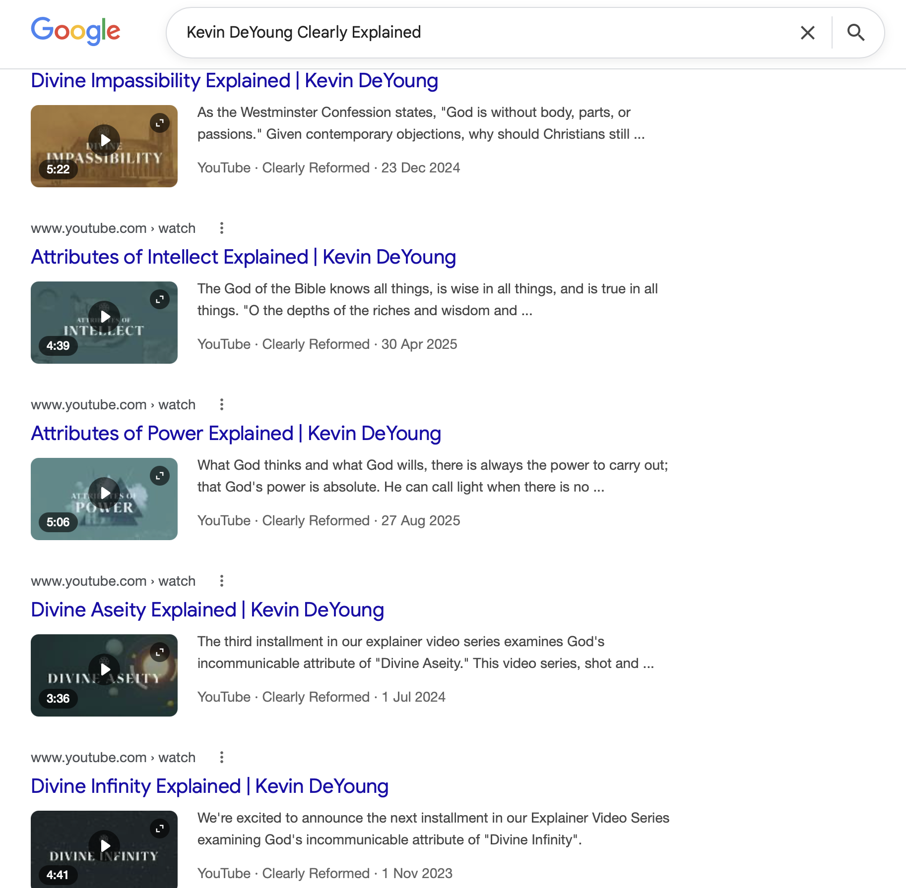

Slide 31
