Slide 1
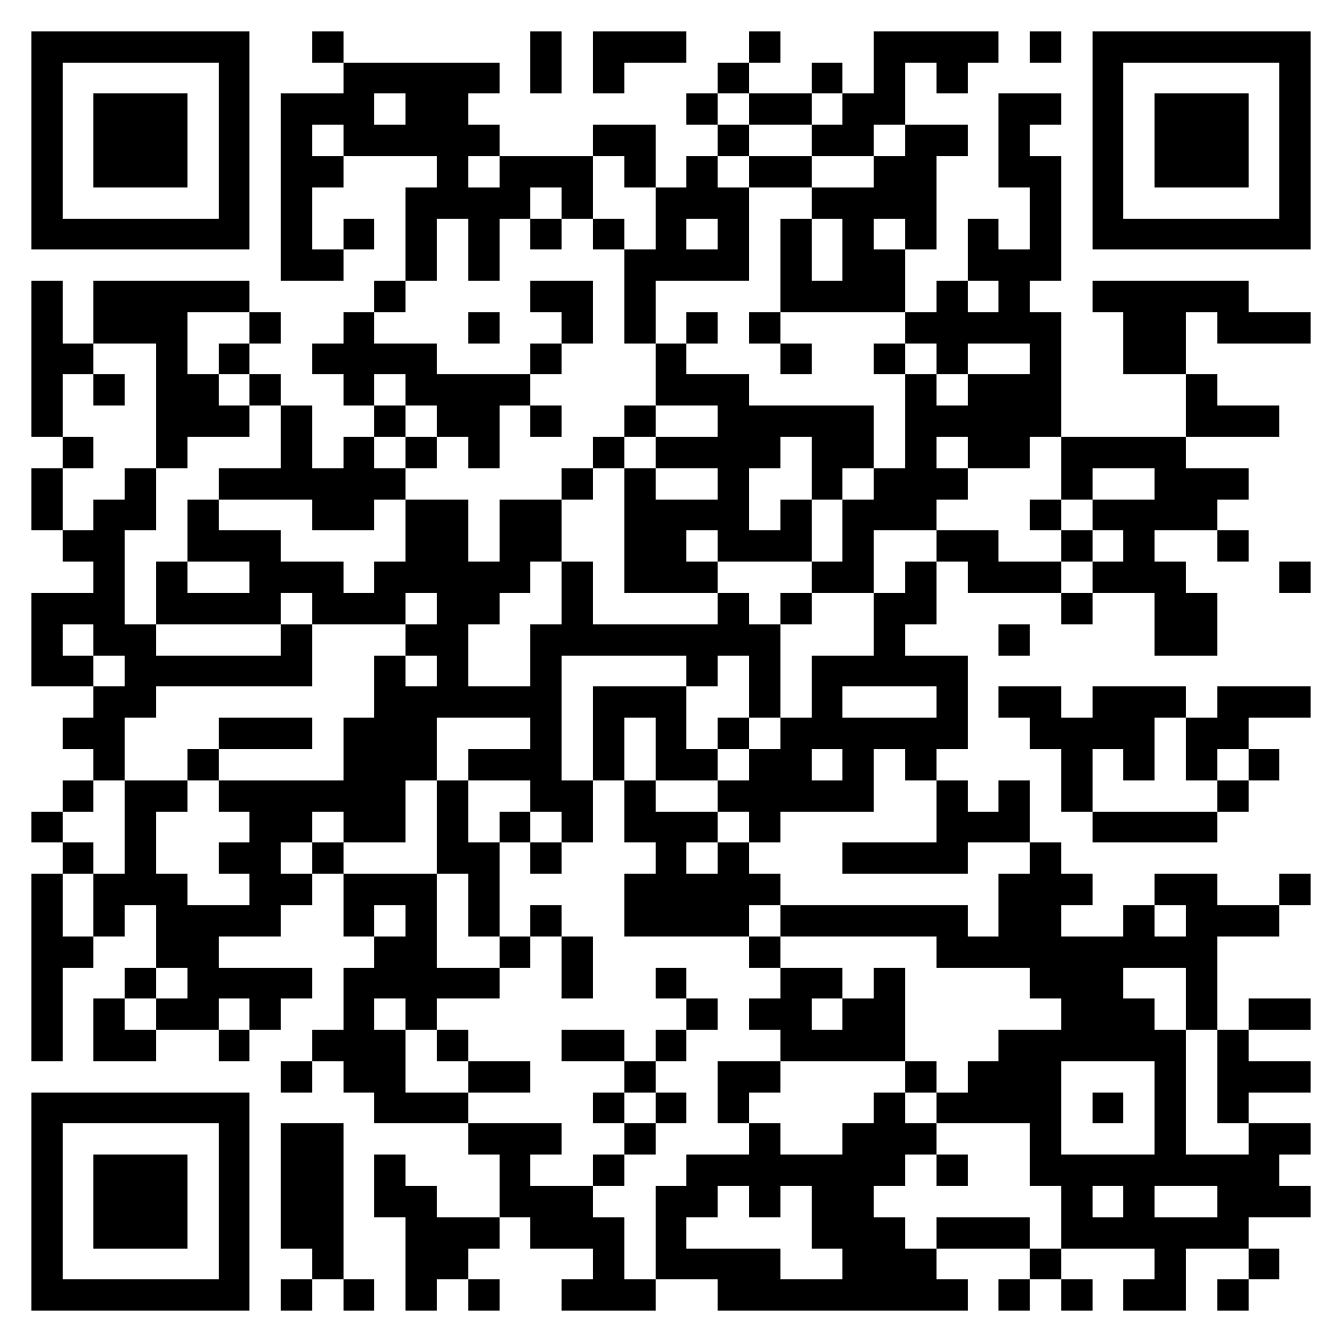
Parenting
Little Humans
Tiffany
Nathan
For River of Life Church
If you want to have a copy of our slides and links
to resources we will be discussing,
please scan the QR code
Notes:
When we found out we were expecting a baby, we probably did like many of you — we were elated, and we panicked just a bit! “Oh my goodness, we’re bringing a tiny little human being into the world! We now need to download all the wisdom in the universe into our brains.”
So we read about and listened to a lot of different methods of parenting and disciplining. And then, of course, we also had in our brains the methods our parents used with us.
But today what we want to give you are not methods. If your takeaway is the Gibson method of parenting, this will be a massive failure. Because when we got to about 0.01% of downloading the wisdom in the universe, we got an error message that said: “Hard drive full. Please empty your recycle bin.” Seriously, though, our methods are flawed, and they may not work for your kids.
Some methods were helpful for us to read about, others not. But what we especially found helpful were the biblical principles that others helped distill for us. And that’s what we hope you’ll take away today.
The Bible gives very little in the way of parenting methods. (That’s why Patrick told me he didn’t think we’d have much to talk about today!) But you can use biblical principles to judge specific methods, as you also evaluate which methods are effective for you as the parenting team, in relation to your child.
By the way, you can use the QR code here to access the slides, and that’ll also give you access to some links to resources we found helpful.

Slide 2
OUTLINE
Today
Next week
1
2
3
4
Little Humans
Disciplined Humans
Discipled Humans
Emotional Humans
treating kids like human beings
helping kids face up to their sinful natures
bringing kids in on what God’s doing
helping your kids with big emotions
If you want to have a copy of our slides and links
to resources we will be discussing,
please scan the QR code
Notes:
Alex already talked about biblical principles, but today we want to dive deeper into how to apply them with younger kids.
Alice and Bentley talked about parenting older kids, so we want to lay out how you get to that point.
Today we’ll be covering two topics: …
Then next week we’ll talk about …
At the end, we’ll have some other miscellaneous advice (garage sale) of things that were helpful to us.

Slide 3
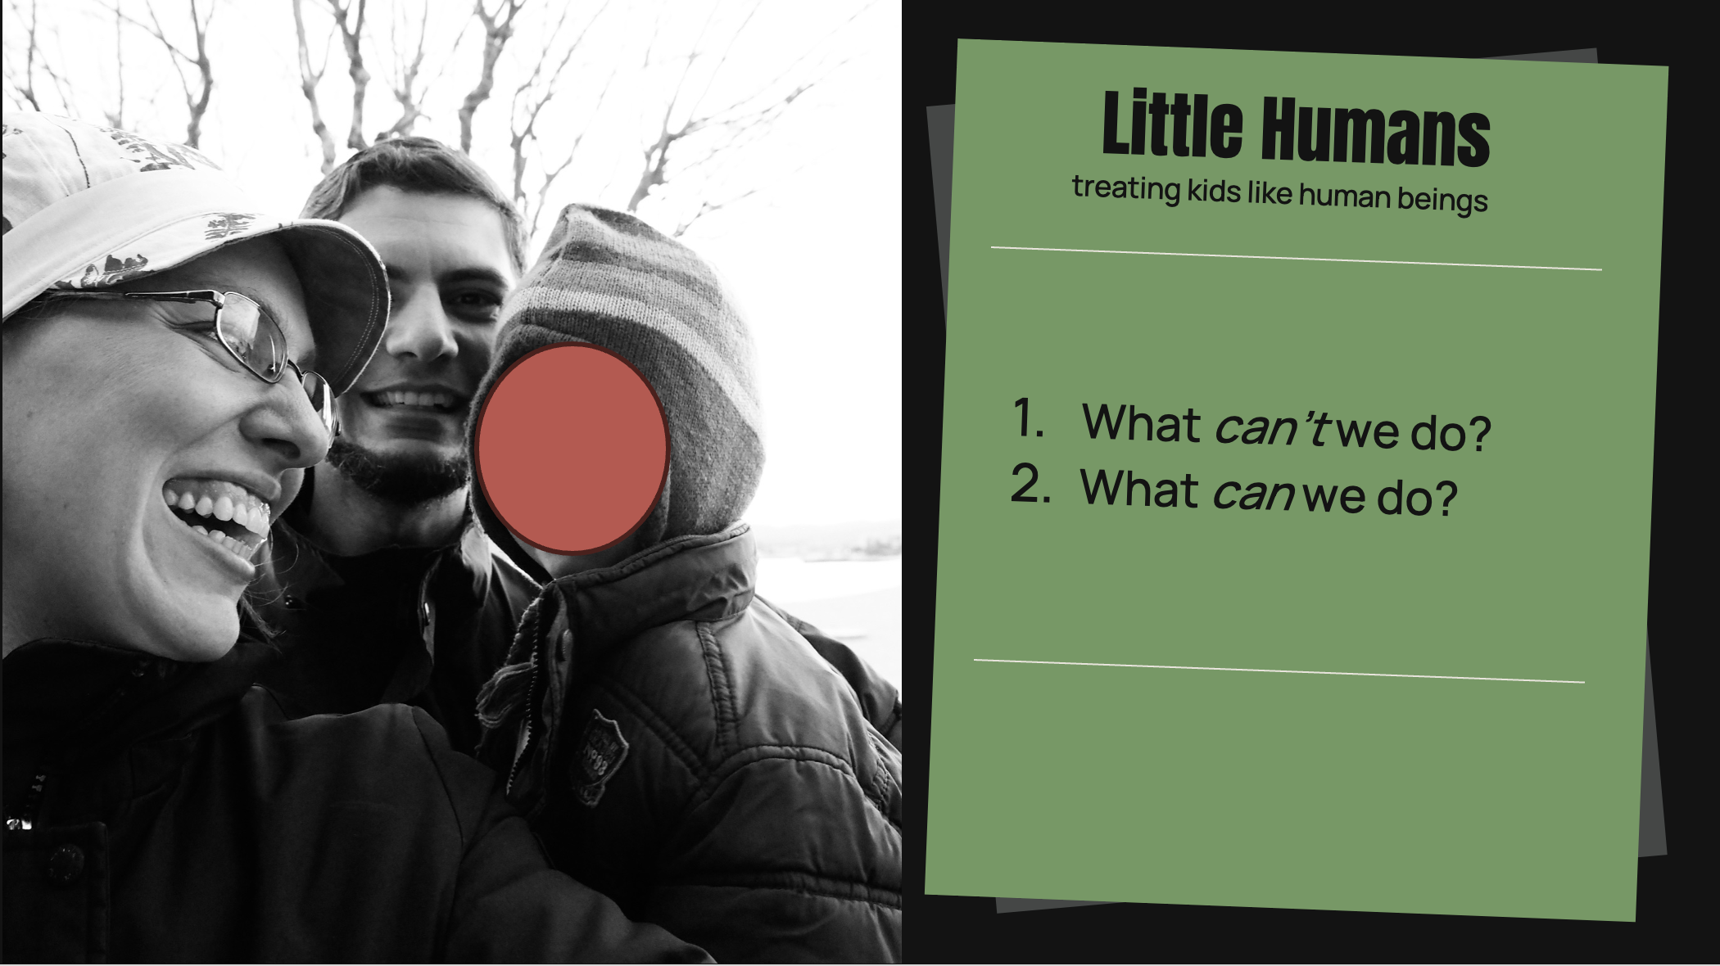
Notes:
Hook
Have you ever heard the saying, “Kids should be seen and not heard”? What do you think is the thinking behind that statement? (Kids are decoration. They’re not part of the important activities adults are doing.) Maybe we wouldn’t say this, but do we act like it? Are we overly concerned about the kids being a disturbance? Do we assume they can’t understand our conversations? Do we suppose they have no valuable input? Or adult time vs. kid time.
Main Idea
Children are of equal value before God, created in his image. They may be “little humans,” but they are still humans. And how we treat them should reflect that. When we treat them as God’s image-bearers, then we also have long-term goals in mind, because we recognize they are on their way to being responsible adults. Is there a switch we can flip? On the one side: “Little kid with zero responsibilities who doesn’t understand any grown-up topics,” and on the other side: “Teenager with adult responsibilities who’s expected to contribute to society”? No. Whether your child is an infant, a 3-year-old, or a 6-year-old, they’re already an image bearer and they’re already somewhere on their way to bearing the moral responsibilities God wants them to have.
Today, when we’re talking about parenting younger kids, we’re keeping long-term goals in mind. We’re thinking of the person we want them to have grown into in 10–15 years.
Speaking of goals, let’s set realistic ones. There are some things we can do as parents and some we can’t. What are some things God does in the human heart that I can’t do? (Discussion: e.g., saving people, sanctifying them, producing the fruits of the Spirit)
If these are things that I can’t do, that only God can do, then they shouldn’t be my goals. I want them deeply, and I pray for them, and I make sure what I’m doing aligns with them. But if my goal is for my child to follow God – something I can’t make happen – then I’m putting pressure on myself and on my child in the wrong ways.
That brings us to what we can do. We’re going to spend half a session on each of the following 3 things, but first let’s lay a biblical foundation for each of them.

Slide 4
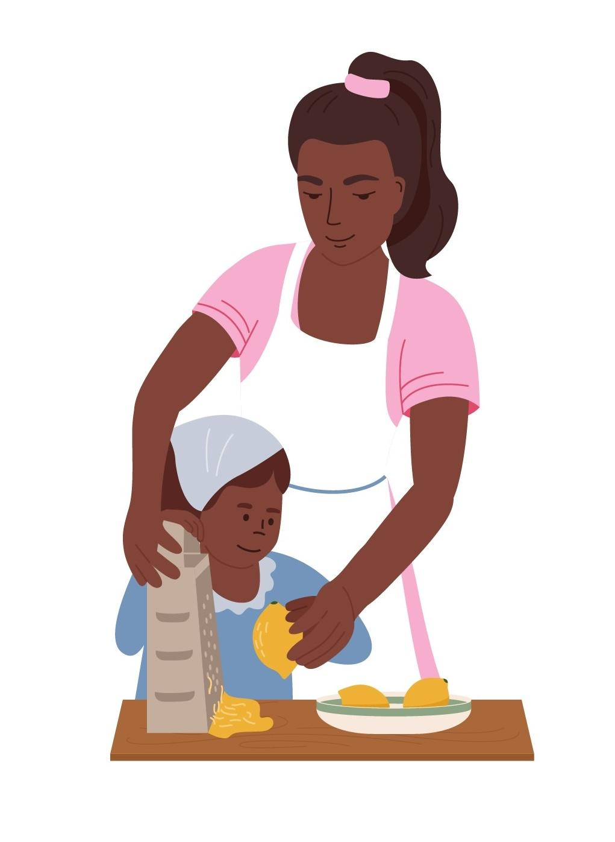
What can we do?
Discipline without provoking
Notes:
Could someone please read Eph. 6:1–4? Here’s a provocative question for you: Whose responsibility is it for children to obey their parents? (The children’s) In multiple places in Scripture where God commands children to obey, he addresses the command directly to the children. Caveat: In one place regarding who is eligible to be an elder (1 Tim. 3:4), this is someone who keeps their children submissive or obedient. It is a sign that he knows how to manage his household. But the general command is not, “Parents, keep your children submissive,” but “Children, obey your parents.”

Slide 5
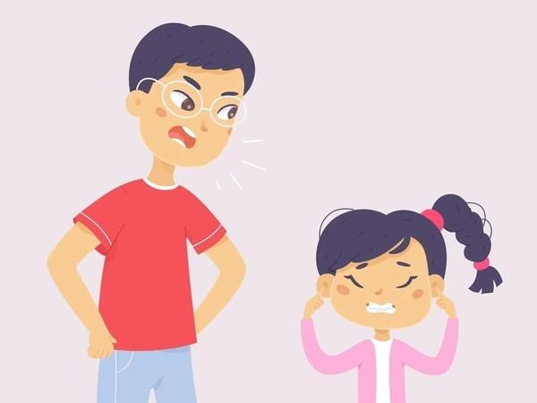
What can we do?
Fathers, do not provoke your children to anger, but bring them up in the discipline and instruction of the Lord.
Eph. 6:4, ESV
“
Discipline without provoking
Notes:
Our responsibility as parents is to discipline without provoking.
In the first session, Alex already addressed why it is that fathers are specifically addressed here – that they have the temptation to either neglect disciplining or to be too rough when they do get involved.
[[Why are fathers especially addressed here? It’s not that mothers aren’t expected to be part of the discipline process – the children are told to obey their mothers as well as their fathers (see also Pr. 29:15, where a mother’s discipline is implied). I suspect it is because men have a temptation to leave child-rearing in general, including discipline, to the moms – and, when they do get involved – to abuse or otherwise anger their children. (“Bring them up in the discipline and instruction of the Lord” might be a summary of the several verses in Proverbs about discipline.)]]
Who else disciplines without provoking? God himself. Could someone please read Heb. 12:7–11? God would have every right to beat us into submission, or to pick and nag until we do everything “just so,” the way he wants. But instead he wants us to obey him out of love. And so he disciplines us for our good, with kindness and patience. If our children are supposed to obey us, and we are not to provoke them, that means we should be the kind of Lawgivers to our children that God is to us. His law leads to life!

Slide 6
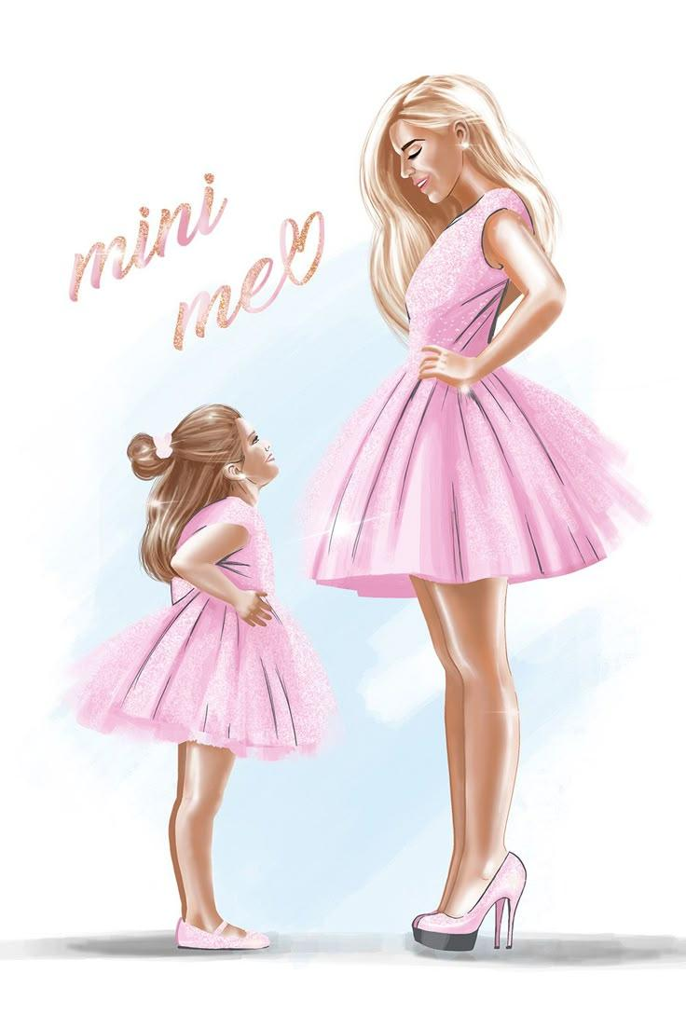
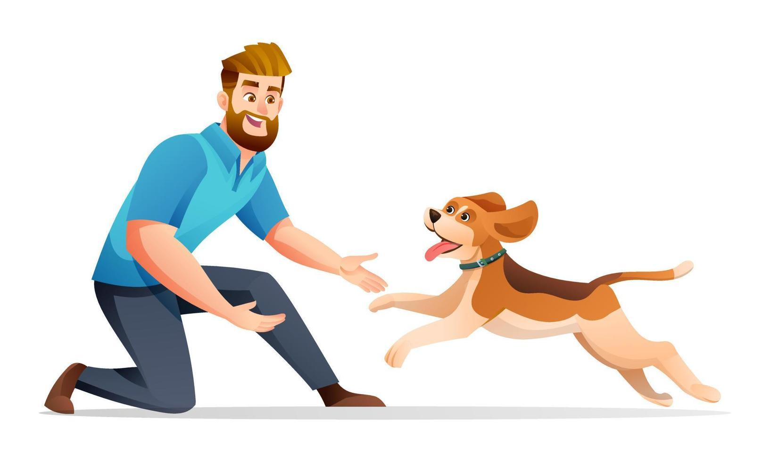
What can we do?
Discipline without provoking
NOT an animal
NOT a mini me
Notes:
Let’s make this more concrete:
Our children are not …
Animals who can’t understand moral choices (what’s the difference between how you treat your dog and how you treat your child? Your dog will never grow up to have the nuclear codes.)
Little me’s who represent me to the world (Example of embarrassing behavior on the U-Bahn after a tiring day at the zoo.)

Slide 7
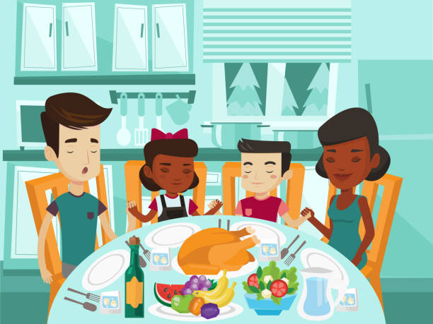
What can we do?
Discipline without provoking
NOT an animal
NOT a mini me
ARE image bearers
ARE growing daily
Notes:
They are …
Human beings made in the image of God (already!)
People who are growing daily in their moral understanding
We’re going to talk more about this in the second half of the session today.

Slide 8

What can we do?
And these words that I command you today shall be on your heart. You shall teach them diligently to your children, and shall talk of them when you sit in your house, and when you walk by the way, and when you lie down, and when you rise.
Deut. 6:6–7, ESV
“
Discipline without provoking
Disciple through teaching and involving them in what God is doing
Notes:
We can make sure our kids hear about the Lord and what he’s doing in our life. Our daily family activities and conversations can be an opportunity for them to encounter God in any and every situation.
We’ll cover this in more detail in the session next week.

Slide 9

What can we do?
I am reminded of your sincere faith, a faith that dwelt first in your grandmother Lois and your mother Eunice and now, I am sure, dwells in you as well.
2 Tim. 1:5, ESV
“
Discipline without provoking
Disciple through teaching and involving them in what God is doing
Live out our relationship with the Lord (love, repentance, fruits of the Spirit)
Notes:
[Condense following]
The Old Testament sometimes talks about children who did or did not “walk in the way” of their parents. (e.g., Samuel’s sons we read about recently)
[E.g., as Solomon was supposed to do re. David, 1 Ki. 9:4, and as Uzziah did regarding his father Amaziah, 2 Chr. 26:4, vs. negative examples Ahaziah of Israel, 1 Ki. 22:52, and Ahaziah of Judah, 2 Chr. 22:3]
We can’t control whether our kids walk in our way or not. But if our actions have cleared a path through the jungle that’s easy to see and easy to walk down, which way will it lead?
There are probably some aspects of that that are pretty scary when we think about our own failures. We are going through a sanctification process, which God is in charge of, and he often includes parenting challenges in that sanctification process!
So what we can do is not just to try to set a good example in our relationship with the Lord, but also to let them see that we love the Lord even when we fail [what repentance looks like, and what it looks like for the Spirit of God to be growing fruit in our lives. In other words, we can open up to them.]
If we try show them only perfection, by hiding the imperfect parts of our lives, they’ll never be able to follow in our footsteps and will eventually realize that that example was fake. But if we show them how to deal with failures, that’s something they can use every day of their lives.
That means: In our jungle pack, we need a bunch of signs that say, “Dead End,” and “Detour,” and “Construction Ahead,” so that we can mark them along the way.
For little kids, one of the big ways we can be real with them and set that environment of openness is showing them how to deal with big emotions: e.g., fear and anger (what are we covering in final section?). We’re going to cover that next week too.
(Transition to Tiff:) We’ve been talking about long-term goals we have for our days with “little humans.” The way we parent shouldn’t be about hitting “milestones” or comparing our kids’ to others. It’s about who we want them to be in 10-15 years. I’ll hand it off to Tiff talk about what that looks like in one particular area.

Slide 10
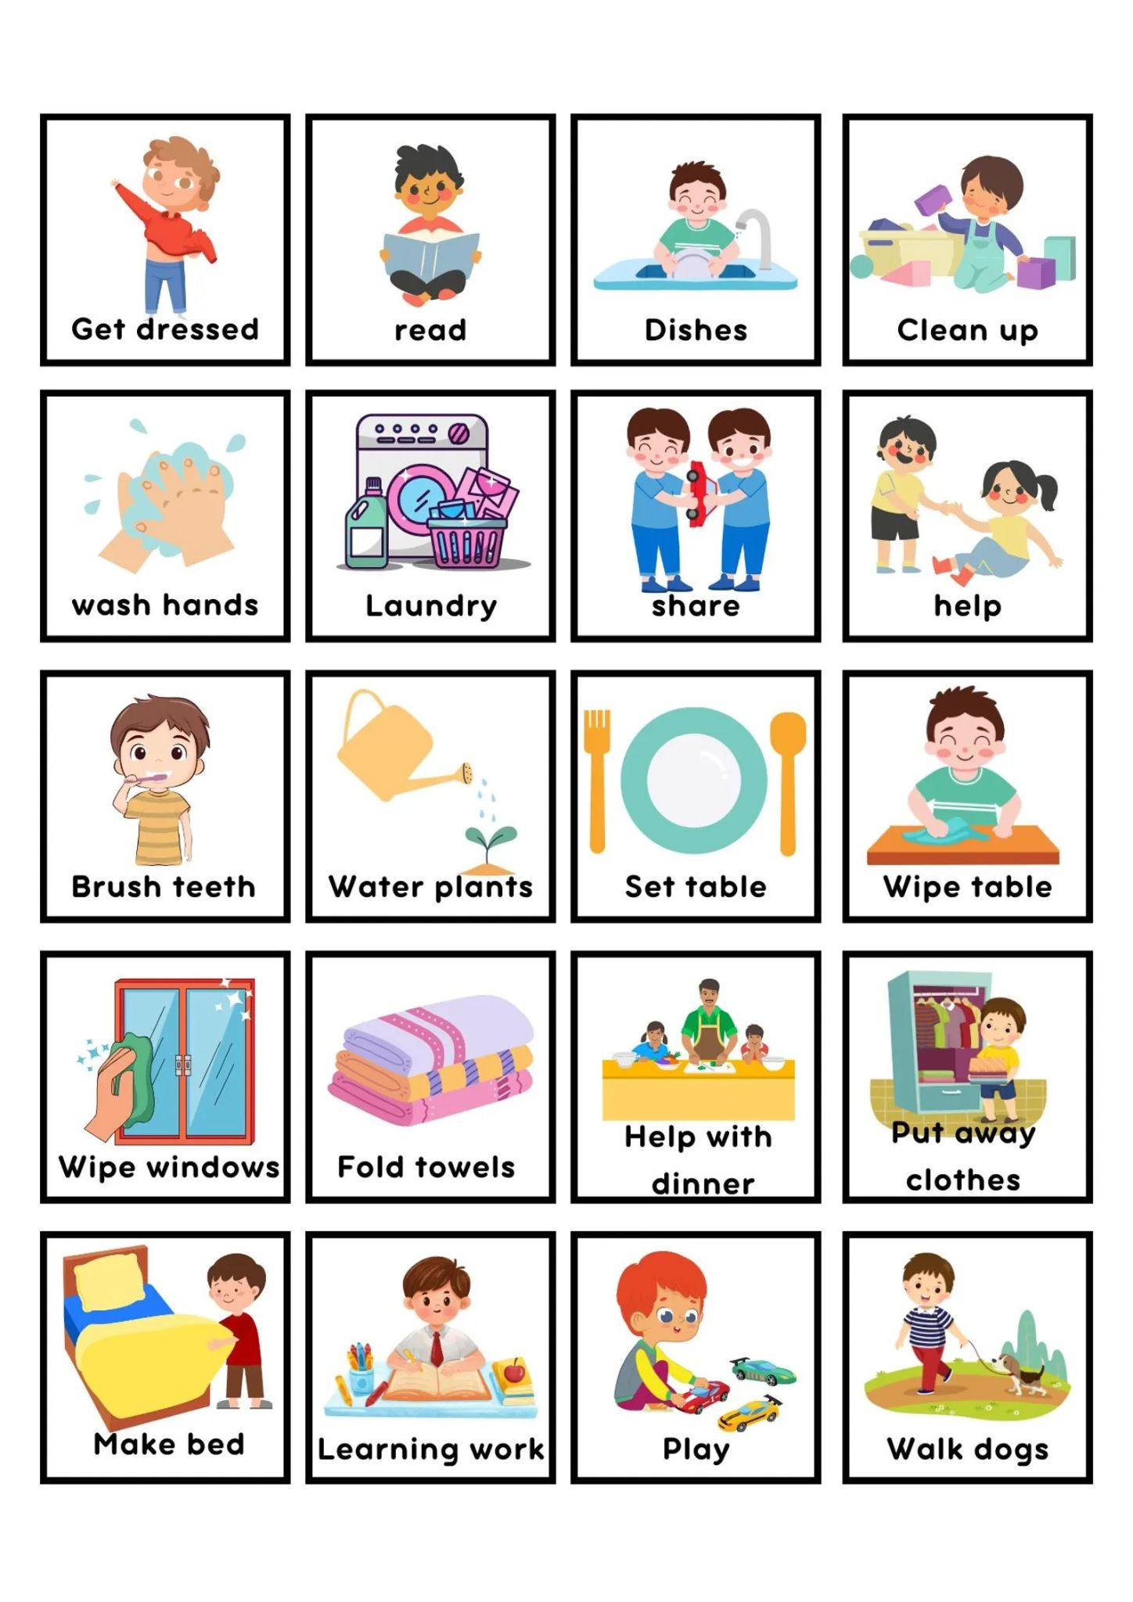
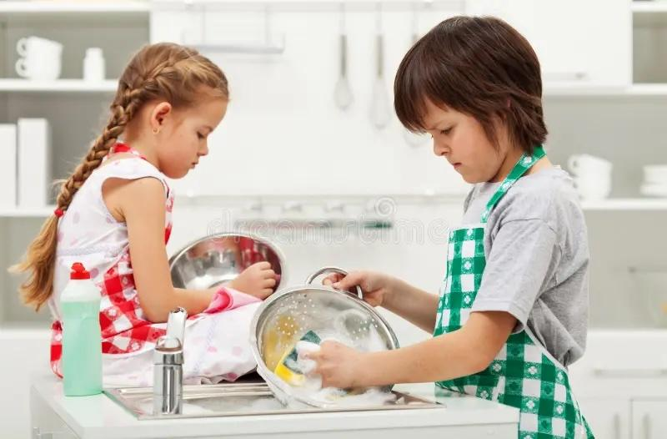
Chores
Notes:
Hello Everyone! So during these talks, I am usually gonna be sharing the practical side of how these principles have worked in our family. From this, highlight something Nathan said earliny. The longer we are parents, the more Nathan and I are convinced that “One size does NOT fit all!” Each family has different needs, different personality mixes and more. So we do not expect you to do the exact same things we do. We hope our personal examples will be a springboard for ideas for your own family. We very much want you to have the freedom to adapt how you implement these principles in your own family.
So, tying back into what Nathan said about these two points of:
1. Thinking in “long term goals”
2. treating our kids with respect as fellow image bearers,
A big area where this has been demonstrated in our family is through chores.
Just to give a little background about myself. I grew up in a subculture with a very strict approach to things like chores. “Kids should be contributing to the family, doing chores from the earliest age possible, always responding in obedience with a smiles and a joyful heart.” Though there are some aspects of this that I think are right, where I was coming from it was very unhealthy, was a burden to the kids and came with a lot of shaming. And it wasn’t treating the kids with respect as fellow image bearers.

Slide 11

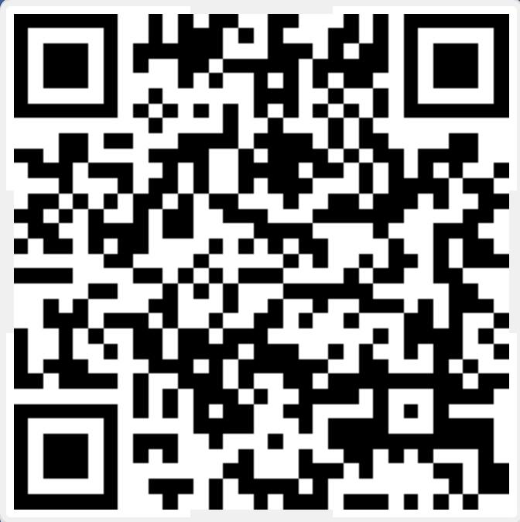
God’s jobs for parents
1. Teach kids about God
2. Keep kids safe
3. Teach kids what they need to know as adults
3. Teach kids what they need to know as adults
Notes:
A book that really helped me do this is: Love Centered Parenting (meaning God’s love, not permissiveness.)
I needed step completely away from this and start over with why do we want Jamey learning chores? This brought us to the idea of long term planning and remembering our jobs as parents.
We explain to Jamey that our God given jobs are:
1) Teach him about God
2) Keep him safe
3) Help him learn what he needs to know to be an adult.
And chores, of course, fall under that third category. When and how we are gonna do chores is decided ultimately by the skills we wanted Jamey to have by the time he was an adult. So our main focus was on teaching long term skills and healthy habits.

Slide 12
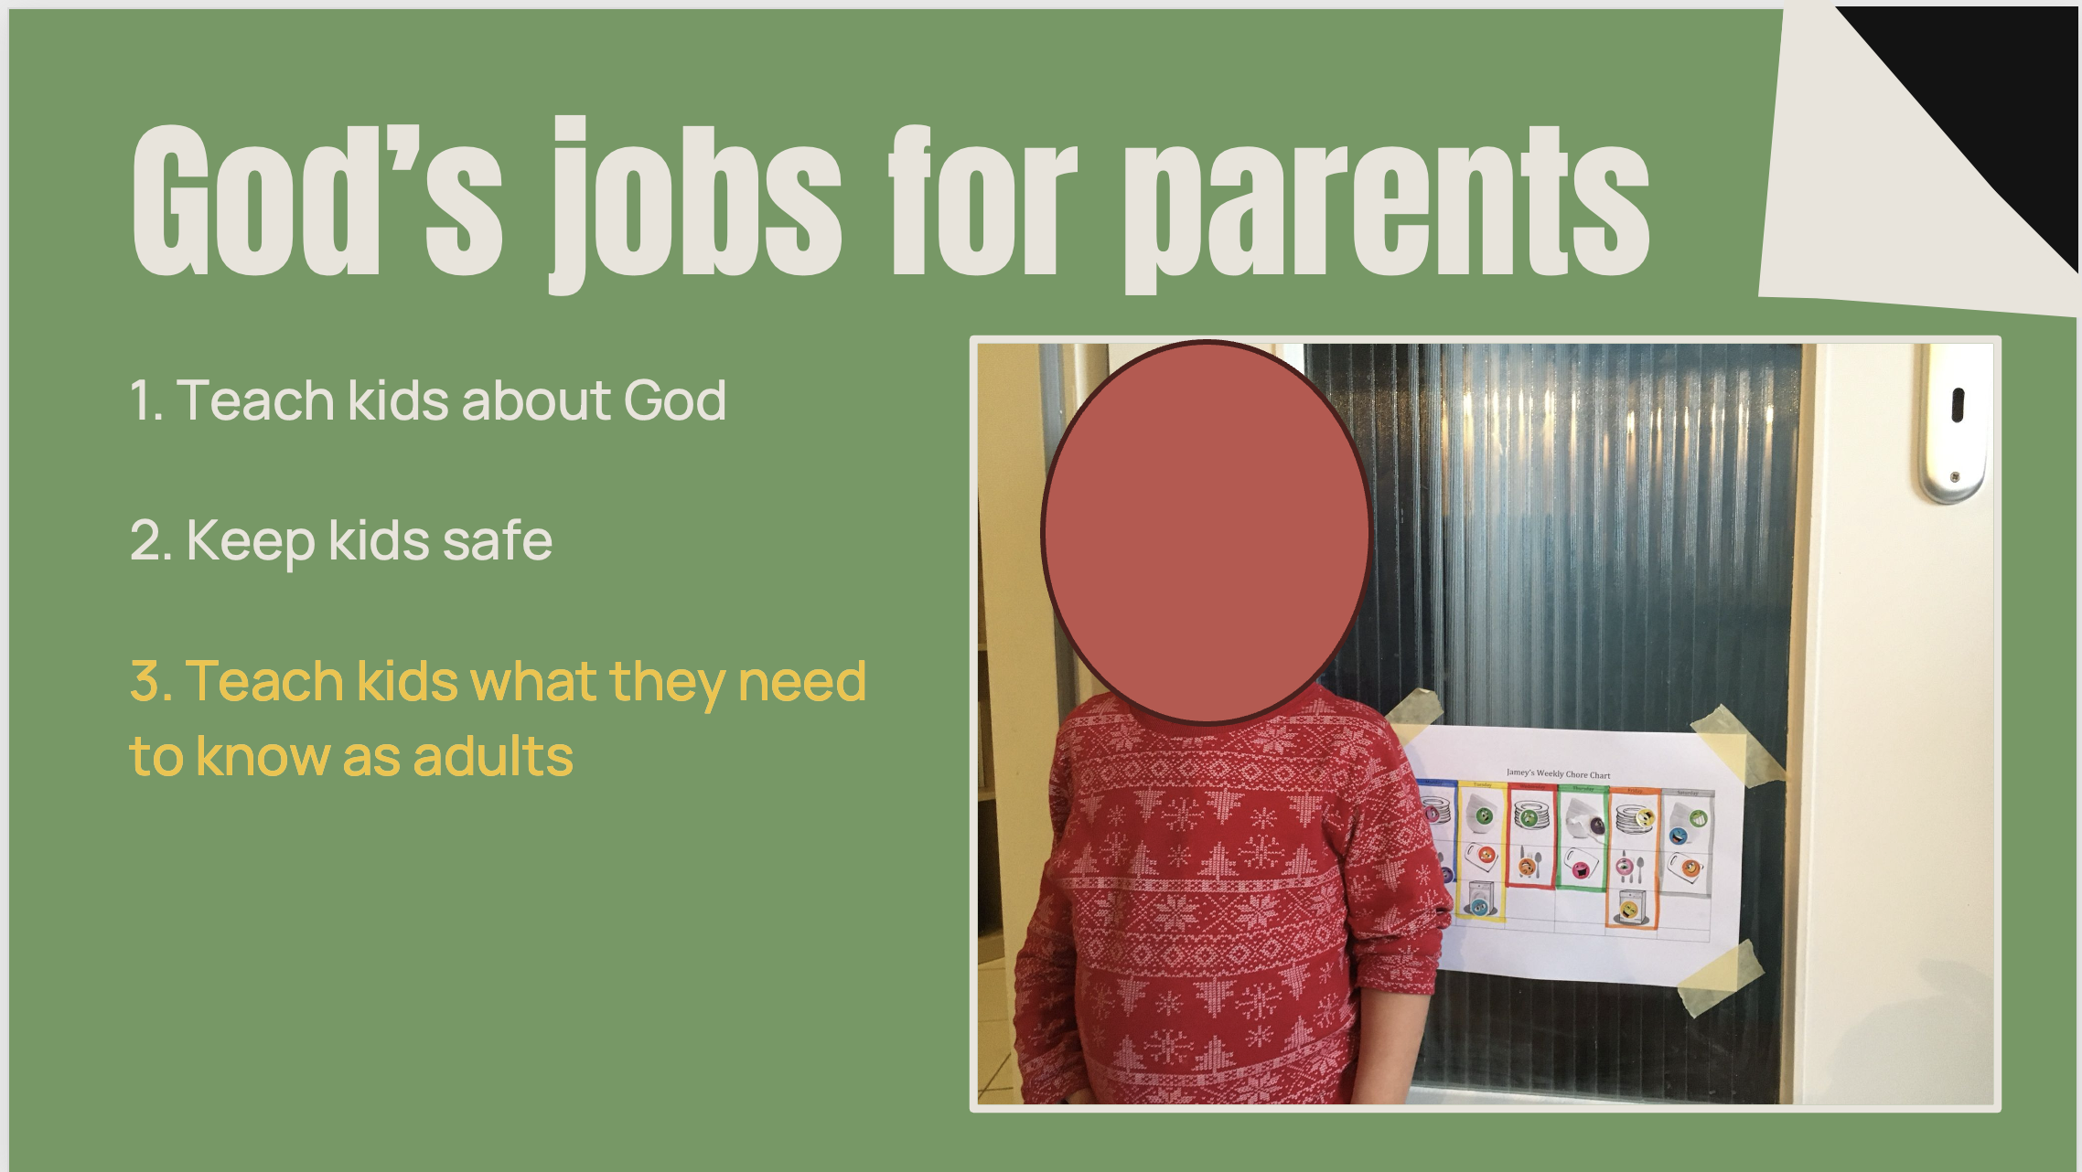
Notes:
So we started chores once Jamey was able to comfortable/safely walk while carry things. Here his Jamey next to his first little chore chart. He got a sticker every time he completed a task.
However, I will be honest, the “joy” of getting stickers quickly wore off. Then our chore list became a mandatory task list that he had to do each day. So it was a daily battle to get the chores done. Though there is a place for having tasks lists that we have to do, whether we like it or not, that wasn’t our goal for chores. Our goal was to be teaching life skills that we wanted Jamey have part of his daily life.
**Just as a little side note. I agree that it is very important to help our kids learn how to do things they don’t want to do, like chores. However, we’ve found (in our experiences so far) that life gives us MANY opportunities to teach this already. We don’t have to manufacture situations to teach this. It comes up very often on it’s own. And again, our goal with chores was to help Jamey adopt healthy life habits.
So as we were thinking this through we decided to switch from having a list, to doing routines.

Slide 13
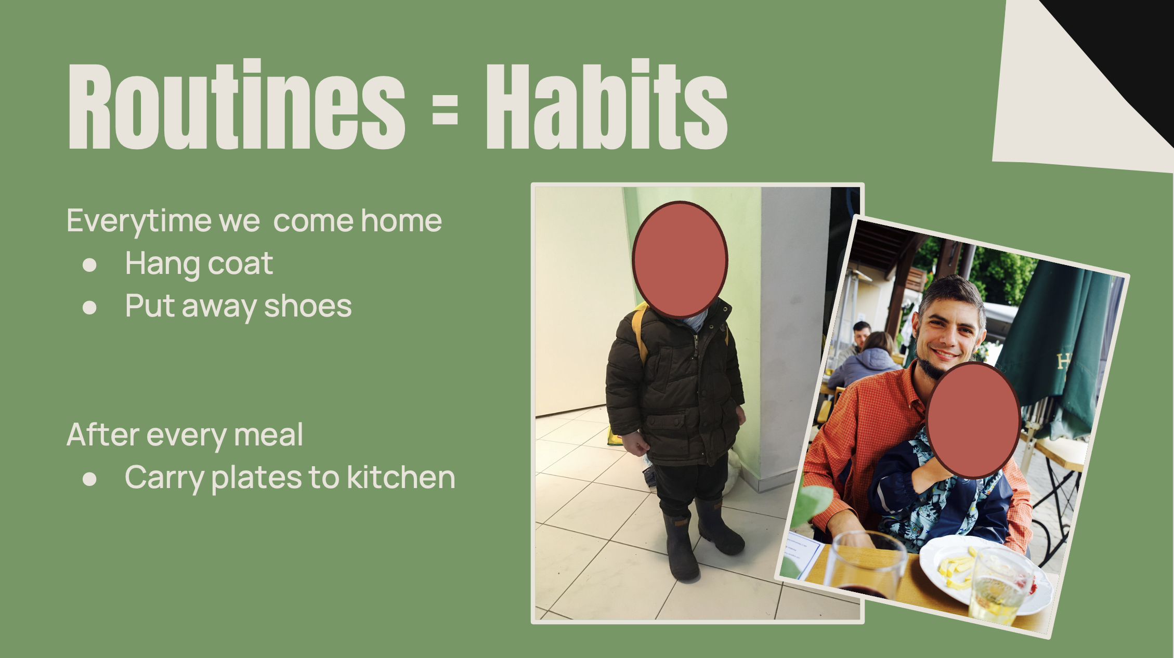
Notes:
So we started chores once Jamey was able to comfortable/safely walk while carry things. Here his Jamey next to his first little chore chart. He got a sticker every time he completed a task.
However, I will be honest, the “joy” of getting stickers quickly wore off. Then our chore list became a mandatory task list that he had to do each day. So it was a daily battle to get the chores done. Though there is a place for having tasks lists that we have to do, whether we like it or not, that wasn’t our goal for chores. Our goal was to be teaching life skills that we wanted Jamey have part of his daily life.
**Just as a little side note. I agree that it is very important to help our kids learn how to do things they don’t want to do, like chores. However, we’ve found (in our experiences so far) that life gives us MANY opportunities to teach this already. We don’t have to manufacture situations to teach this. It comes up very often on it’s own. And again, our goal with chores was to help Jamey adopt healthy life habits.
So as we were thinking this through we decided to switch from having a list, to doing routines.

Slide 14
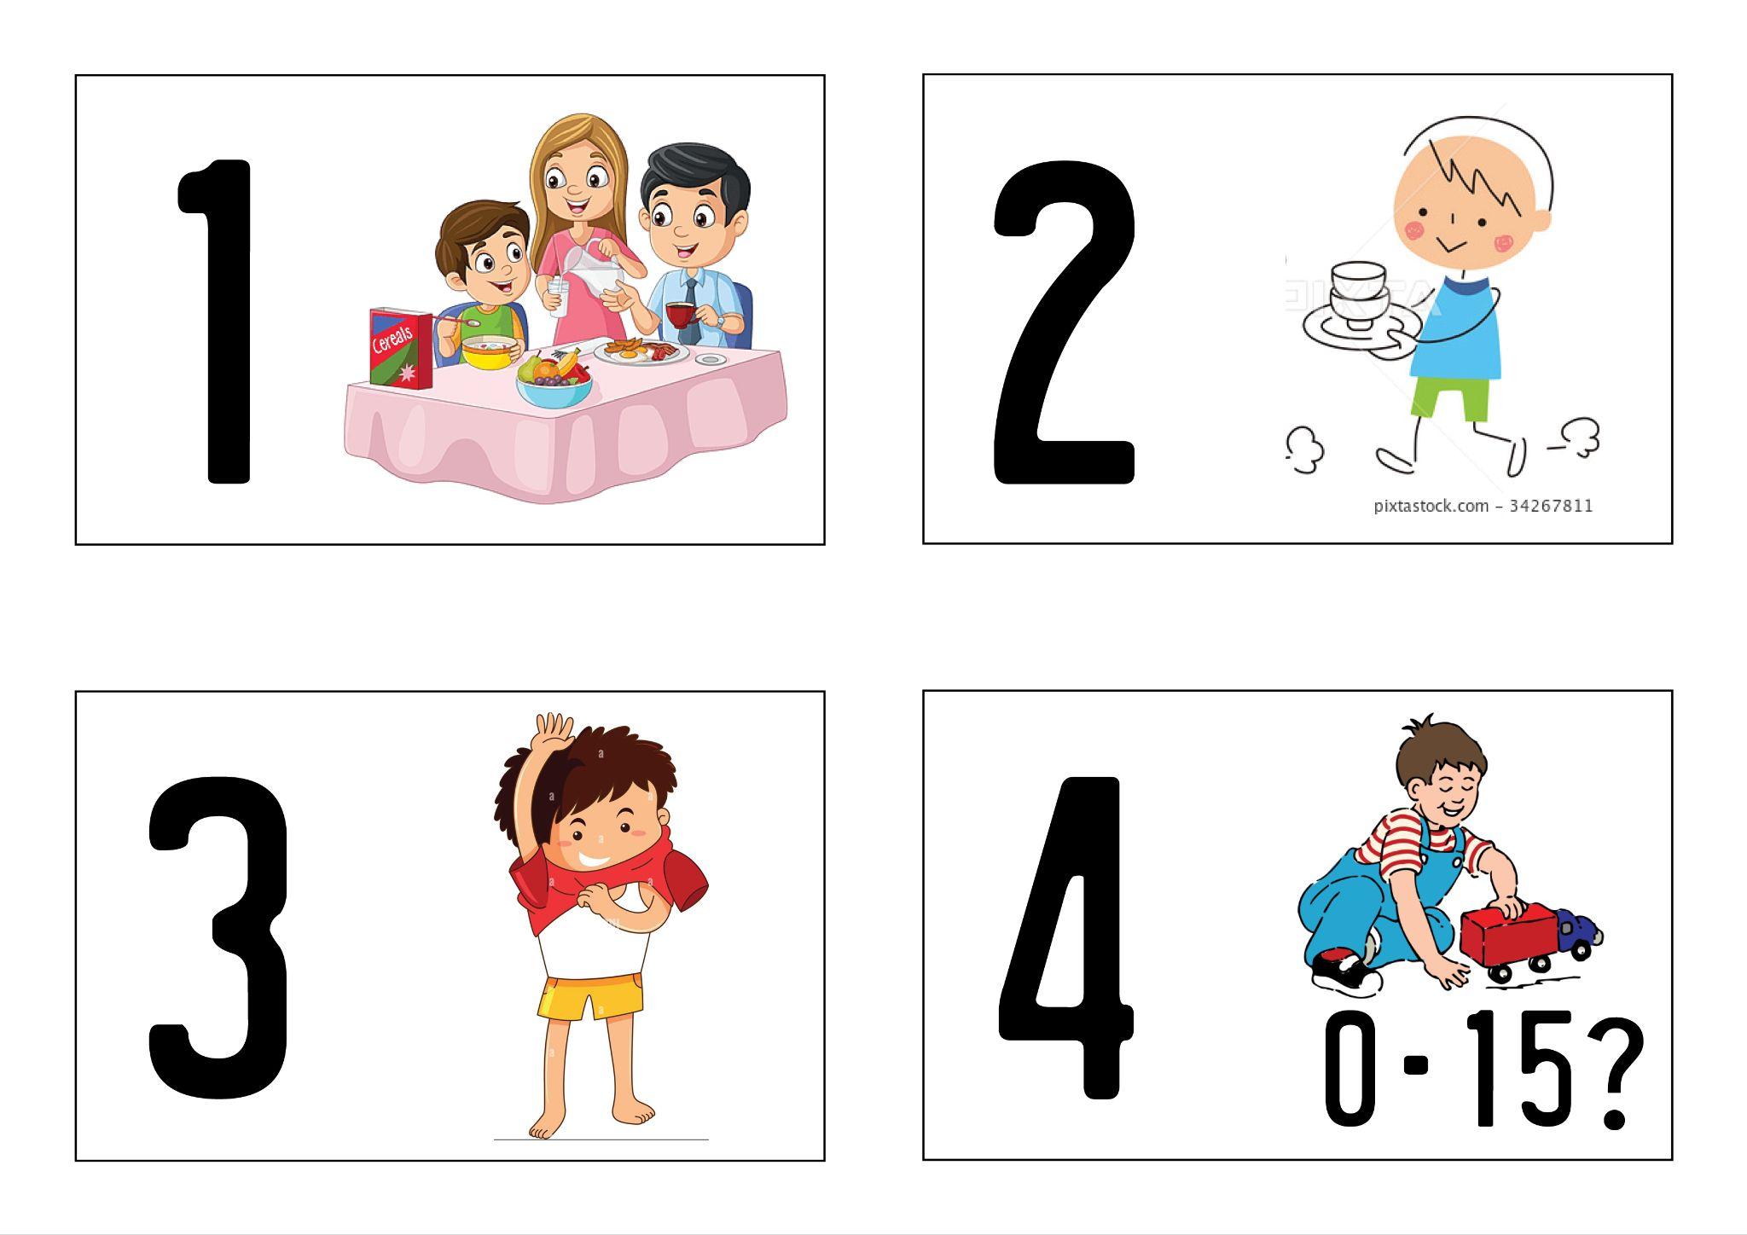
Routines = Habits
Each new chore we teach is always adding to a routine
Notes:
Once school started the routines became more complex/longer.
We usually had/have a lot of protests when first learning a routine. But if we break them into small manageable chunks it is easier. This also why we add new chores slowly! We we get to the motivation part in a minute.

Slide 15
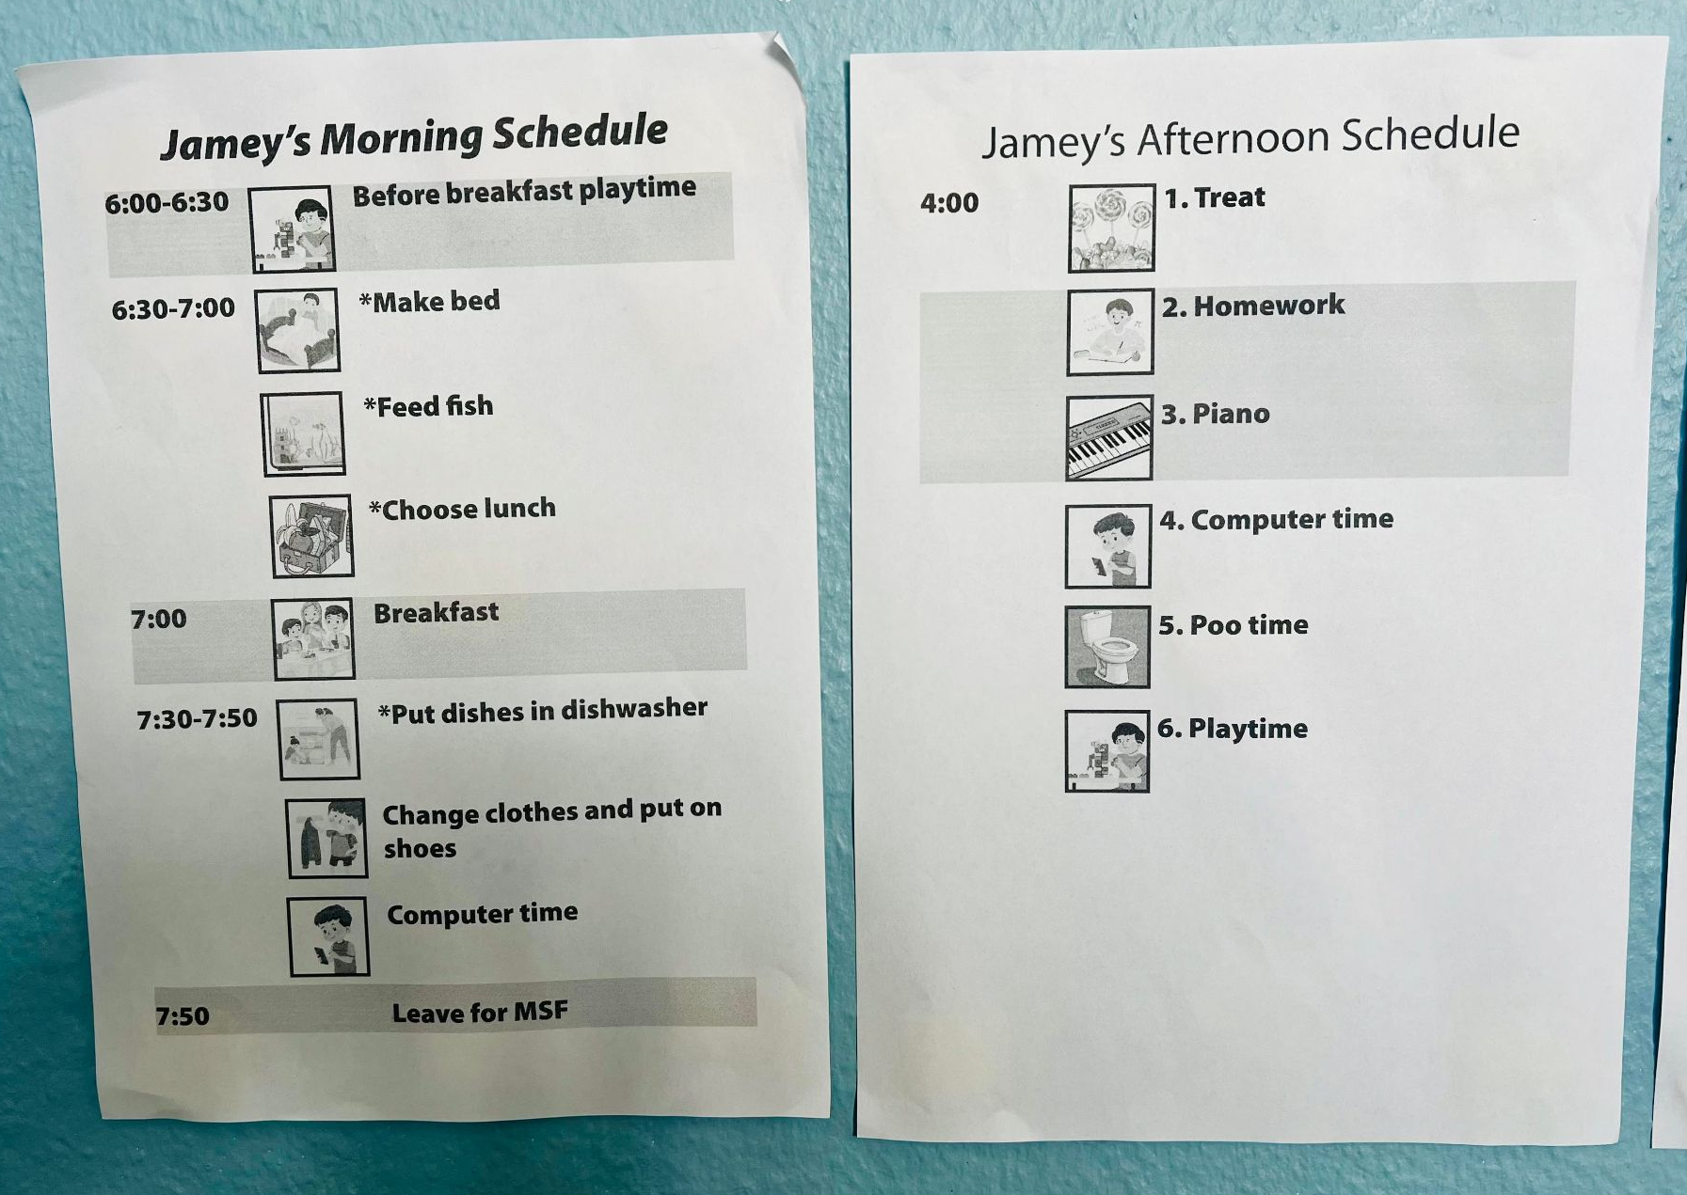
Routines = Habits
Each new chore we teach is always adding to a routine
Notes:
This is the list now

Slide 16
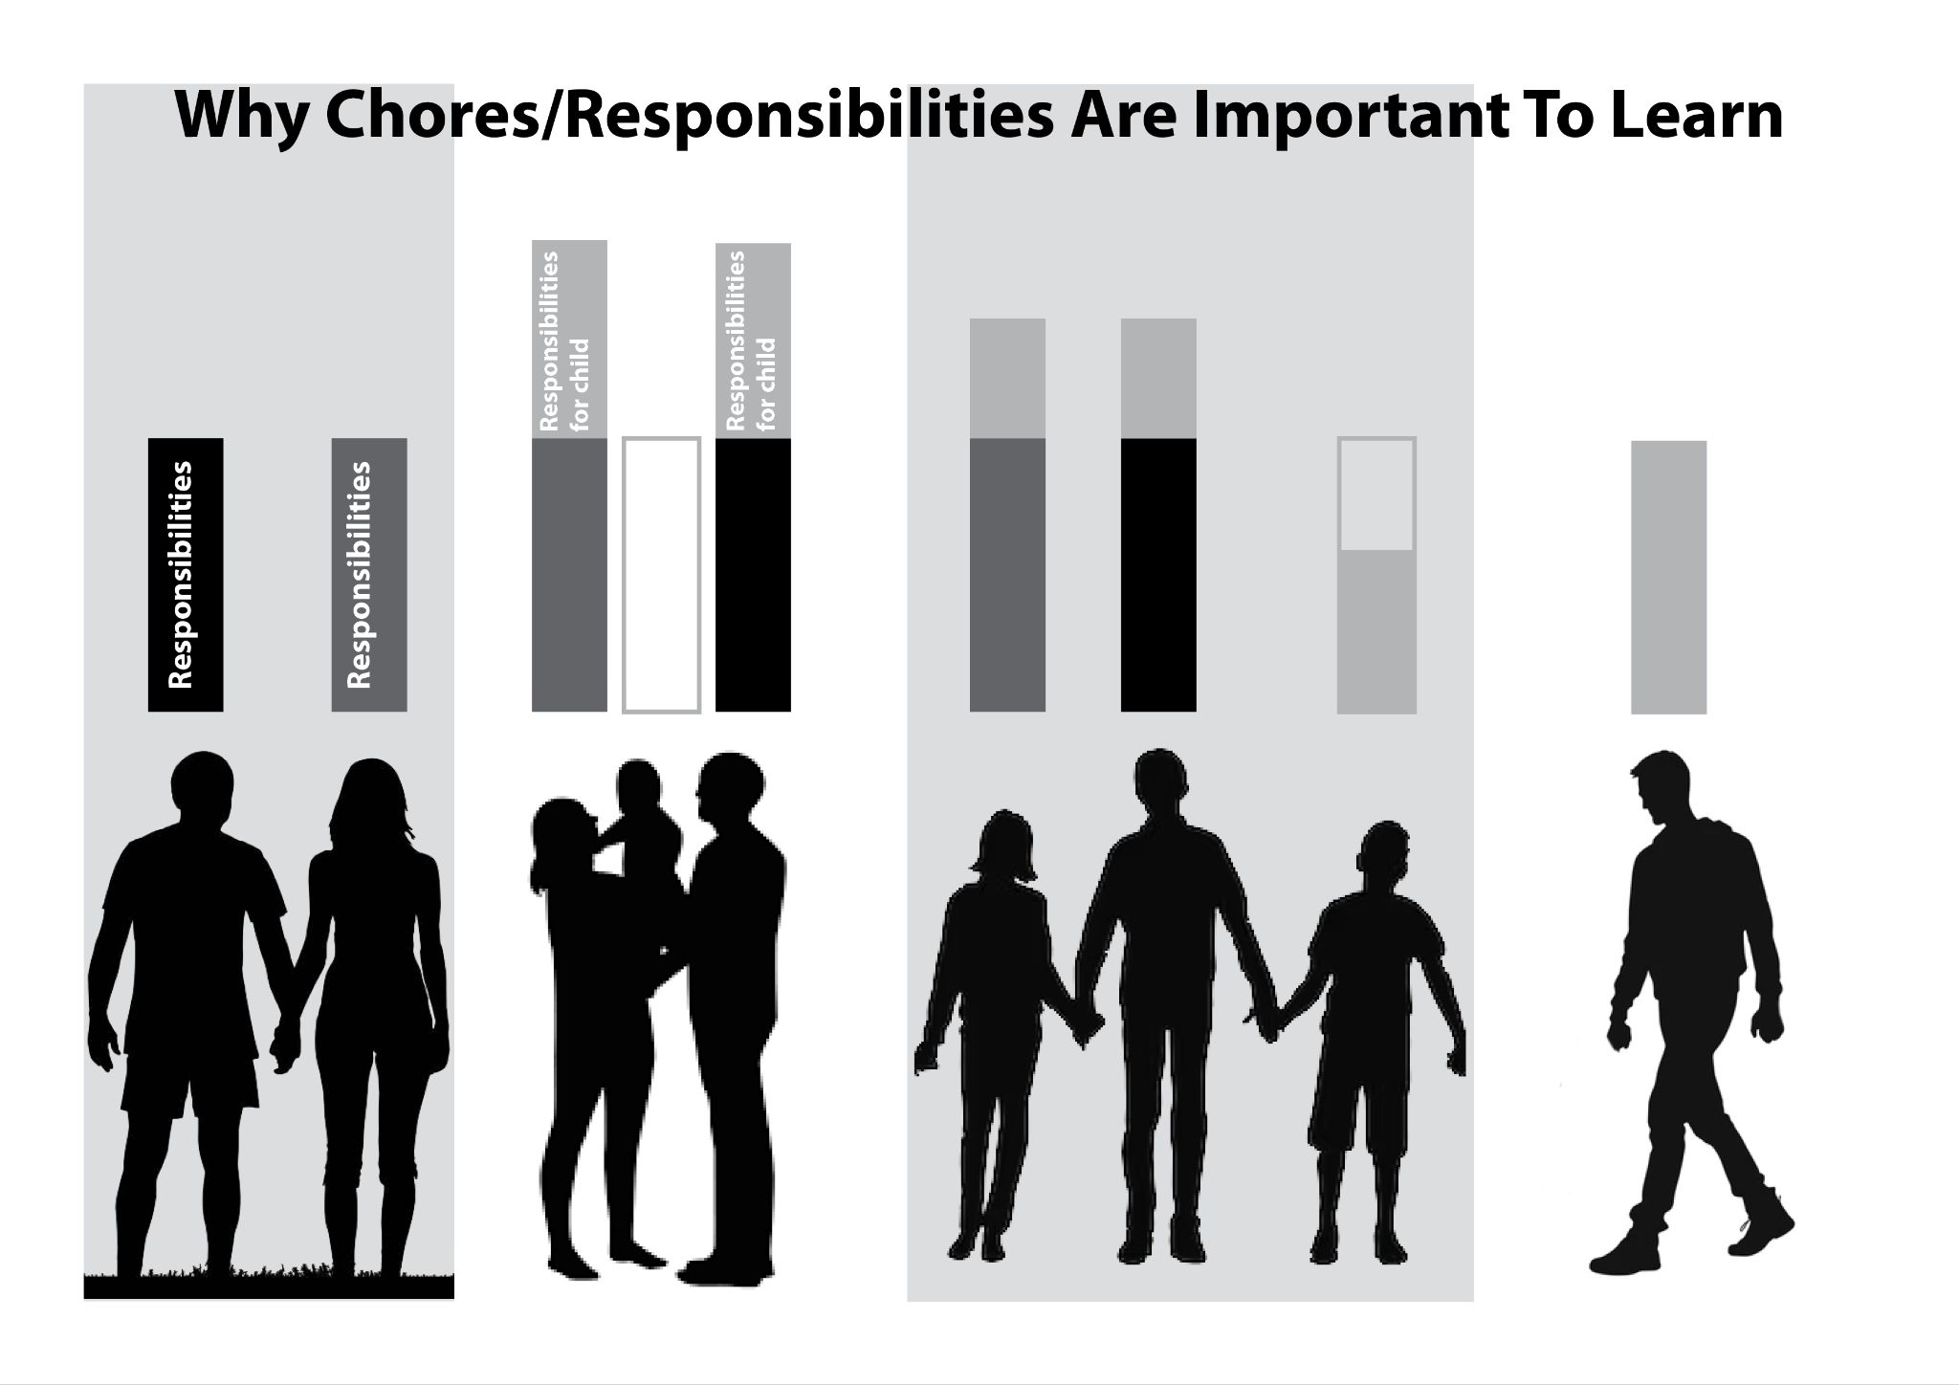
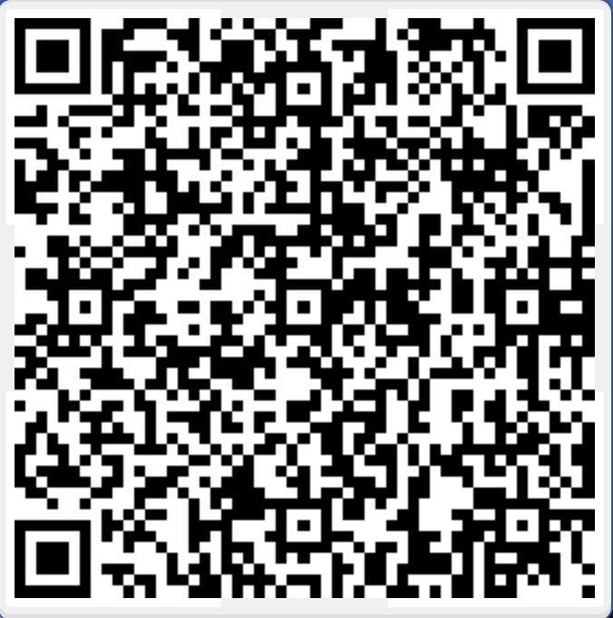
Explaining the “why” on chores
Notes:
Before we jump into how to help motivate your kids, I want to make a little side note on explaining the “why” of chores to your kids. Again, this is a springboard moment, where I am sharing how we did it to help give you ideas for how to talk to your kids. But ultimately how you do it, is between y’all and God.
But Jamey often asks the why’s for things, because he is super logical little guy and it really helps him in his obedience if he understands “why.” It also helps us have lots of great theological conversations if we make ourselves a safe place to ask “why.”
So thinking of chores as life skills, explain the chart.

Slide 17

Positive Rewards vs. Bribing
Notes:
I want to finish up this section by talking about motivating. How to help motivate your kids to learn these new habits.
So as an adult, when you want to start a new healthy habit (such as going to the gym regularly) does just muscling through and forcing yourself to go work? Does forcing yourself to do a task list help you build this habit? Let’s be honest, for adults this basically never works. Instead we give ourselves positive reinforcements, goals and encouragements to build a habit. I think this is the same for “little humans.” They aren’t different from us in this way.
However, if we have some
positive reinforcements
goals
celebrations when those goals are reached,

Slide 18
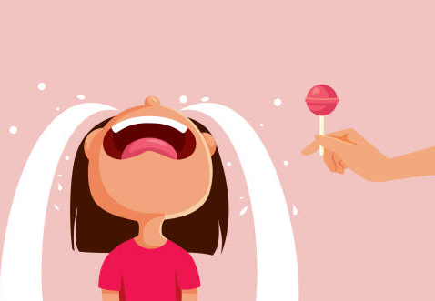

Positive Rewards vs. Bribing
Notes:
So we decided to do this with Jamey. Where he a goal he was working towards and when he reached it we celebrated with a reward.
Now, I’m guessing that this might be sending off red flags, “Oh no! You should never bribe your kids!” But I want to talk about the difference between bribing and celebrating.
Bribing: Is trading a treat for a desired action. It’s instantaneous, “if you do this, then you get this” It’s not celebrating a right choice, but rather manipulating the child to get them to do what you want. There is also no end point that is designated.
Celebrating: When a child makes a series of right choices, then you celebrate those actions with a reward. The reward is a one time treat for achieving a goal. So an end date is set.

Slide 19
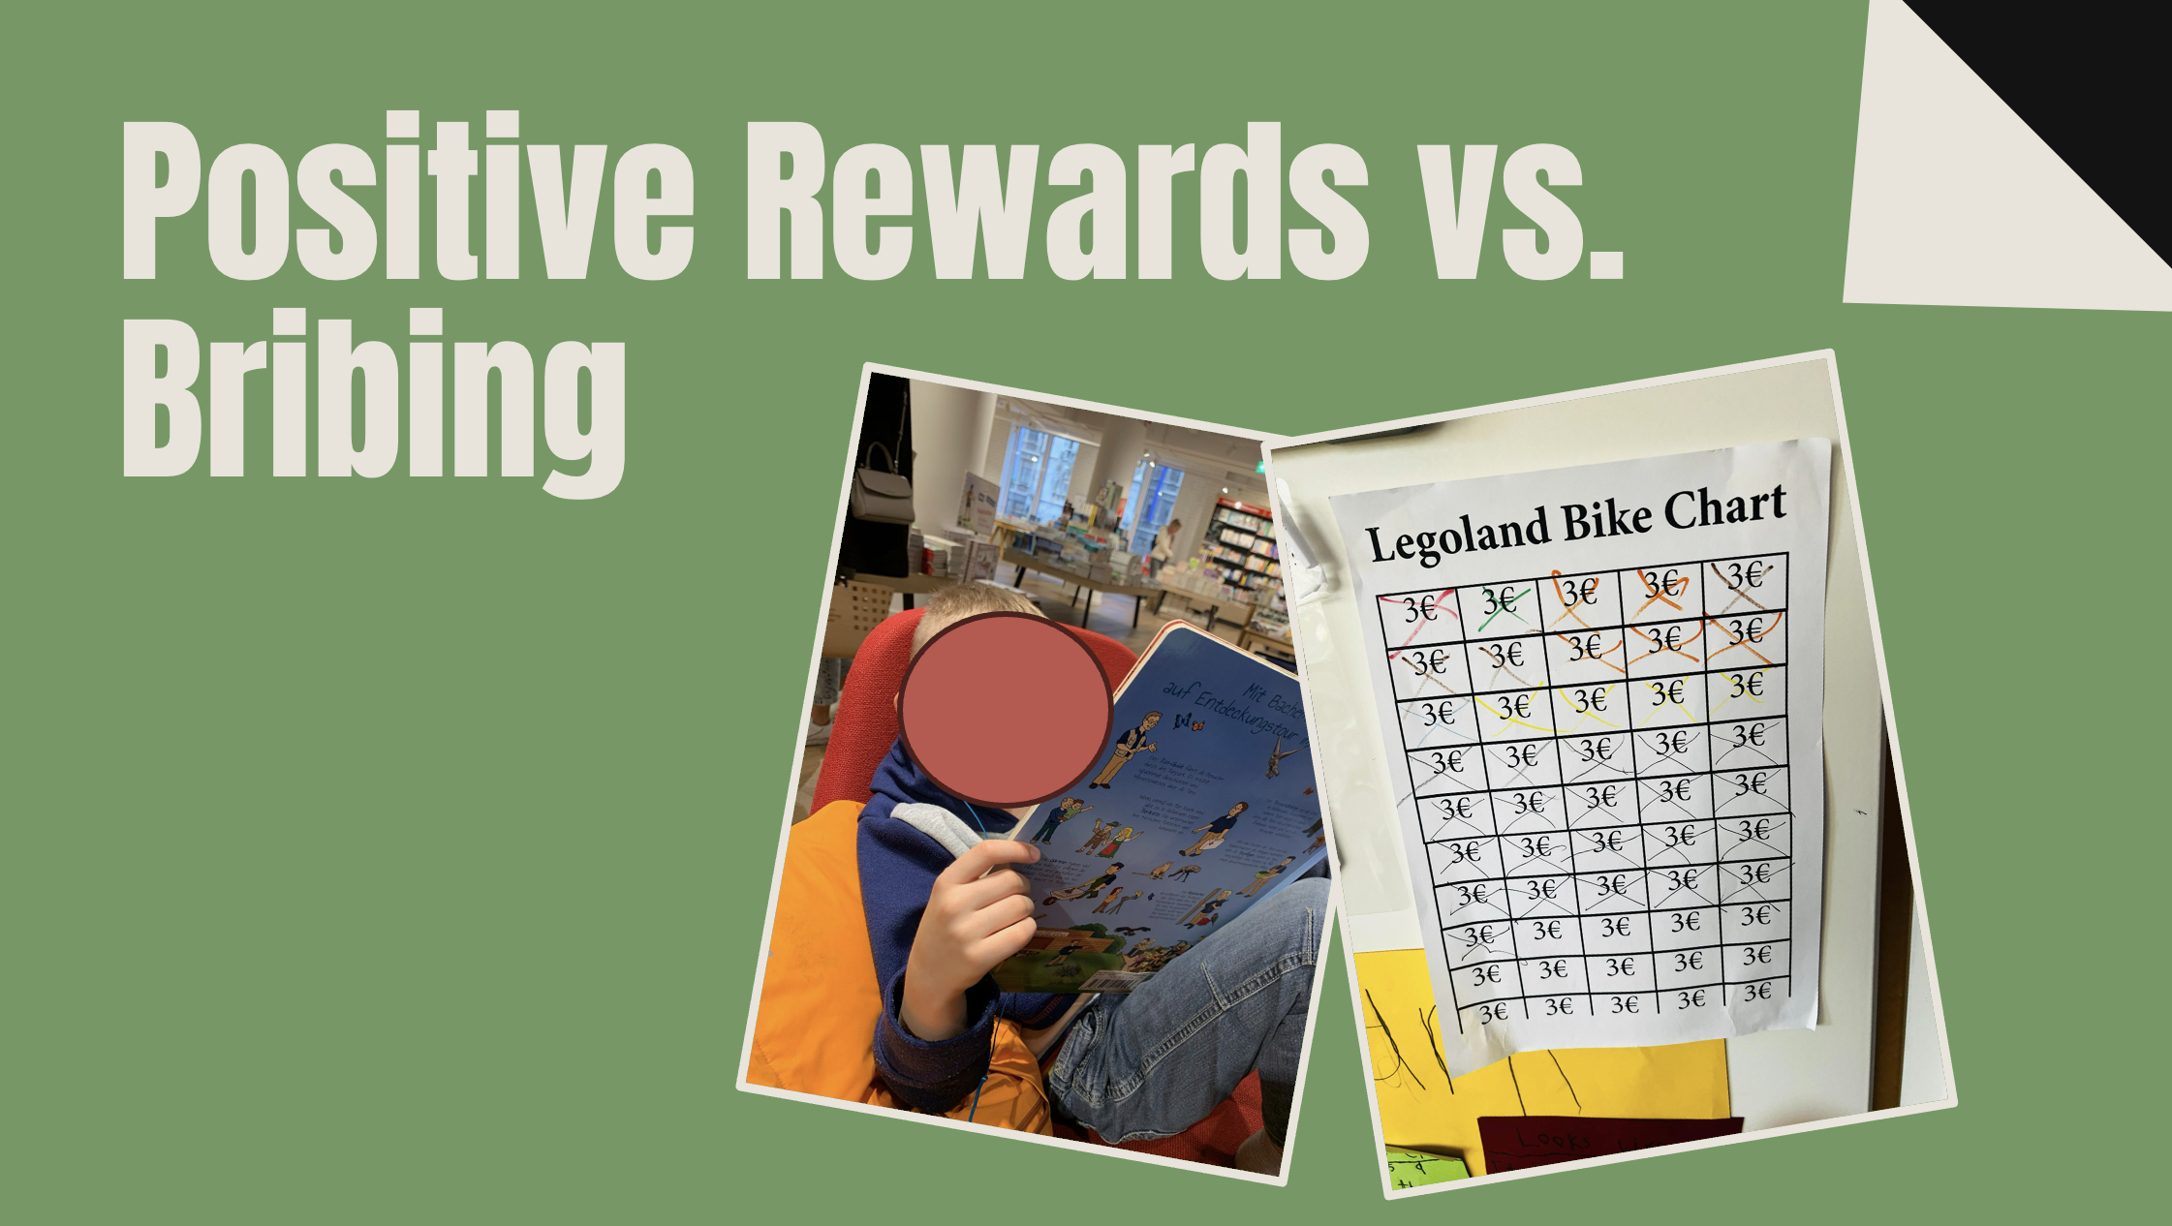
Notes:
So each time, Jamey is learning a new routine/skill, we set a goal for him, using a point system. He got a point every time he successfully did a the new skill. Note: this was only when he did the “new skill!” not every chore or task. Just the new one. When he earned 10 points (when he was little), 30 points as he got older. He would receive a reward. Usually a new book (cheap item, and dependant on the age of the child for how long term the goal is).
The ideas was that he would earn points until he had mastered the skill/it was a habit. Then we would stop the point system until the next skill was added.
Interestingly enough this worked great and the points faded off naturally. By the time the skill became a habit, he lost interest in the rewards, but the skill/habit continued. So if you are worried that this be a huge battle at the end of each goal, I just want to encourage you, that will probably not happen.

Slide 20
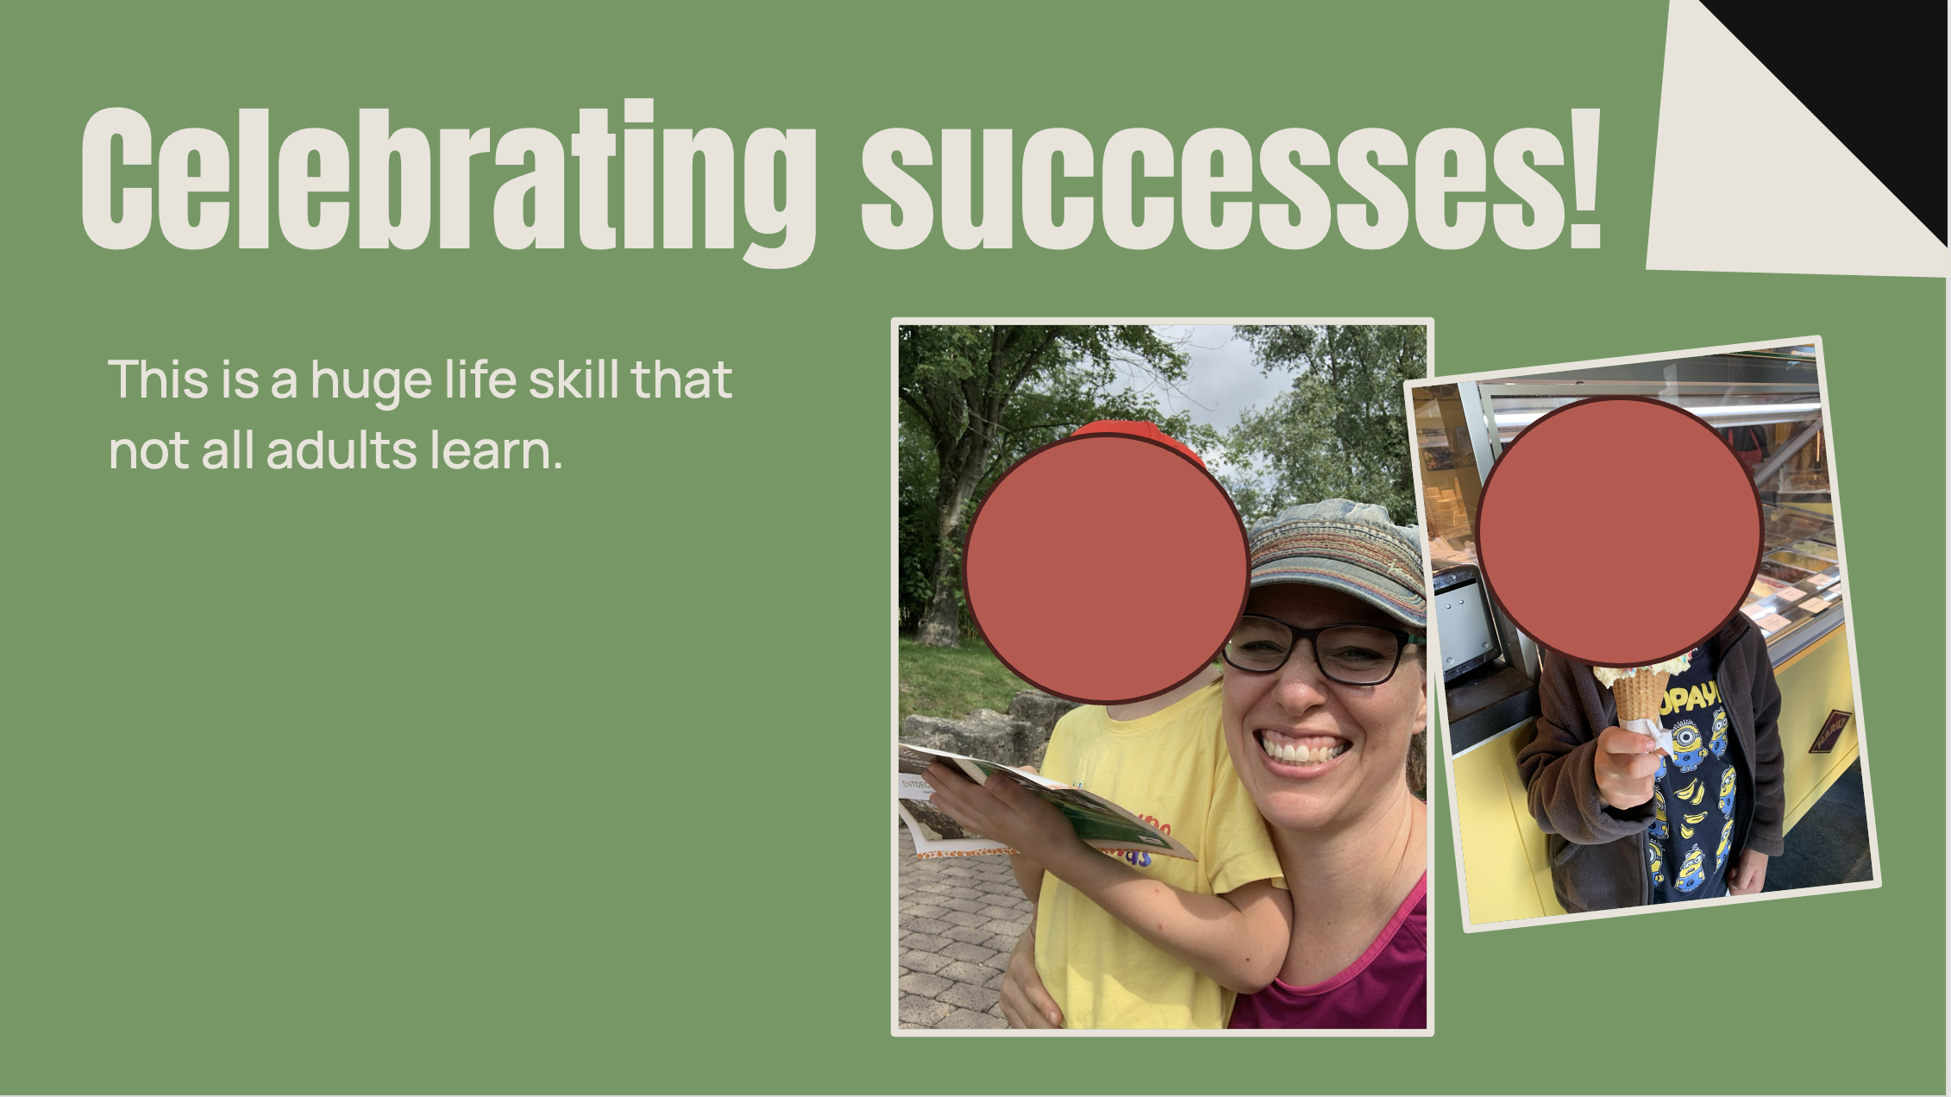
Notes:
So each time, Jamey is learning a new routine/skill, we set a goal for him, using a point system. He got a point every time he successfully did a the new skill. Note: this was only when he did the “new skill!” not every chore or task. Just the new one. When he earned 10 points (when he was little), 30 points as he got older. He would receive a reward. Usually a new book (cheap item, and dependant on the age of the child for how long term the goal is).
The ideas was that he would earn points until he had mastered the skill/it was a habit. Then we would stop the point system until the next skill was added.
Interestingly enough this worked great and the points faded off naturally. By the time the skill became a habit, he lost interest in the rewards, but the skill/habit continued. So if you are worried that this be a huge battle at the end of each goal, I just want to encourage you, that will probably not happen.

Slide 21
Disciplined Humans
helping kids face up to their sinful natures
Two easy roads &
a hard one
A battle of the will
Notes:
We read earlier that we are to discipline our kids without provoking them. But how should we discipline them?
I’m going to suggest that our children become provoked when we use inappropriate means to try to control them.

Slide 22
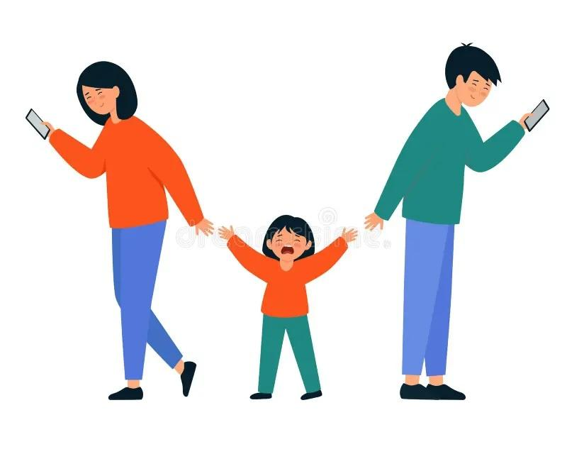
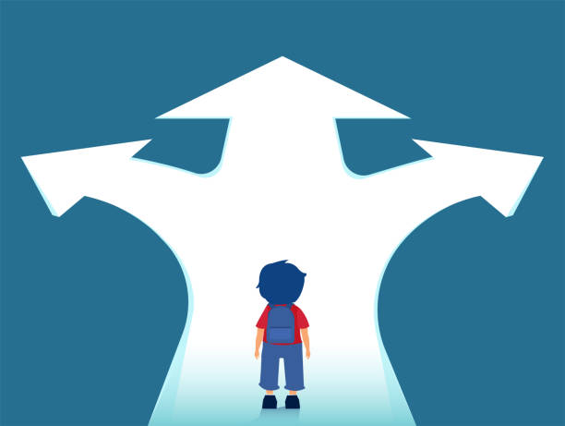
The two easy roads and a hard one
avoidance
Notes:
Both of the easy roads have to do with the ways I try to control my child’s behavior in the moment.
One road is the avoidance road: avoiding conflict with the child and avoiding spending emotional energy. It’s not putting in the work to enforce the rules you’ve laid down for your child. It’s too much work to require them to obey. It’s also putting off things for the future. You tell yourself, “We can work on that skill later” – (whatever it is: getting dressed, clearing the table, picking up after themselves. Or, “They’ll learn it when they go to school.” I find it super tempting to just ignore certain things when I’m tired, or when I don’t have the emotional energy to go into a battle.) This isn’t discipline, it’s swiping a credit card: “Let me relax, I’ll pay later, pay later, pay later.”

Slide 23
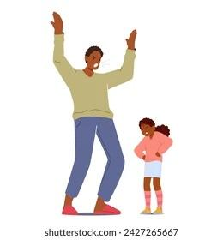
The two easy roads and a hard one
avoidance
dominance
Notes:
The other easy road is the dominance road: dominating my child in order to avoid embarrassment and feel in charge. This road maybe doesn’t sound easy, but it’s also a shortcut. Imagine a classroom back in the day of our parents or grandparents. The children are all sitting up straight in their chairs, raising their hands to ask questions, saying “Yes sir” and “Yes ma'am,” and parroting back exactly the answer the teacher dictated to them. The teacher is patrolling the room with a ruler, ready to smack anyone who’s out of line. This might not sound easy to achieve, but it takes a lot less energy and investment from the teacher than engaging in the children’s real questions, problems, and social/emotional issues. And how are those kids going to learn to think for themselves and become lifelong learners? Sadly, some homes operate this way as well. The reason this is also a lazy method of parenting is that it’s only superficial. It’s not dealing with the underlying issues, because it’s not listening to what’s actually going on in the child’s heart and mind. It also sets up the parent as someone who can do no wrong, who always saw and heard things correctly the first time, and who never needs to apologize. (Next week, when we talk about emotions, we’re going to get into why that’s unhealthy.)

Slide 24
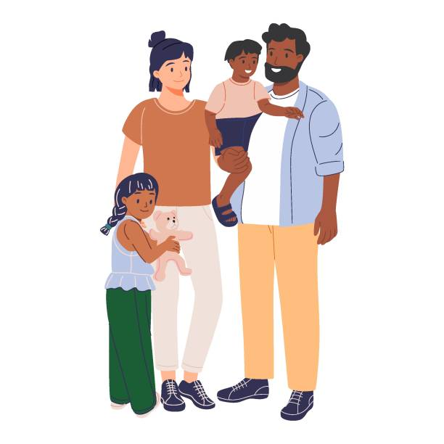
The two easy roads and a hard one
avoidance
dominance
shepherding
Notes:
The hard road is the shepherding road. It means asking, “How am I going to help my child mature as a person, even if in the moment it means hard work or embarrassment?”

Slide 25
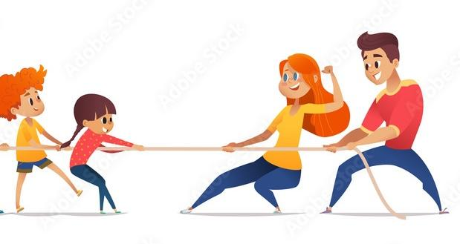
Battle of the Will
Notes:
As a parent, you might have used the phrase, It’s a “battle of the will,” when you and your child are working toward opposite goals. Who’s going to be more stubborn and determined, and who’s going to break first? But think about this: ultimately as a parent I want the child to submit to God’s will. I want them to come to the place of recognizing that their sinful nature is battling against God. They shouldn’t be thinking, “Just wait another 10 years until I’m on my own, and then I won’t have my parents telling me what to do,” but instead recognize that their whole lives long they’re faced with the decision of following God or not.
So let’s think about what we’re trying to accomplish with discipline. If my ultimate goal is to control my child’s behavior, then I’m just postponing them coming to terms with their conflict with God.
What are the different ways we might try to exert control? Let’s look first at the dominating ways of controlling.

Slide 26
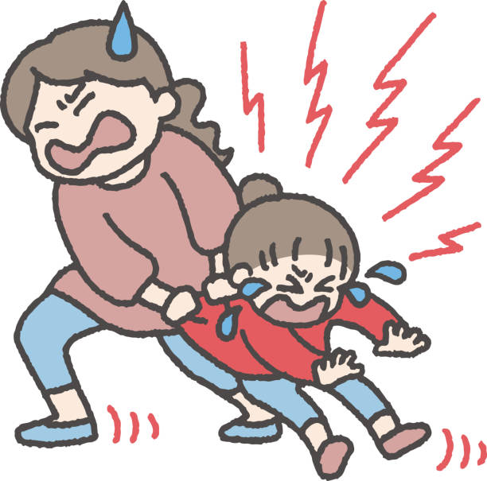

Battle of the Will
Physical Control
Notes:
- At earliest stage, there’s physical control. And for some things this is necessary. I can and I will make you take your medicine or keep you from running out into the road. But the limits of this quickly show. I can't physically force the child to eat. (Have you tried?) And the child can quickly wear me down.

Slide 27
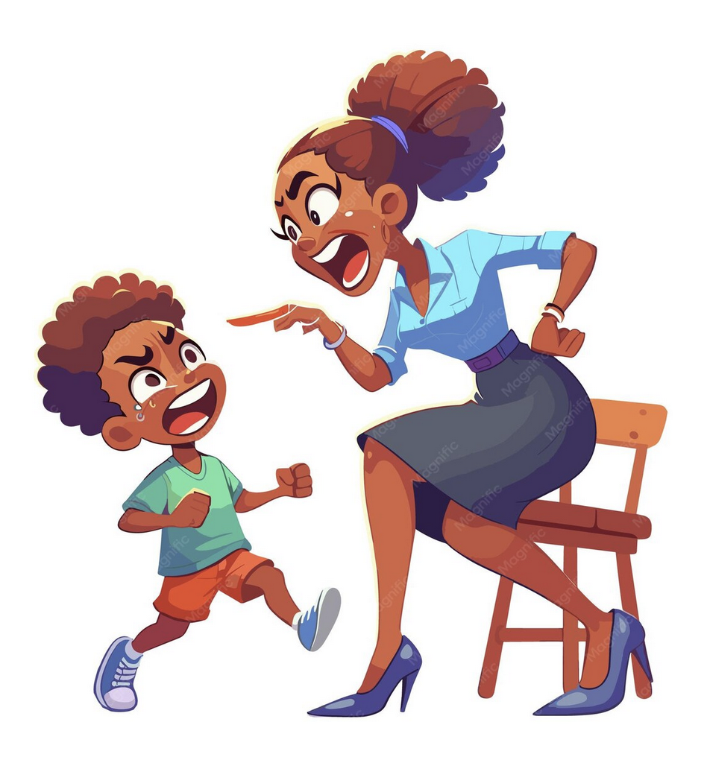
Battle of the Will
Physical Control
Fear
Notes:
- Fear: At that point I can threaten and make the child afraid of me. This is not a healthy fear of consequences for their actions, but rather scaring them into submission in the moment. This might also lead to them being afraid of what God will do to them rather than having the healthy awe and respect they should have for him. Since we’re their first authority figure, how we treat them can impact how they understand God.

Slide 28
Battle of the Will
Physical Control
Fear
Bribery
Notes:
- Then there are the avoidance ways of controlling.
- We already mentioned the difference between bribery and rewards.

Slide 29
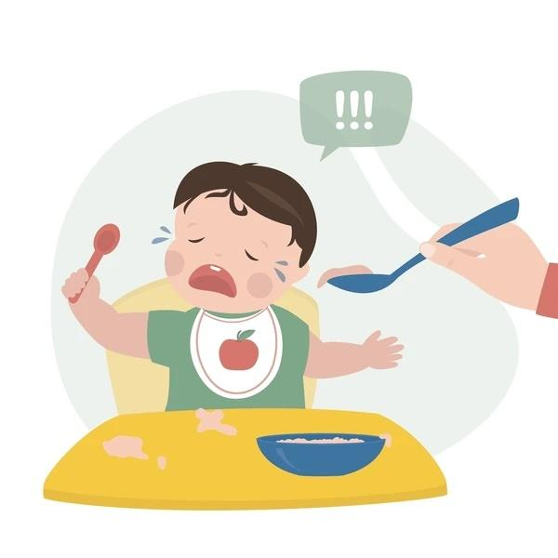
Battle of the Will
Physical Control
Fear
Bribery
Emotional Manipulation
Notes:
But here’s a really easy one to slip into: emotional manipulation. “Aww, you won't eat for Papa!? You don't love me!” We predicate our relationship with them on their behavior in ways that will train them to think our love and maybe even God’s love is dependent on their good works.

Slide 30
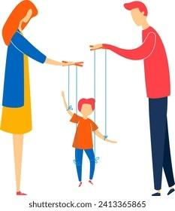
Battle of the Will
Physical Control
Fear
Bribery
Emotional Manipulation
These methods are all about the parents controlling the child rather than developing the child’s moral capacity.
Notes:
All these methods lead to the parents controlling the child. This may lead to good outward behavior in the short term. However, once the child is no longer under the parent’s guidance, they can go crazy wild or they have to teach themselves how to be an adult.
All of the above are treating them like animals instead of recognizing their God-given moral capacity.

Slide 31

Notes:
If your child grows up to be someone who holds the nuclear codes, what do you want them thinking in that moment when their finger’s over the button? “Will Daddy be angry with me if I do this? Will he still love me? Will I still get that ice cream cone?” (No, you want them thinking, “What is my responsibility before God?”)

Slide 32
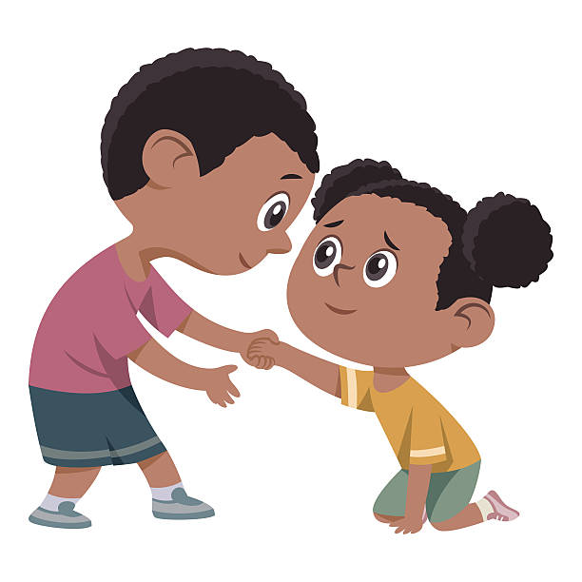
Battle of the Will
Appeal to the will
Notes:
- Instead of using these methods to control my child, what I want is for my discipline to make an appeal to his will. What I mean by that is not that the discipline is optional, but to acknowledge that he has a moral choice that affects his relationships (with me and with God). That choice will have consequences. For now these consequences are ones I set or at least filter, but they stand for real-life ones. I want the kinds of consequences that I impose or that he naturally faces to be ones that make him think about the path he is choosing before God.
This appeal to the will does some really important things:

Slide 33
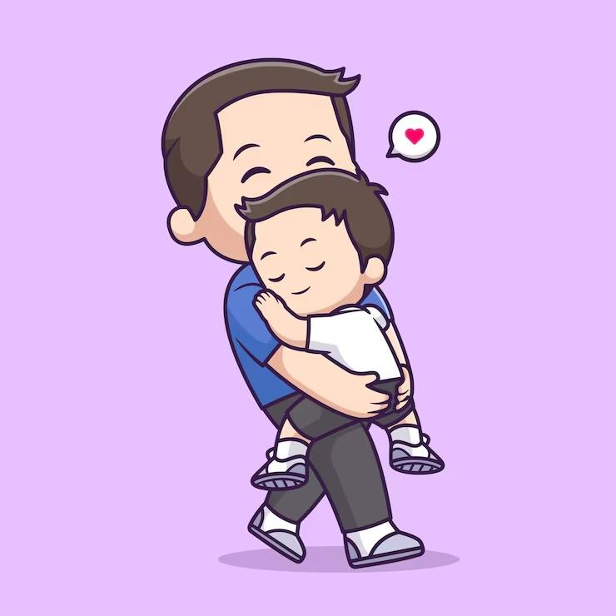
Battle of the Will
Appeal to the will
Paves the way to repentance
& forgiveness
Notes:
- It paves the way to repentance and forgiveness, as I’m talking with the the child about choices and consequences and matters of the heart.

Slide 34
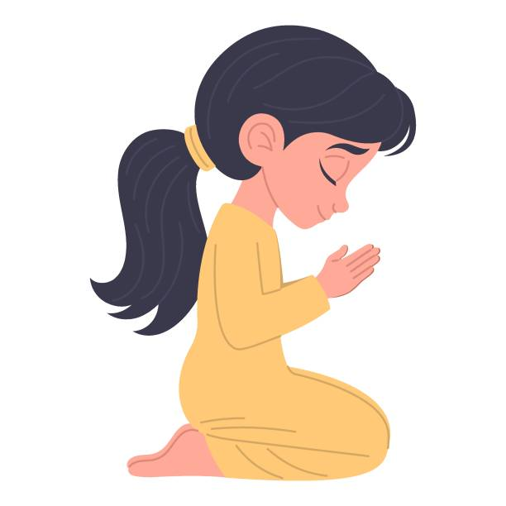
Battle of the Will
Appeal to the will
Paves the way to repentance & forgiveness
Recognize their need for God
Notes:
- Ultimately through this process we hopefully help them come to realize that they are sinful, we are sinful, we feel powerless to change ourselves, and our sin does real-life damage to others and ourselves. That’s where they have the opportunity to understand the Gospel. In those discipline moments, we’re talking about those things, and I’m praying that the Holy Spirit is working to convict of sin and to help them understand on a heart level what Jesus has done for them.

Slide 35
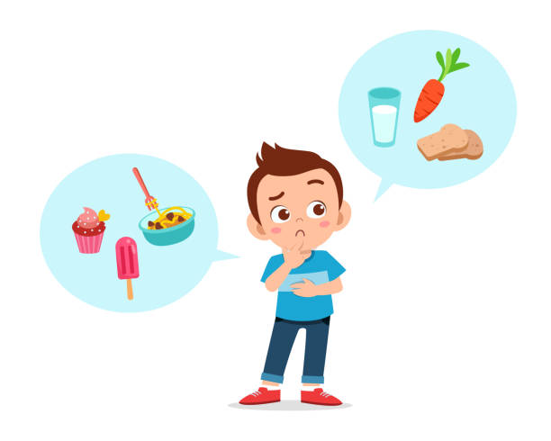
Battle of the Will
Appeal to the will
Paves the way to repentance & forgiveness
Recognize their need for God
Develops self-control
Notes:
The habits this kind of discipline develops are ones of self-control. As they are able, in larger and larger ways, they learn to control themselves instead of me controlling them. Lord-willing, this is a self-control that’s not legalistic – not motivated out of the desire to show oneself better than everybody else – but is the fruit-of-the-Spirit self-control that is part of God’s sanctifying work through repentance and transforming grace.
It feels like a risky strategy because they may not ultimately choose to respond to God’s work. But it would be worse for us not to acknowledge that they have a choice. As parents, we can’t make that choice for them, but we can provide them with all the opportunities, knowledge, and tools to choose to receive the Gospel and accept God’s transforming work in their hearts.

Slide 36
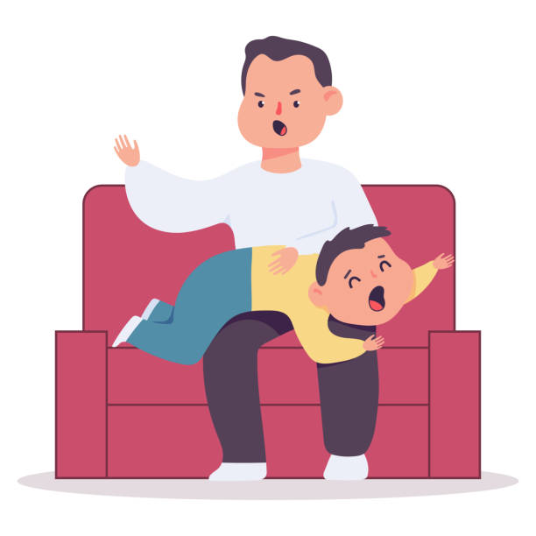
Spare the rod, spoil the child?
Notes:
When it comes to enforcement, we’ll share a couple of methods in a bit, but we hope you can take away some principles.
First, though, let’s get one thing out of the way. Who here has heard the saying, “Spare the rod, spoil the child.” This is actually not in the Bible, but it sounds similar to Prov. 13:24. (Could someone please read that?)
News flash: The Bible does not command you to spank your children. There are 2 reasons this verse should not be taken as a command to spank:
Read it in the context of the book. Proverbs is a collection of sayings that are intended to teach wisdom. They are not commands like the commandments God gave to Moses on Sinai. They are wise principles or observations to reflect on, often using concrete images to teach us about something general, e.g., “Discipline is a form of love, and not disciplining your child is neglecting them.”
Read it in the context of the genre. Hebrew poetry has verses with two or three parts that play off each other. Here it’s a contrast. The opposite of “sparing the rod” is not spanking your child three times daily. It’s being “diligent to discipline.” That means putting in the thought and energy to train your child and being consistent.

Slide 37

All Discipline Should Include:
Never out of anger
Always in private
Never injuring the child
Always reconciling afterward
Notes:
The discipline methods that are appropriate and effective depend quite a bit on your individual child. We’ve chosen not to spank. But if you do spank, make sure you do it in the same parameters that are appropriate for all forms of discipline: never out of anger, always in private, never injuring the child, and always reconciling afterward.
Pass off to Tiff

Slide 38
All Discipline Should Include:
Never out of anger
Always in private
Never injuring the child
Always reconciling afterward
Whenever possible ask “why?” and really listen to the answer.
Notes:
Hey all, I would add one more item to this list.
Whenever possible, ask why, and really listen to the answer? This is to help put in a safe guard because we parents aren’t perfect.
When disobedience happens stop to check the source. Is it lack of focus (neurodiversity) or lack of will. The response to both is very different.
Know the whole story before you pass judgement.
Have you ever been in a situation where someone passed a snap judgement on you that wasn’t fair, and you didn’t have a chance to defend yourself. It’s SOOOOOO frustrating, right? If you jump in and pass judgement, you can cause a lot of resentment and frustration (rightfully so). However, if you take the time to ask some questions and make sure your fully understand the situation, it makes a huge difference.
Example: Your kid, Amy, hit Jessie. Before you punish the hitting, you ask why. Then you find out that Jessie had promised to sit with Amy at lunch, but then chose to sit with Susie. After lunch, Amy confronted Jessie and hit her. Ok, you can give a very different reaction. This is not a just a poor choice, this is a choice made out of hurt and anger.
So first, acknowledge the hurt. “I’m so sorry that this happened. It wasn’t ok that Jessie broke her promise. Let’s go talk to Jessie after we’re done here.”
Then talk about the bad choice: “Was hitting the right way to let out your anger? What was a better way to respond? There is be a time-out later.”
You’ve communicated to Amy:
that you love and care about her
That you are not assuming the worst about her
That you want to hear when she’s hurting and will help her process that or talk to Jessie about it
And your helping her recognize that she made a bad choice in hitting.
That is what shepherding.

Slide 39
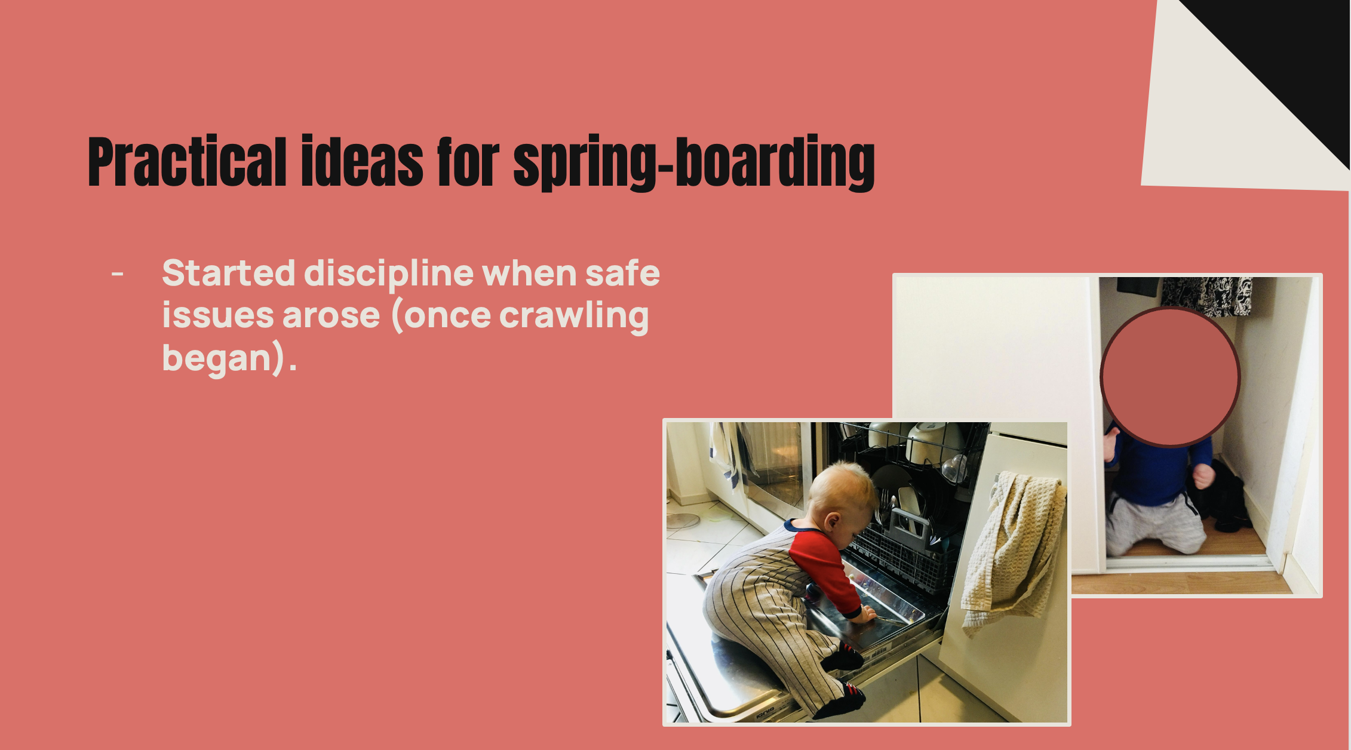
Notes:
Ok, I have a few more ideas to help with springboarding.

Slide 40
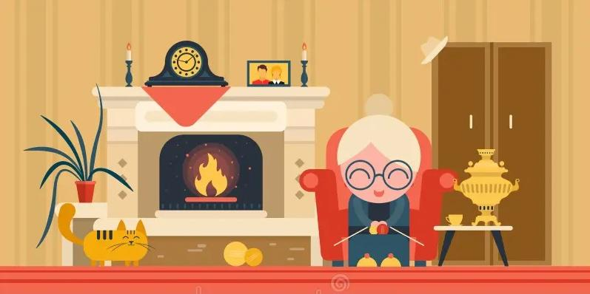
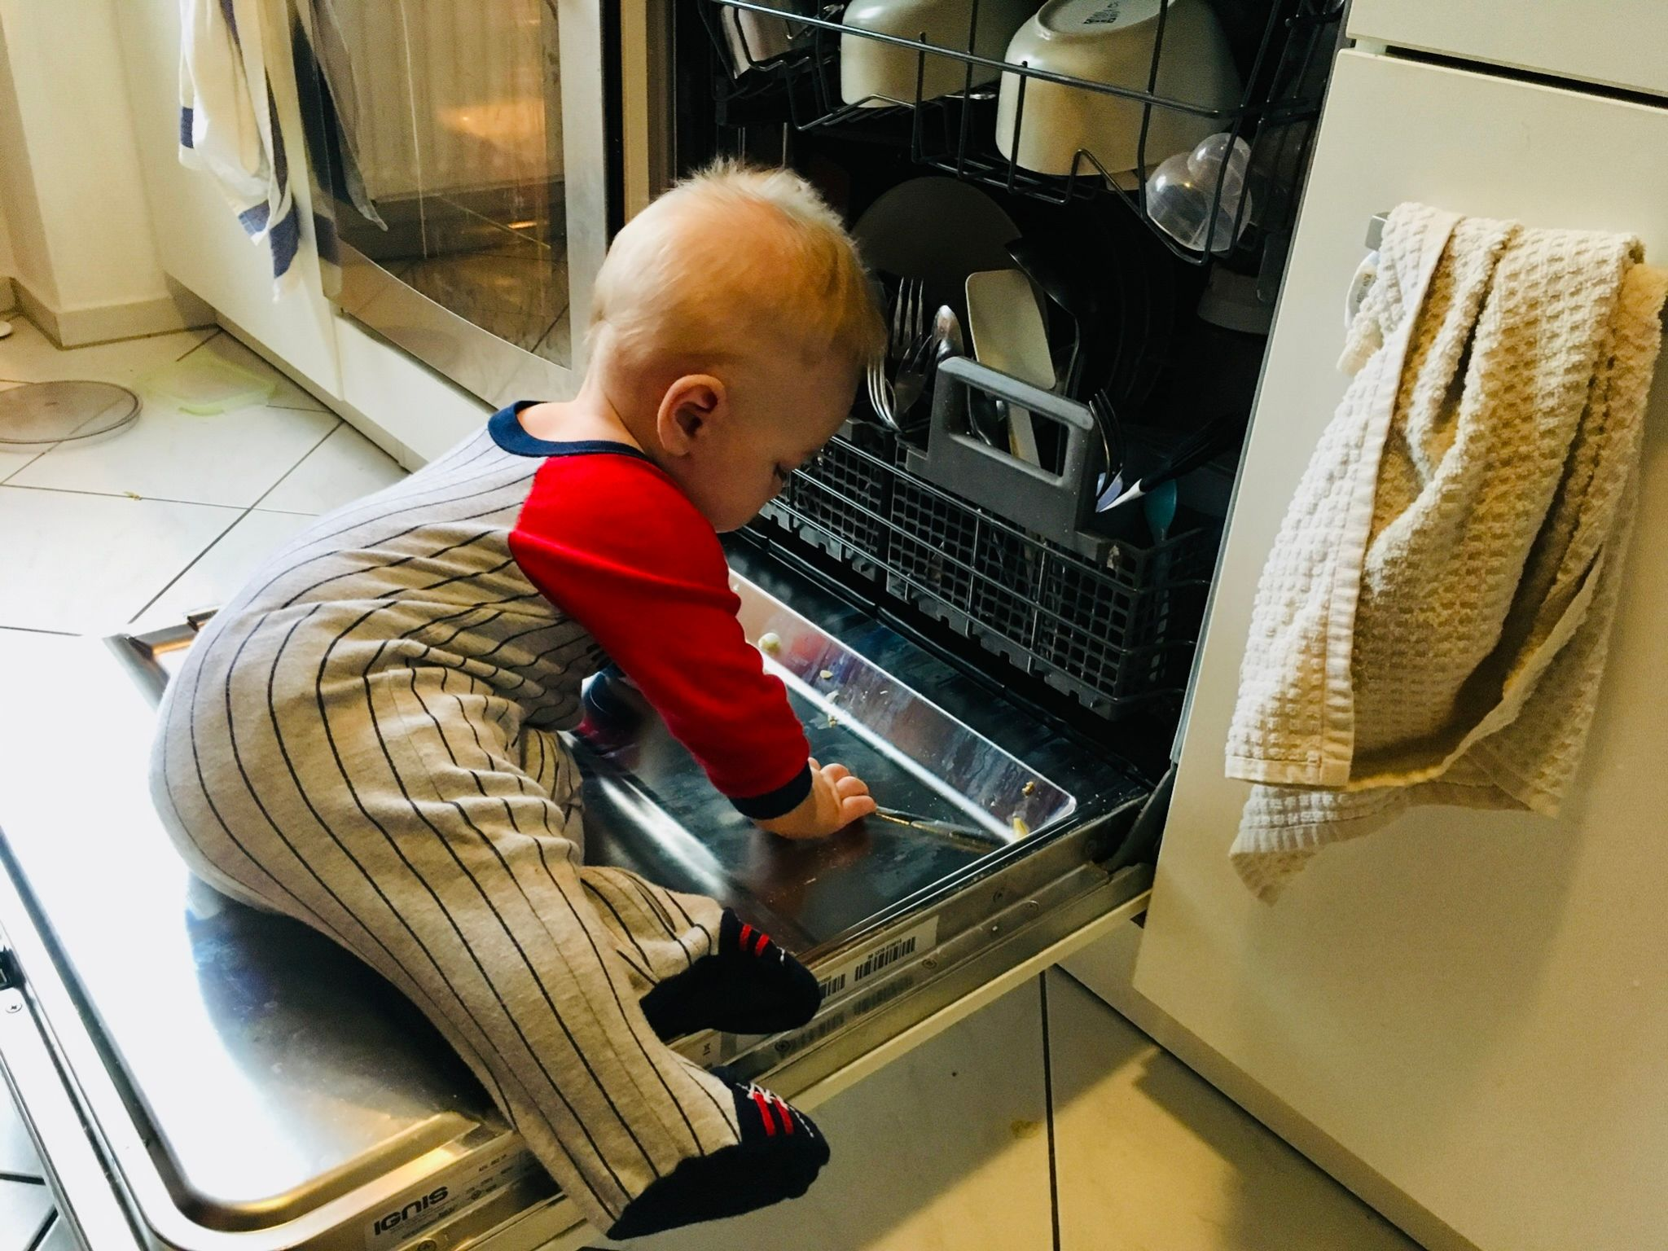
Practical ideas for springboarding
Started discipline when safe issues arose (once crawling began).
Took the time to really establish what “no” meant.
Notes:
After we clearly established what it meant. We also tried hard to set ourselves us for success by minimizing the things we needed to say, “no” to.
We’ve all been to the grandmas house who has nick nacks on every shelf, right where kids can grab them! You have to say “no” every two seconds. That is exhausting for everyone.
Whenever possible, set your situation up for only needing “no” for the most important things. Help everyone succeed.

Slide 41
Practical ideas for springboarding
Started discipline when safe issues arose (once crawling began).
Took the time to really establish what “no” meant.
Time outs and natural consequences.

Slide 42
Practical ideas for springboarding
Started discipline when safe issues arose (once crawling began).
Took the time to really establish what “no” meant. Then didn’t use it too often.
Time outs and natural consequences.
Now, (at age 8) we often involve Jamey in the discussion.
Notes:
Example: Not all the items on the routine list were consistently getting done. Jamey helped us brainstorm on how to fix that problem. Now, he’s very willingly taking on that responsibility.
He’s taking more and more responsibility for himself.

Slide 43
In what ways do we sometimes treat children as not being equal-value human beings?
What systems have been effective for you in motivating your child to learn routines?
What is one long-term goal you have for yourself in parenting?
What do you think it looks like to discipline without provoking?
What do you find out by listening to your child in discipline situations? How often is your initial assessment of the situation wrong?
Why do you think God gives the command to children to obey, rather than telling parents to make their children obey?
What is a situation where you’re tempted to “swipe the credit card” instead of disciplining?
What do you think?

