Slide 1
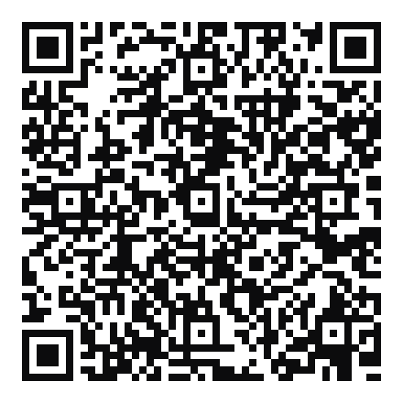
Parenting
Little Humans
Tiffany
Nathan
For River of Life Church
If you want to have a copy of our slides and links
to resources we will be discussing,
please scan the QR code
Notes:
Intro
By the way, you can use the QR code here to access the slides, and that’ll also give you access to some links to resources we found helpful.

Slide 2
OUTLINE
Last week
Today
1
2
3
4
Little Humans
Disciplined Humans
Discipled Humans
Emotional Humans
treating kids like human beings
helping kids face up to their sinful natures
bringing kids in on what God’s doing
helping your kids with big emotions
If you want to have a copy of our slides and links
to resources we will be discussing,
please scan the QR code
Notes:
Last time we talked about Little Humans and Disciplined Humans.
We looked at the implications of children already being made in God’s image — that we should treat them as people with equal value and who are already in the process of growing into the God-given moral responsibilities that they will have as adults. Children are not pets, and their also not your mini-me who represents you to the world.
That means also disciplining them in a way that they’re learning to carry those moral responsibilities, they’re learning self-control, and they’re learning who they are as sinful humans who’ve been offered salvation by their Heavenly Father, who is both loving and just. We want to shepherd them rather than trying to control their outward behavior.
Today we’re going to be fleshing out what it looks like to teach kids about the Lord. This includes the “spiritual” activities we do with them, but it’s also about involving them in what God is doing in our lives, and walking them through how to deal with big emotions.
At the end, we’ll have some other miscellaneous advice (garage sale) of things that were helpful to us.

Slide 3
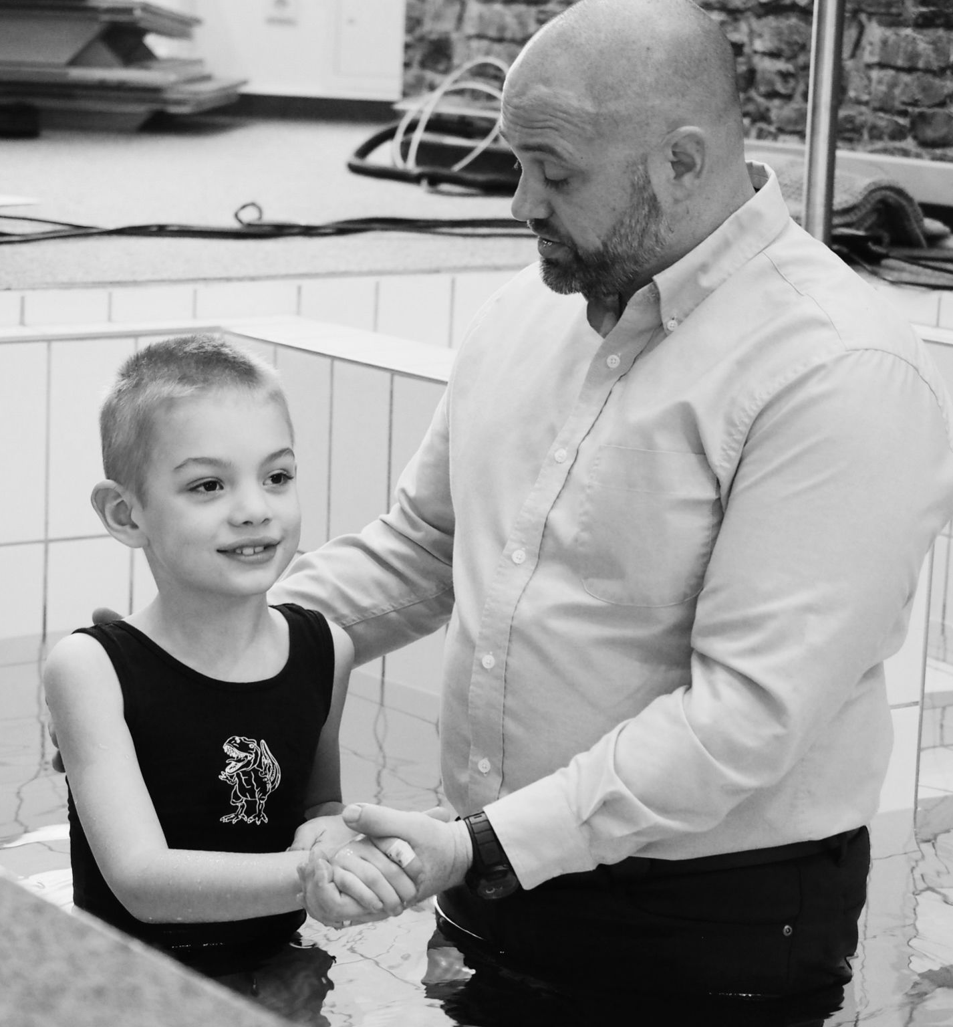
Discipled Humans
bringing kids in on what God’s doing
Covenant witnesses
Tag-teaming it

Slide 4

Notes:
Picture the scene at Mt. Sinai: The Israelites are huddled around the mountain, trying to make out the figure of Moses, who’s up on top. A cloud has come down upon the mountain, and thick smoke is swirling around it. Suddenly thunder cracks. One of the little ones screams and grabs onto his mom in terror. The mountain begins to shake, and out of nowhere they hear the blast of a ram’s horn. Everyone takes a step back. One of the dads tells his little daughter, “Don’t look.”
Then they hear a voice coming from the mountain saying, “I am the Lord your God, who brought you out of the land of Egypt, out of the house of slavery” (Ex. 20:2).
The Israelites would never forget that day. But when this very same God told them to go conquer the land of Canaan, who was it – among those standing there at Sinai that day – who would ultimately obey him? Was it the seasoned generals? The wise elders? The brave young warriors? No, it was the children hiding behind their mother’s skirts.

Slide 5
“
And the Lord heard your words and was angered, and he swore, ³⁵ ‘Not one of these men of this evil generation shall see the good land that I swore to give to your fathers, ³⁶ except Caleb the son of Jephunneh … ³⁹ And as for your little ones, who you said would become a prey, and your children, who today have no knowledge of good or evil, they shall go in there. And to them I will give it, and they shall possess it.
Dt. 1:34–39 ESV
Notes:
Could someone please read Dt. 1:34-39? Was it a coincidence that these little kids were there at Sinai, hearing the voice of God with their parents? No, God planned it that way. Please read Dt. 5:2-4.

Slide 6
“
The Lord our God made a covenant with us in Horeb. ³ Not with our fathers did the Lord make this covenant, but with us, who are all of us here alive today. ⁴ The Lord spoke with you face to face at the mountain, out of the midst of the fire
Dt. 5:2–4 ESV
Notes:
A generation later, here’s what the children would realize …
Please read Dt. 5:2-4. “Not with our fathers … but with us.” God wanted the children to be part of the covenant. He planned it.
But the third generation – their children – didn’t hear that voice. And they wouldn’t grow up in the wilderness where every day you had to collect the manna God sent from heaven. They would grow up in houses and on farms, not having experienced the Exodus. And their children wouldn’t even have any memories of wandering in the wilderness. How would they come to know the God of their fathers?
Therefore, God tells them throughout the book of Deuteronomy how to bring their children in on what God has done and is doing.
Conversations: God’s Word in all daily life situations (Tiff example - conversation about evangelism)
Telling what God has done in previous generations
Reminders: things we saw God do
Holidays: celebrating together what God has done
Explaining: the reasons for what we’re doing
Hearing Scripture read together

Slide 7
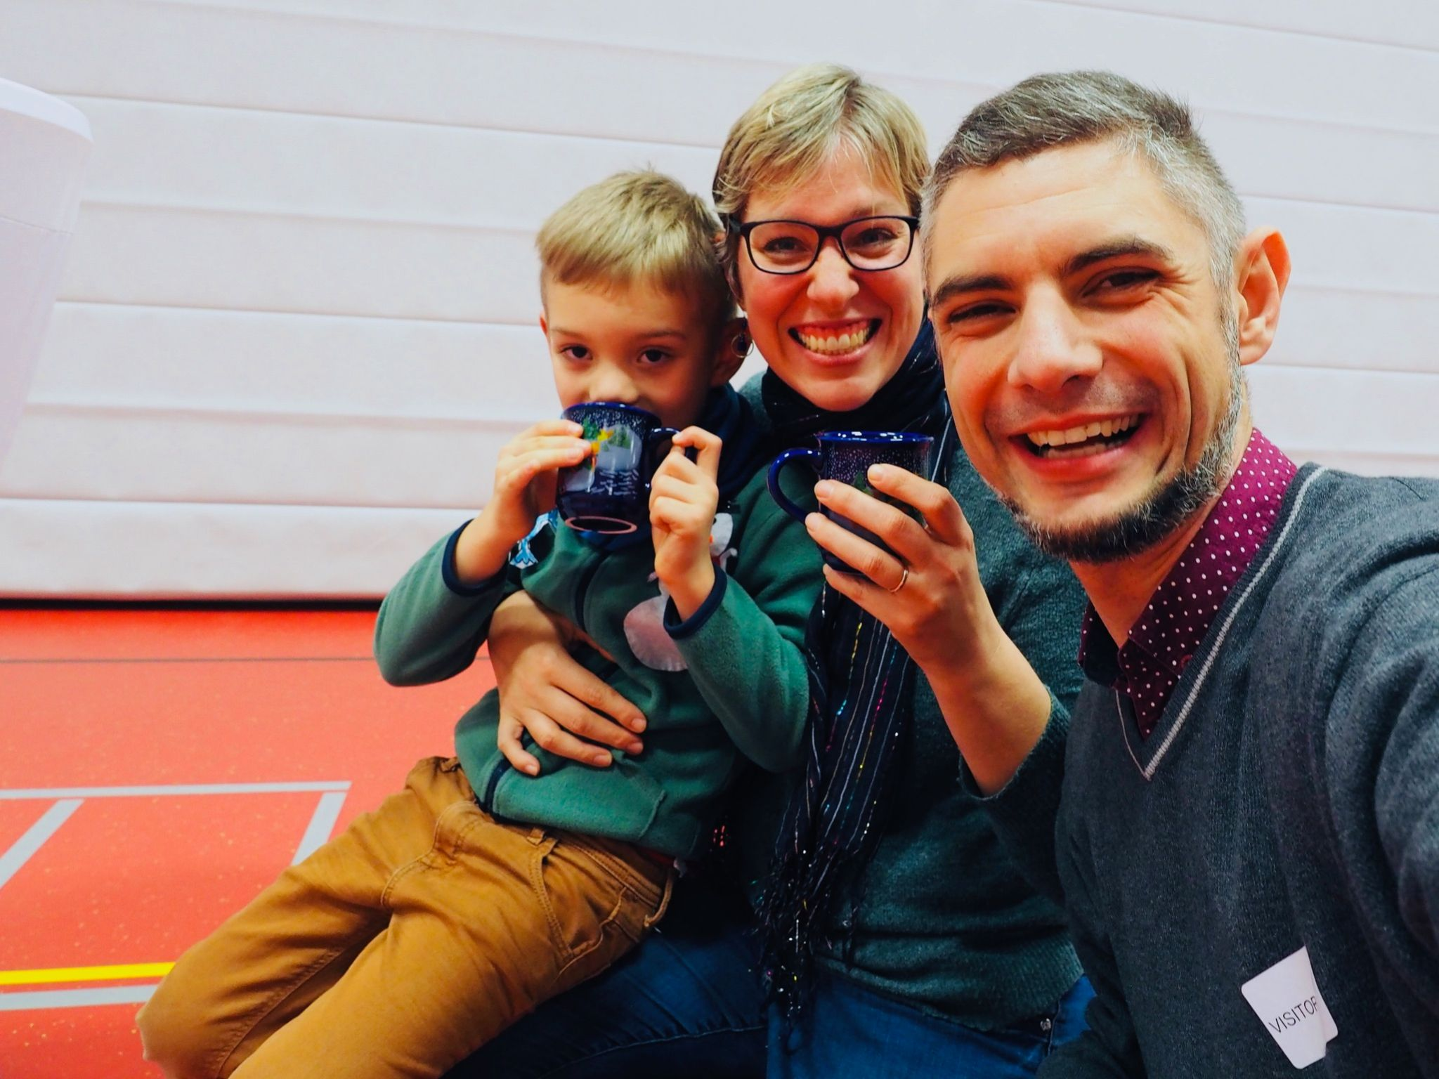
Tag-teaming it
Notes:
You’ll notice that some of these are things that happen at church, but all of them are things that happen in the home.
What we found is that we’re each better at different aspects of this, but I didn’t need to be ashamed of the fact that Tiff did some of these better, or vice versa. God put us together as a team for a reason.
- Nathan: reading Bible, bedtime routine, memorizing Scripture, formal stuff
- Tiff: Talking about it in daily situations, what's going on in her life = best mentoring situations

Slide 8
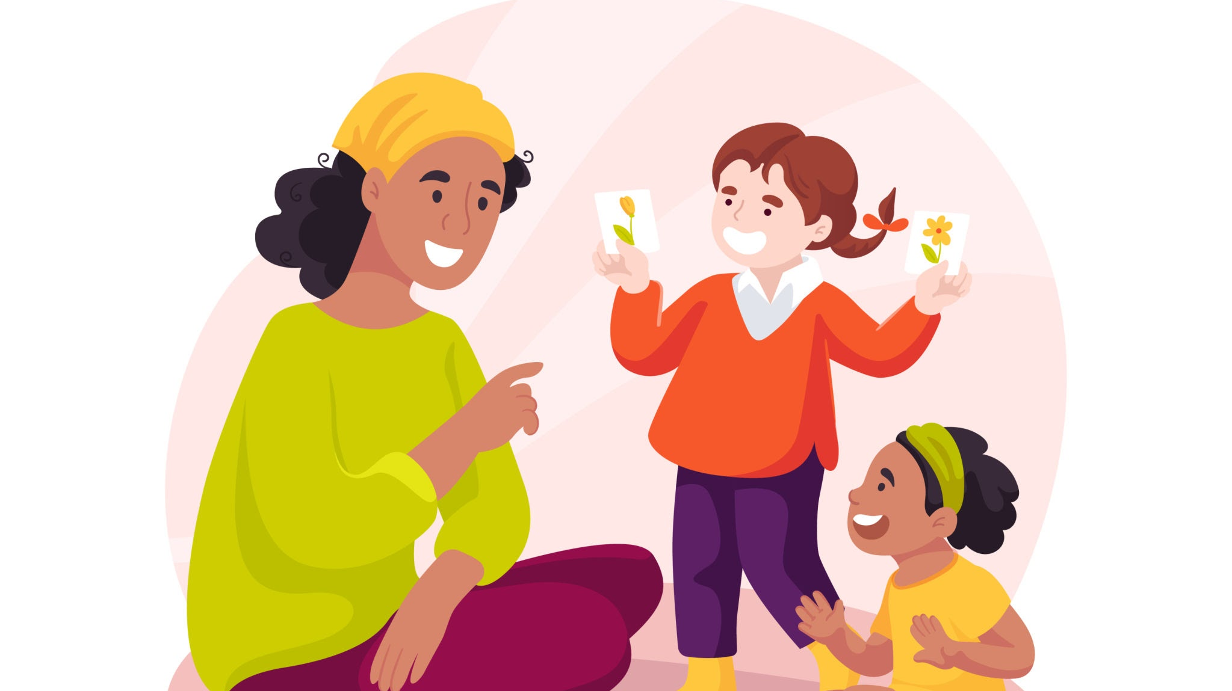
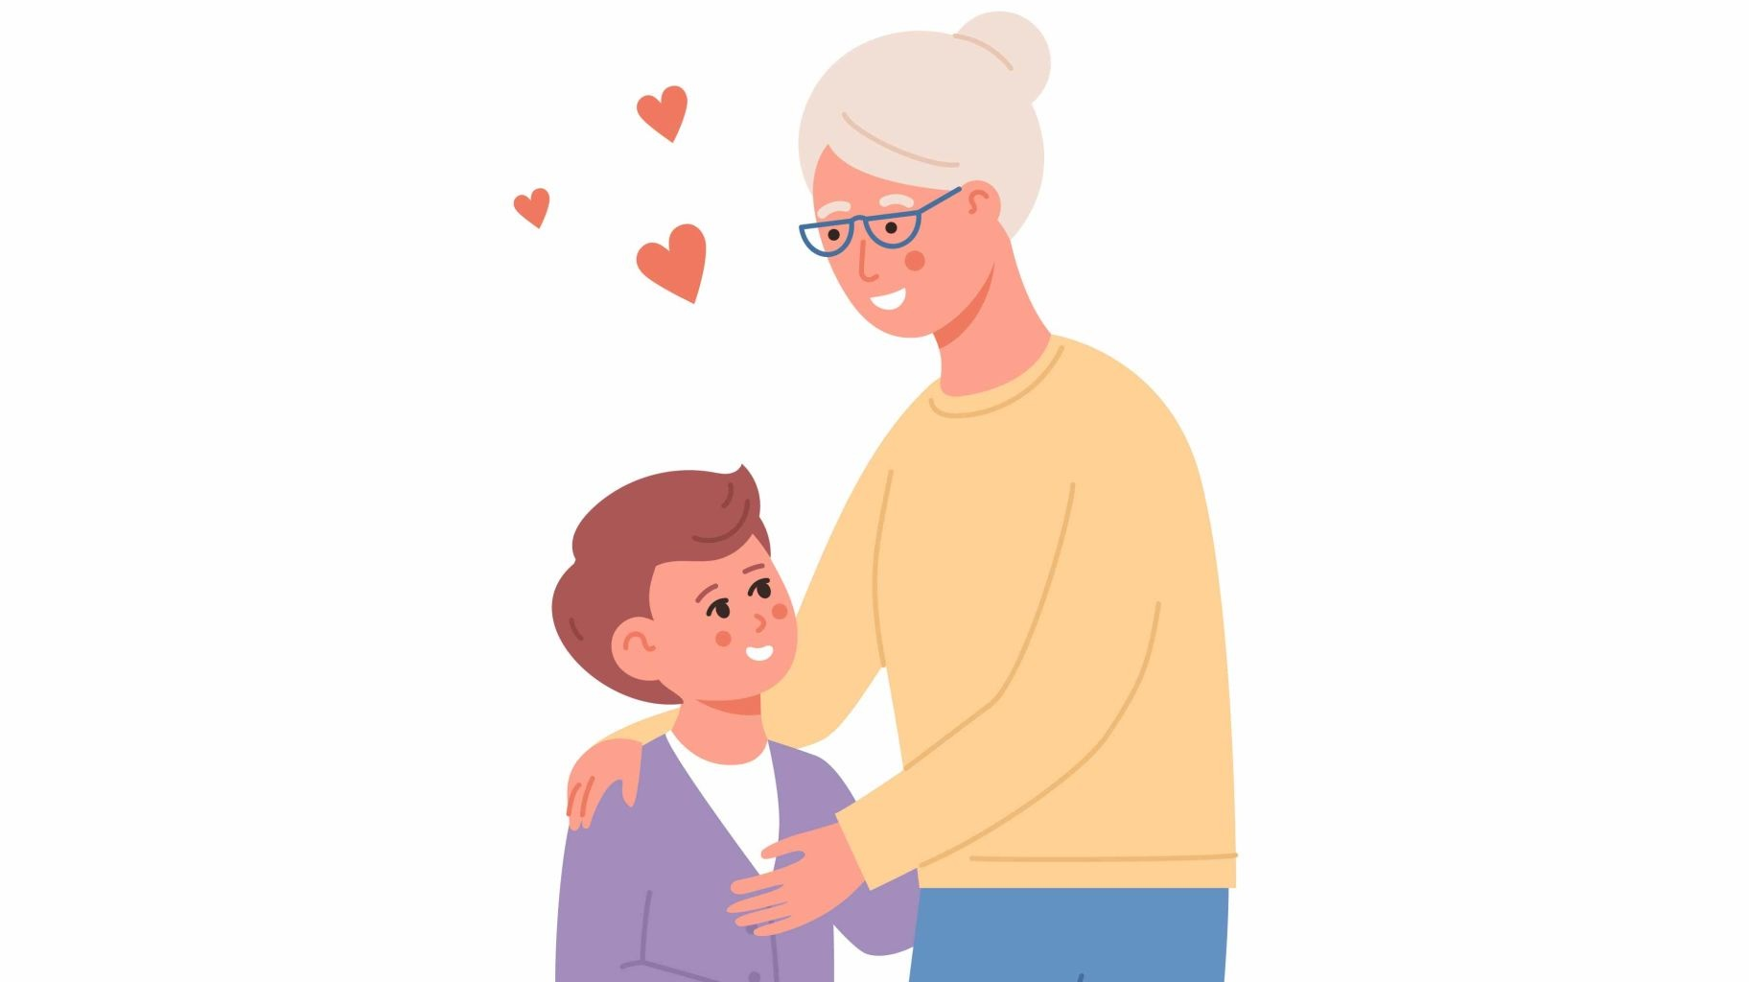

Tag-teaming it
Conversations: God’s Word in all daily life situations
Telling what God has done in previous generations
Reminders of things we saw God do
Notes:
Conversations: God’s Word in all daily life situations (Tiff example - conversation about evangelism)
Telling what God has done in previous generations: Jamey’s interest in our childhoods, grandparents
Reminders: things we saw God do: shepherd

Slide 9



Tag-teaming it
Holidays: celebrating together what God has done
Explaining the reasons for what we’re doing
Hearing Scripture read together
Notes:
Holidays: celebrating together what God has done: Tiff will tell about Christmas, Passover
Explaining: the reasons for what we’re doing: holidays/Passover, but also discipline
Hearing Scripture read together: including evening receptiveness

Slide 10
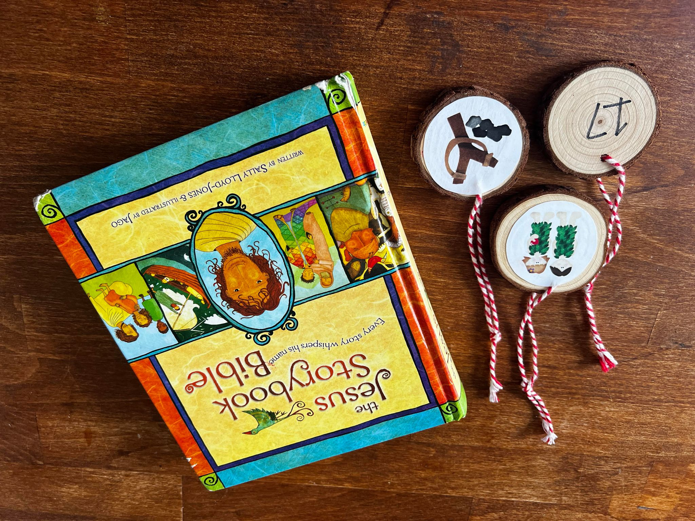



Practical ideas for spring-boarding
Jesse Tree Pictures
Jesus Storybook Bible
Wood Discs

Slide 11

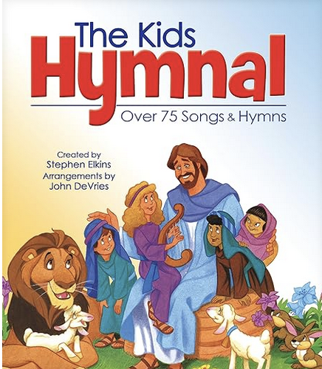


Practical ideas for spring-boarding

Slide 12
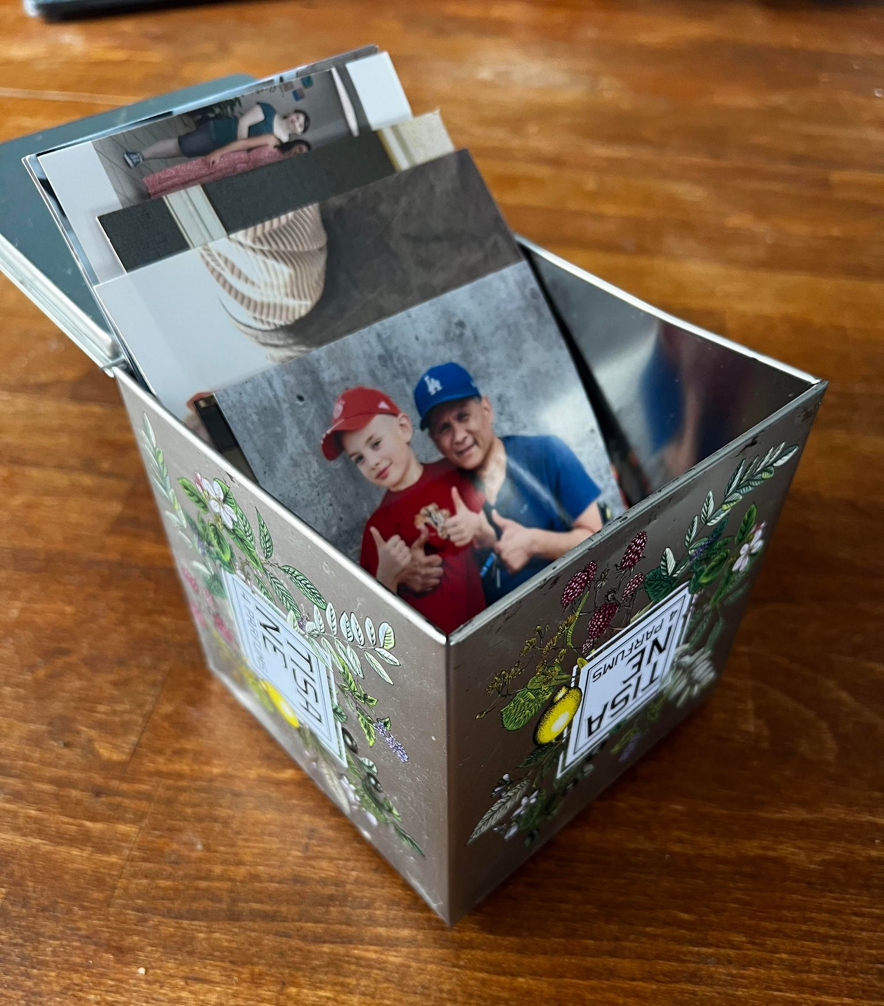


Practical ideas for spring-boarding
Notes:
Possibly discussion about how people in the class are doing it/plan to do it?

Slide 13
-What has worked well for your family?
-What would work best for your family?
Notes:
Possibly discussion about how people in the class are doing it/plan to do it?

Slide 14
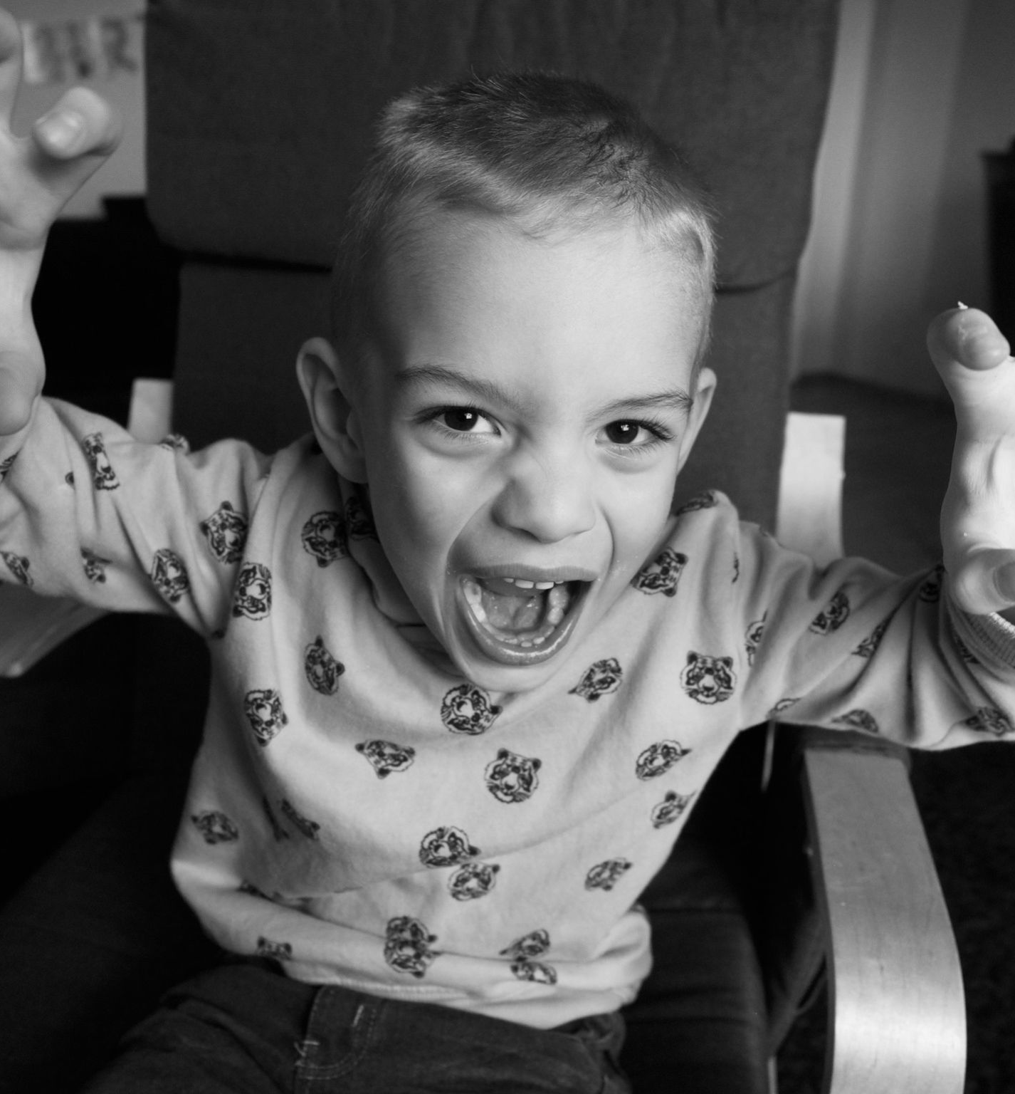

Emotional Humans
helping your kids with big emotions
Notes:
Which of you have emotions … sometimes?
Which of you parents have kids who have emotions?
Which of you thinks Jesus had emotions during his time on earth?
If we all have emotions, and if we believe God created us to have emotions, then why do we sometimes speak to our kids as though they shouldn’t have them?
“Don’t cry, there’s no need to be sad.”
Or, “Don’t be scared, there’s nothing to be afraid of.”
Or, “You’re angry right now, and I’m not going to talk to you when you’re angry.”
During the “terrible twos” and threes and afterwards, our kids are experiencing huge feelings they don’t know what to do with. They don’t need us to dismiss their emotions, downplay them, or teach them to ignore them. They need us to help them understand and acknowledge their emotions, and show them how to take the next step when they feel this way.
(Pass off to Tiff)

Slide 15
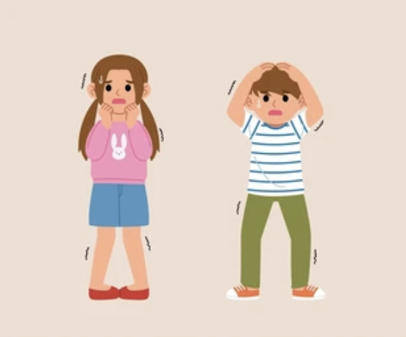
Emotional Humans
Notes:
I want to start by giving a little background on why this subject became so important to us. For autistic folks, their bodies don’t necessarily communicate clearly which emotion they are feeling. They just know that they are having a big emotion. So excitement may feel the same way as fear or anger. Because of this, it’s very hard for autistic folks to know how to respond to their big emotions. They just know that they are feeling uncomfortable.

Slide 16
Emotional Humans
Recognizing which emotion they are feeling
Notes:
As we were learning this about Jamey, at the same time I was going through a lot of therapy where I was learning about my anxiety disorder and how to deal with anxiety. So all of us were learning about the importance of emotions at the same time!

Slide 17
Emotional Humans
Recognizing which emotion they are feeling
How to express/”let out” emotions
Notes:
This helped us recognize that Jamey was going to need extra help in learning how to recognize emotions and then how to “let them out” in a good way. This has become a huge piece in our parenting, but big emotions play a huge part in why littles need discipline and discipleship.

Slide 18

How emotions work
Hormones play a big role
Notes:
Learning to recognize which emotion where having and how to “let it out” appropriately is something that all kids need to learn.
So let me first explain what is happening in the body when we have emotions.
Hormones play a big piece in feel emotions. When we have an emotion, hormones are released so that our body “feels” that emotion.
NEXT SLIDE
Because of this, it’s important to know that emotions will never stay at their peak or highest point. They will always eventually run out, then our emotions go down.

Slide 19
How emotions work
Hormones play a big role
Hormones will eventually come down
Notes:
They will always eventually run out, then our emotions go down.

Slide 20

How emotions work
Hormones play a big role
Hormones will eventually come down
If hormones are:
  ignored
  distracted from
  pushed down
They last a longer!
Notes:
For example,
you feel fear
your body lets out those hormones
and it you let yourself experience and work through that fear,
then the fear comes down.
However, if you try to ignore, distract yourself, or push down that fear, it will keep popping back up throughout the day. This process can last hours, until your hormones run out. So it’s an important skill to learn to let yourself process an emotion so that you let it “out” at the start, instead of holding onto it and then having that emotion build up and and keep impacting you.

Slide 21
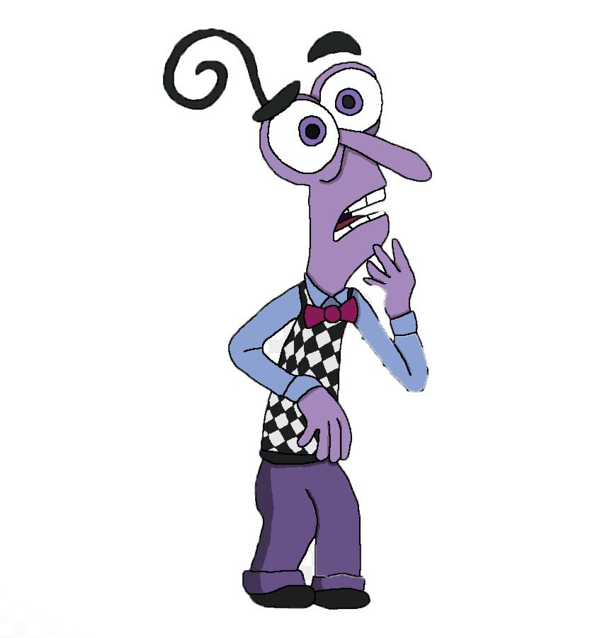
Fear - uncomfortable but helpful
How does fear help us?
Notes:
So let me walk you through how we did this with fear and anger:
How does fear help us?
Fear: First is explaining to kids that fear is uncomfortable but not negative. It is there to help protect us from danger.

Slide 22

Fear - uncomfortable but helpful
How does fear help us?
It can help us too much!
Notes:
However, fear can be overly helpful and stop us from doing things that are ok. So we when we feel fear we have to figure out if it’s helping us or not.
So here is a chart of what we do with Jamey when he has a fear.

Slide 23
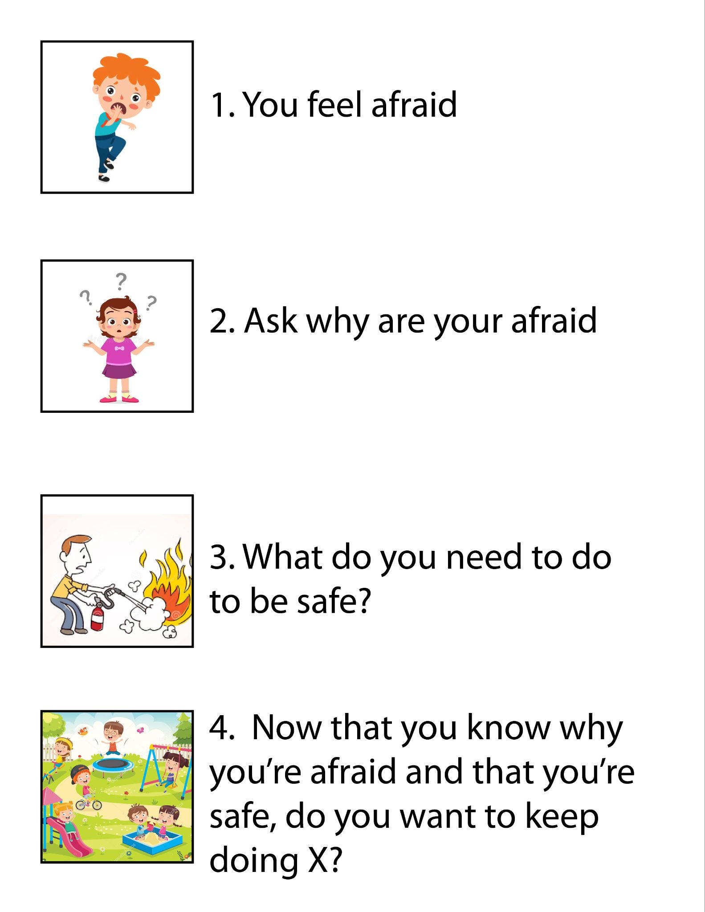
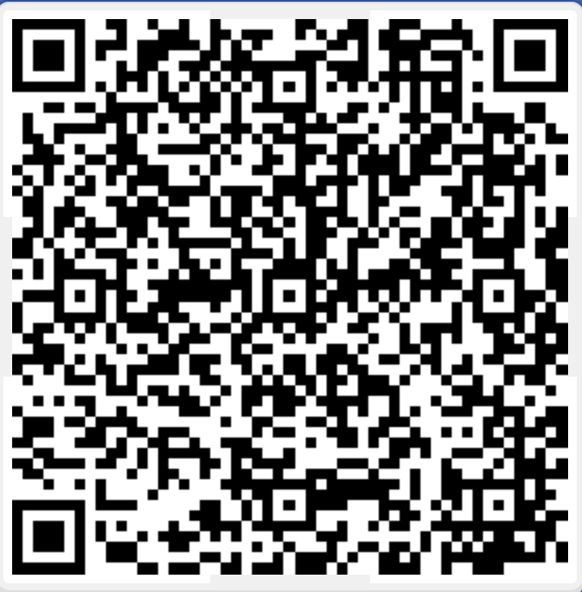
Notes:
So let’s say you’re at the playground and your kiddo is refusing to go play with their sand toys in the sandbox
Ask a few questions to figure out why they don’t want to go. Then you find out that they are afraid that another kid might take or break their toys. A legitimate fear!
Help them know they are feeling fear
Help them realize why they are afraid (“Are you afraid someone will break or hurt your toys?)
What can we do to help that?
- PRAY
- Put away extra special toys that might get broken
- Remember to say “no, please stop” if someone takes your toys (learning to set boundaries)
- If they don’t listen, come get me (you are on their team)
Now that we are safe and we have a plan, so do you want to go play in the sand now? (I don’t have to listen to fear anymore)

Slide 24


Anger - helpful but hard to control
How does anger help us?
Notes:
So let me walk you through how we did this with fear and anger:
How does anger help us?
Anger: This is another big emotion that usually gets us into trouble. However, it is meant to help us. It inspires us to fight for justice and right the wrongs of the world. It is healthy, but super important to let it out in a healthy way.

Slide 25
Anger - helpful but hard to control
How does anger help us?
Hard to control
Notes:
Hard to control, so it takes a long time to work learn this skill.

Slide 26
Anger - helpful but hard to control
How does anger help us?
Hard to control
Hurting is never an option!
Notes:
Have to let it out in a way that doesn’t hurt themselves, others, or their surroundings.
Ideas to suggest to your kids:

Slide 27
Anger - helpful but hard to control
Ideas:
  jumping (trampoline)
  running
  hitting pillows
  big emotions buddy
  alone time
  silent screams

Slide 28
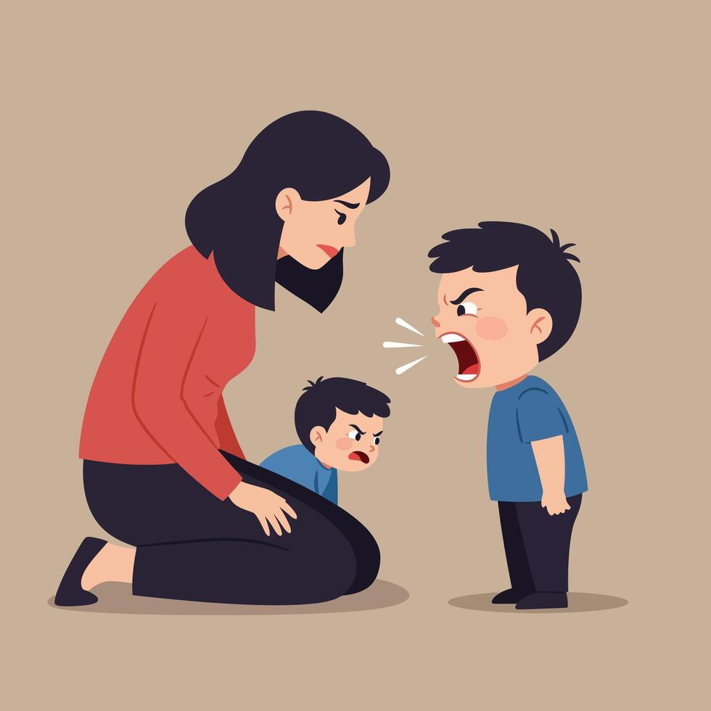
Still showing respect
Notes:
I want to end this section by touching on how your kids express emotions to you, especially anger and frustration. This is tricky, because it’s easy for us to get offended and let our own emotions take over.

Slide 29
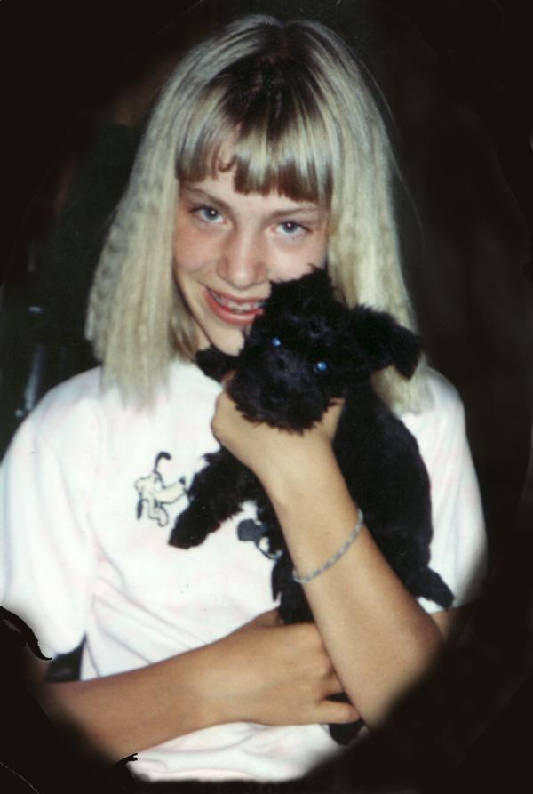
Still showing respect
Notes:
For me growing up, show respect meant never disagreeing in any way. I could never defend myself, share frustration, and NEVER get angry. This did not teach me healthy patterns for treating authority figures as an adult.
So we decided that instead of saying, “never disagree” but rather “disagree respectfully.”

Slide 30
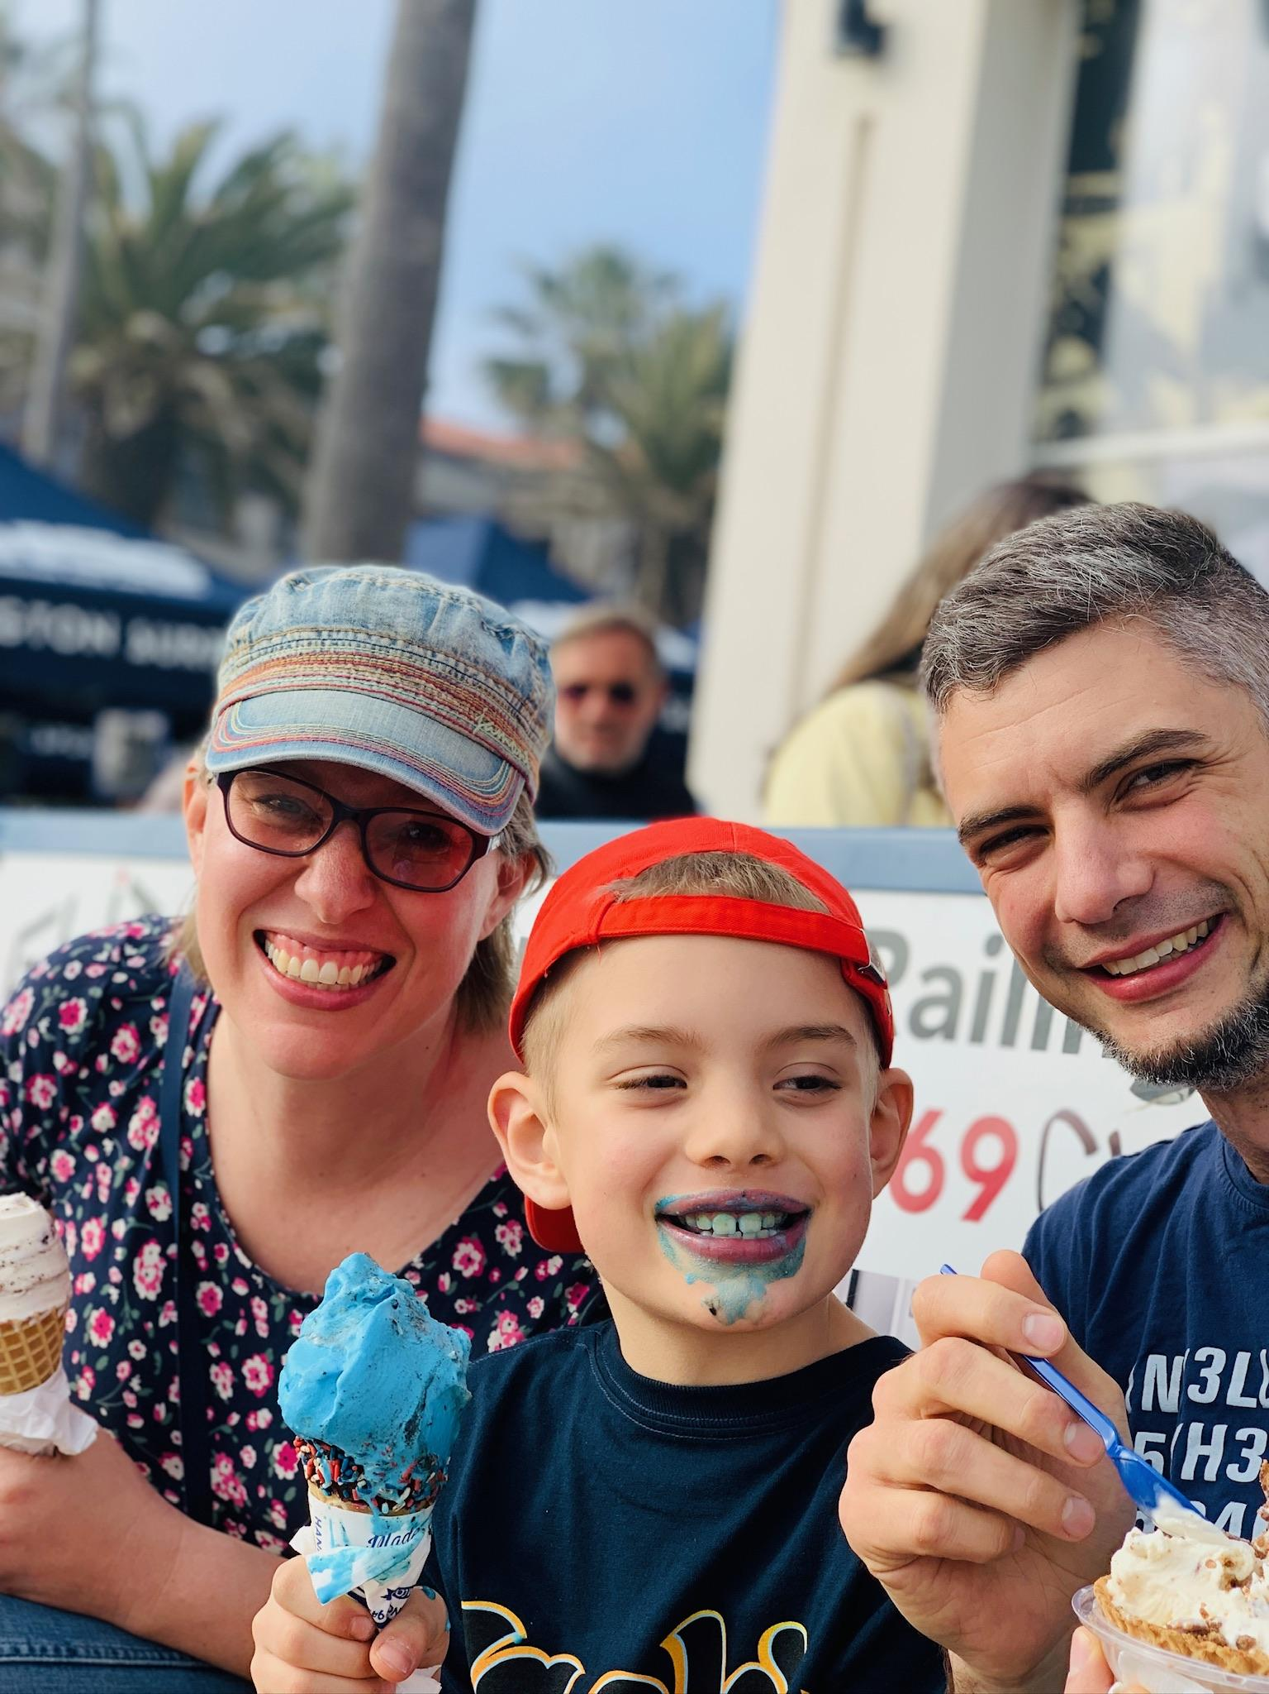
Still showing respect
Respectful voice and volume
Respect for us as humans
Respect for our authority - we make the final decision
Notes:
So for Jamey, he is allowed to object to what we’re doing. He is allowed to share his opinions and suggest compromises. However, it has to be done with respect.
Respectful voice and volume
Respect for us as humans (not treat us like we’re stupid)
Respect for our authority - we make the final decision (Mom and Dad decisions)
For us, this goes a long way towards following the Biblical command to “Not provoke your kids.” This approach allows them to feel heard and understood, it also allows them to suggest ideas for changes or compromises (practice problem solving). And we talked about this last time, but as they get older and can be more they are involved in the discipline process, they can take more responsibility for their actions. Finally, you are helping them set patterns for how they should treat authority figures in the future.
This process is a lot of hard work, but we have found it to be really fruitful and very rewarding in how we deal with conflict in our family.

Slide 31
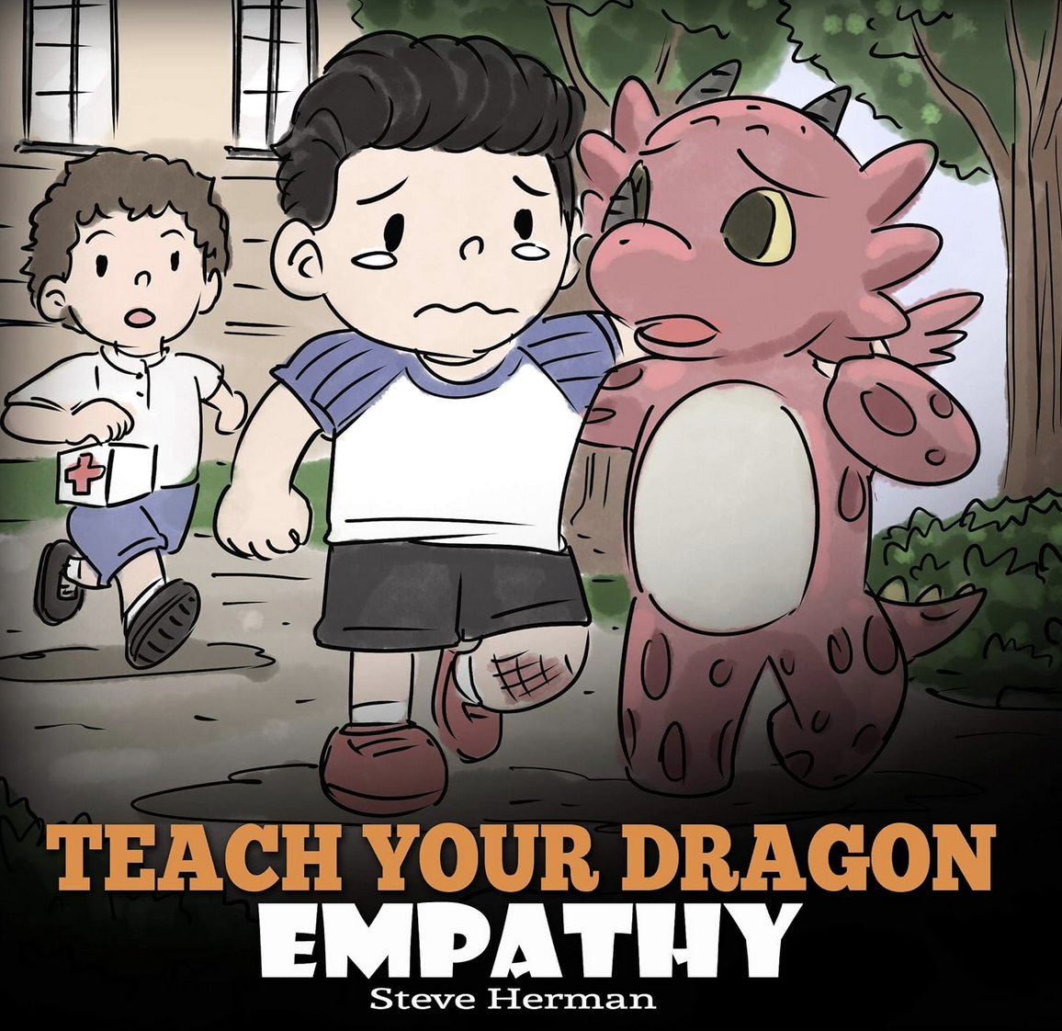

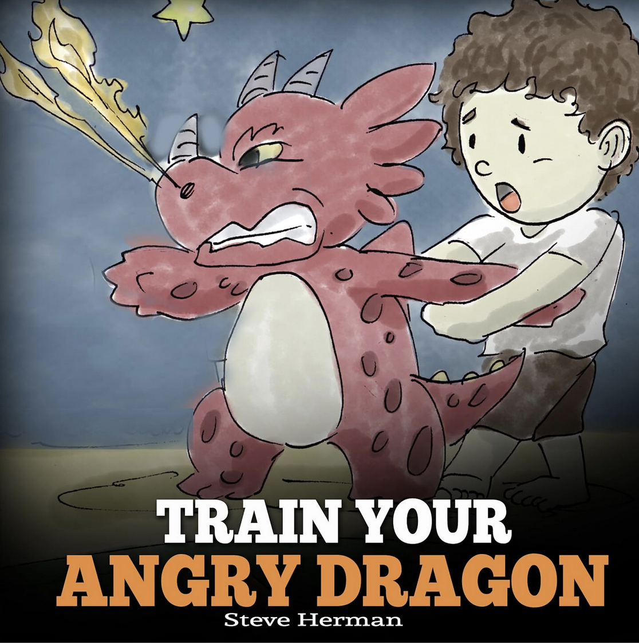

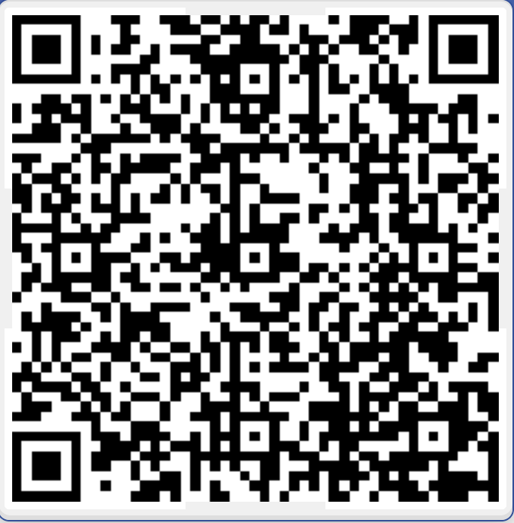
Other helpful resources

Slide 32




Other helpful resources

Slide 33


Other helpful resources

Slide 34
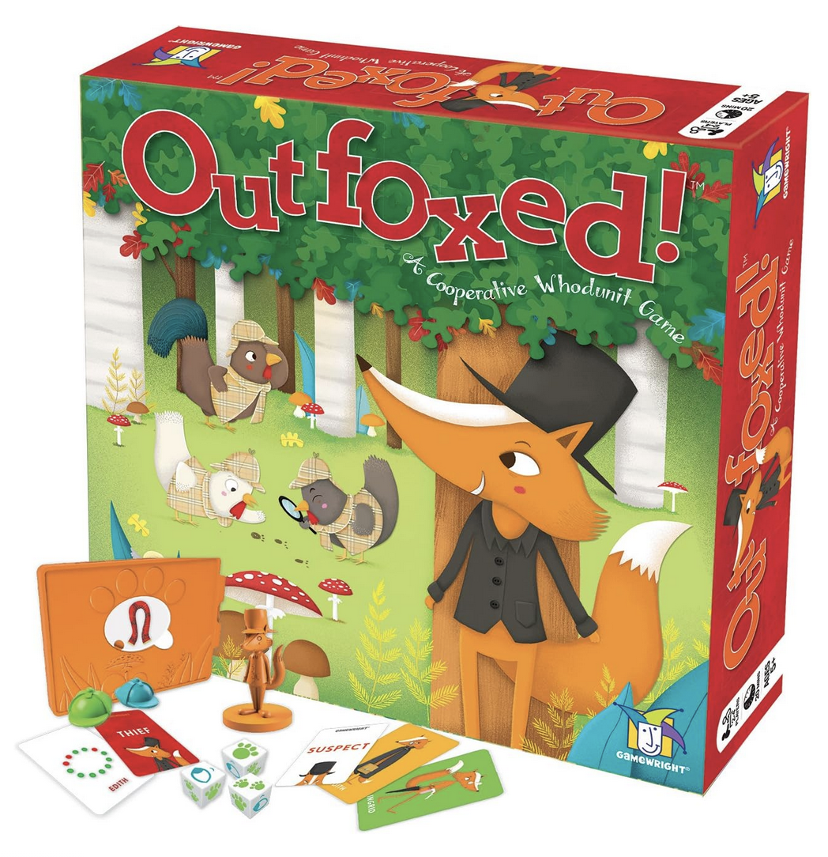
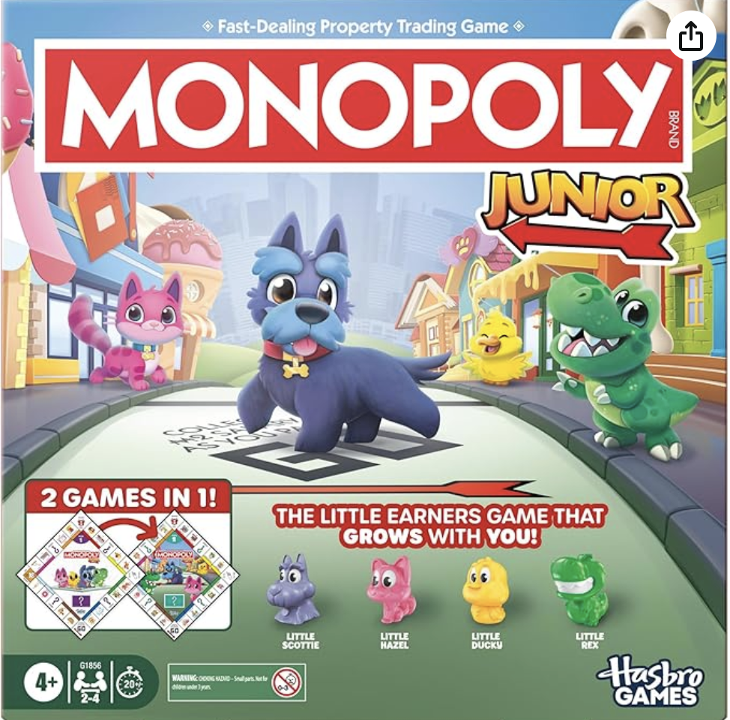


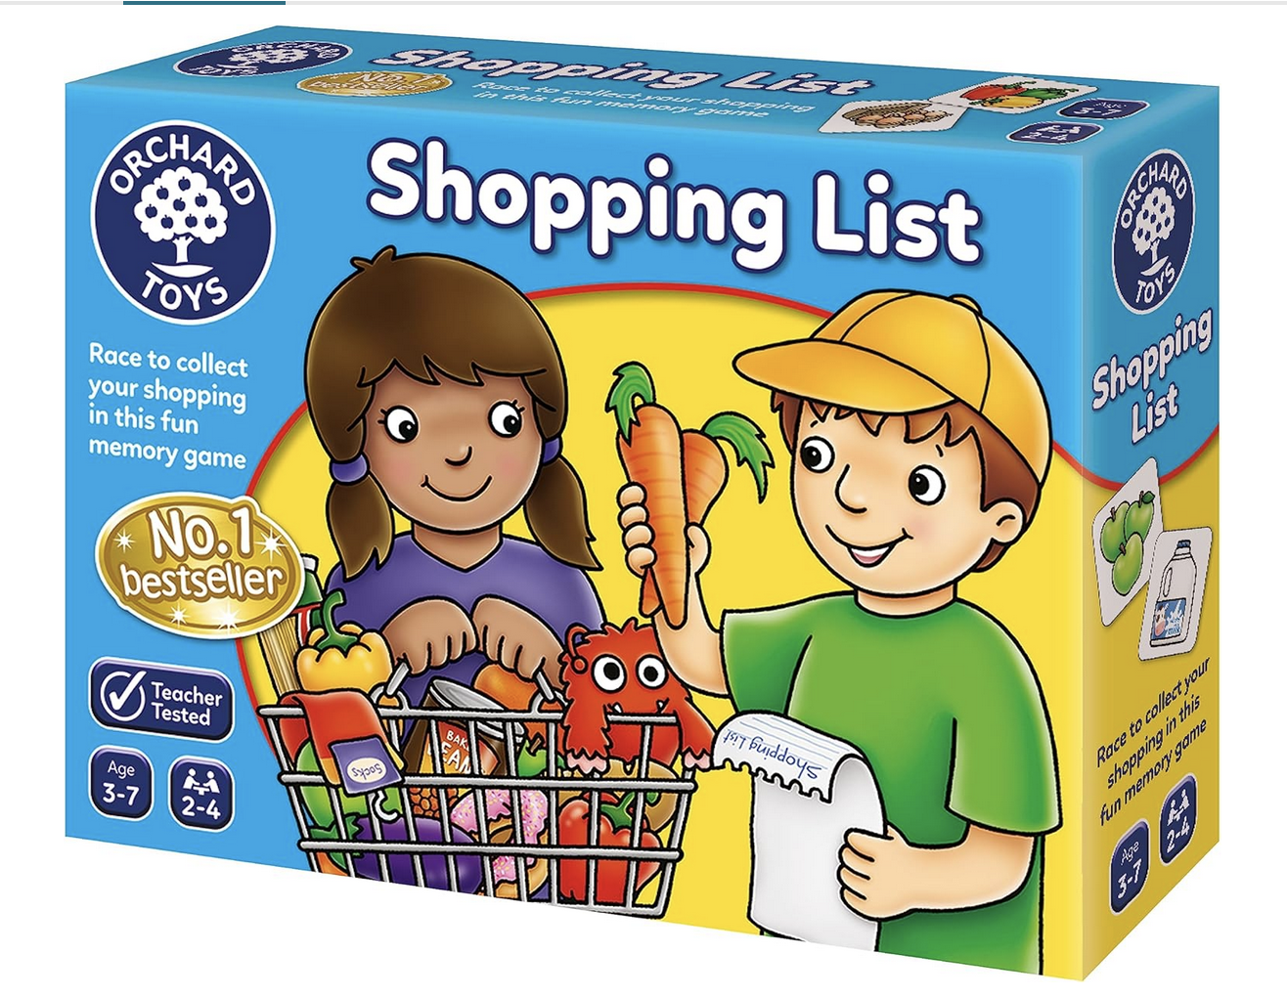

Other helpful resources
Ages 5+
Ages 4+
Ages 3+

Slide 35


Other helpful resources
Book 1: Ages 3-5
Book 2: Ages 5-8
Book 3: Ages 8-12
Book 4: Ages 12-16

